Slide 1
Creating Libraries

Slide 2
Libraries
Libraries in programming languages are collection of prewritten code that users can use and reuse to optimize tasks
This can be files, programs, routines, scripts, functions
This collection of reusable code is targeted for specific common problems
C Library
Header Files
Predefined functions

Slide 3
Header File
C source files that hold the definition of functions and data structures
Tells the compiler how to call some functionality
Contains the function prototypes, data types and constants used with the libraries
Files end in “.h”
Library
Where the actual functionality is implemented
Contain the function body

Slide 4
Library Categories
Static
  Collection of precompiled object files that are linked with a program at compile time
  They become part of the executable
  Location needs to be correct
Shared/Dynamic
  Compiled binaries linked at runtime, allowing code to be shared among multiple programs
  compiled into shared objects (“.so” on Unix/Linux, “.dll” on Windows)
  Memory Efficiency: Loaded into memory once, regardless of the number of programs using them
  Changes to the library don't require recompiling programs.

Slide 5
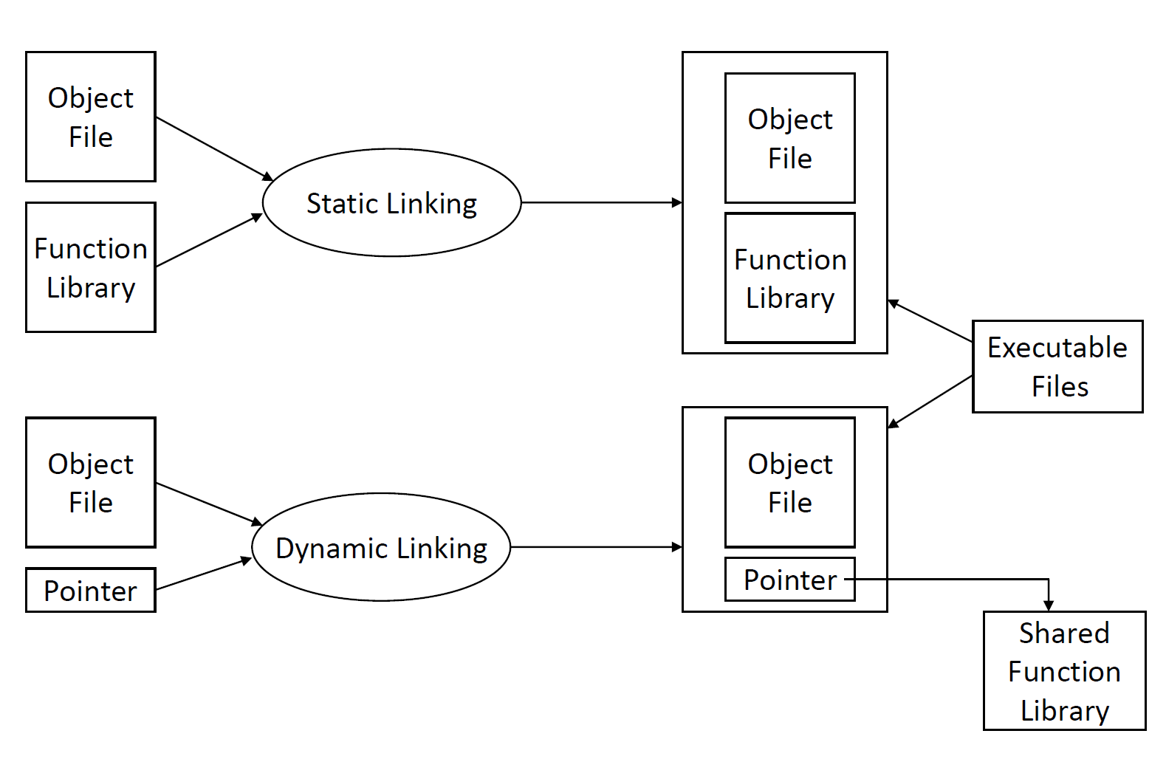
Library vs Header File (Static vs Dynamic)

Slide 6
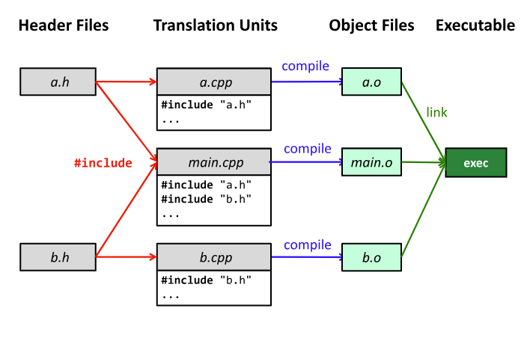

Slide 7
Standard C Library
Common functions that we don’t need to write ourselves
Provides a portable interface to many system calls
Function prototypes declared in standard header files
  #include <stdio.h>
  #include<time.h>
  #include<string.h>
  #include<stdlib.h>
  #include<math.h>

Slide 8
<stdio.h>
File Operations:
  FILE: The structure type representing a file stream.
  fopen(): Opens a file for reading or writing.
  fclose(): Closes a file.
  freopen(): Associates a new file with an existing stream.
Input Functions:
  scanf(): Reads formatted input from the standard input or a file.
  fscanf(): Reads formatted input from a specified file stream.
  sscanf(): Reads formatted input from a string.
Output Functions:
  printf(): Prints formatted output to the standard output.
  fprintf(): Prints formatted output to a specified file stream.
  sprintf(): Prints formatted output to a string.
Character Input/Output:
  getchar(): Reads a character from the standard input.
  putchar(): Writes a character to the standard output.
  fgetc(): Reads a character from a specified file stream.
  fputc(): Writes a character to a specified file stream.
String Input/Output:
  gets(): Reads a line of text from the standard input (deprecated due to security issues).
  fgets(): Reads a line of text from a specified file stream.
  puts(): Writes a string to the standard output.
  fputs(): Writes a string to a specified file stream.
Formatted Output:
  sprintf(): Writes formatted data to a string.
  snprintf(): Writes formatted data to a string with a specified maximum length.

Slide 9
<string.h>
String Manipulation Functions:
  strcpy(): Copies a string.
  strncpy(): Copies a specified number of characters from one string to another.
  strcat(): Concatenates (appends) one string to another.
  strncat(): Concatenates a specified number of characters from one string to another.
  strcmp(): Compares two strings.
  strncmp(): Compares a specified number of characters of two strings.
  strlen(): Returns the length of a string.
  strchr(): Finds the first occurrence of a character in a string.
  strrchr(): Finds the last occurrence of a character in a string.
  strstr(): Finds the first occurrence of a substring in a string.
String Copy and Concatenation with Memory Control:
  memcpy(): Copies a specified number of bytes from one memory location to another.
  memmove(): Copies a specified number of bytes from one memory location to another, handling overlapping regions.
  memset(): Sets a specified number of bytes to a given value.
Tokenization Functions:
  strtok(): Splits a string into tokens based on delimiters.
String Conversion Functions:
  atoi(): Converts a string to an integer.
  atol(): Converts a string to a long integer.
  atof(): Converts a string to a floating-point number.
Dynamic Memory Allocation:
  malloc(): Allocates a specified number of bytes of memory.
  calloc(): Allocates memory for an array of elements, initializing them to zero.
  realloc(): Changes the size of a previously allocated block of memory.
  free(): Deallocates memory previously allocated by malloc, calloc, or realloc.
Other Utility Functions:
  strerror(): Returns a pointer to the textual representation of the current errno value.
  strcmpi() (non-standard): Case-insensitive string comparison.
  strdup() (non-standard): Allocates memory and duplicates a string.
Character Classification:
  isalpha(): Checks if a character is an alphabetic character.
  isdigit(): Checks if a character is a digit.
  isalnum(): Checks if a character is alphanumeric.
  isspace(): Checks if a character is a whitespace character.
Memory Comparison:
  memcmp(): Compares two blocks of memory.

Slide 10
<math.h>
Trigonometric Functions:
  sin(): Sine function.
  cos(): Cosine function.
  tan(): Tangent function.
  asin(): Arcsine function.
  acos(): Arccosine function.
  atan(): Arctangent function.
  atan2(): Arctangent of the quotient of its arguments.
Hyperbolic Functions:
  sinh(): Hyperbolic sine function.
  cosh(): Hyperbolic cosine function.
  tanh(): Hyperbolic tangent function.
  asinh(): Inverse hyperbolic sine function.
  acosh(): Inverse hyperbolic cosine function.
  atanh(): Inverse hyperbolic tangent function.
Exponential and Logarithmic Functions:
  exp(): Exponential function (e^x).
  log(): Natural logarithm.
  log10(): Base-10 logarithm.
Power Functions:
  pow(): Power function.
  sqrt(): Square root function.
  cbrt(): Cube root function.
Rounding and Remainder Functions:
  ceil(): Round up to the nearest integer.
  floor(): Round down to the nearest integer.
  round(): Round to the nearest integer.
  trunc(): Truncate towards zero.
Absolute Value Functions:
  fabs(): Absolute value for floating-point.
  abs(): Absolute value for integers.
Angular and Hyperbolic Functions:
  fmod(): Returns the remainder of the division of two floating-point numbers.
Constants:
  M_PI: Pi (π) constant.
  M_E: Euler's number (e) constant.
  Other constants like M_SQRT2, M_SQRT3, etc.
Miscellaneous Functions:
  hypot(): Euclidean distance function.
  fmax(): Returns the greater of two floating-point numbers.
  fmin(): Returns the smaller of two floating-point numbers.

Slide 11
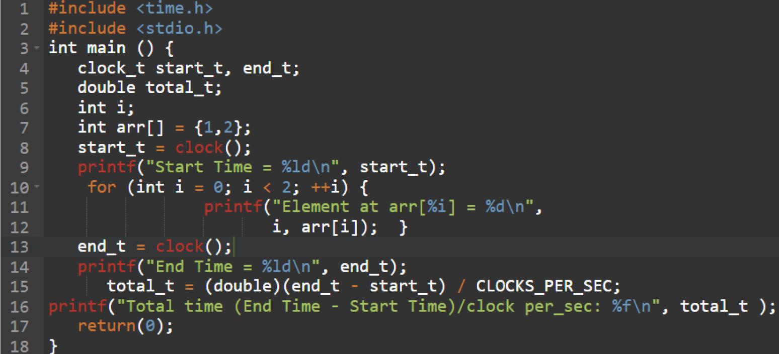
Standard Library Example

Slide 12
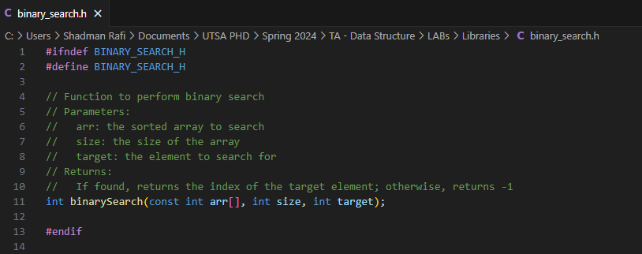
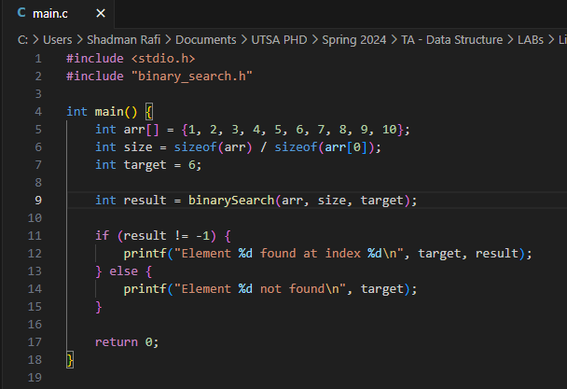
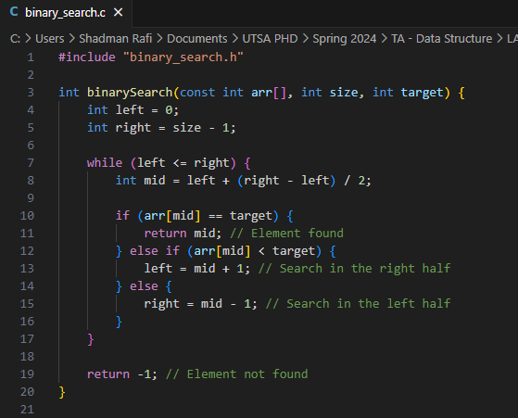
Writing your own library

Slide 13
Design Principles
The National Security Agency (NSA) has designated 11 design principles as part of the Cyber Operations Centers for Academic Excellence (CAE-CO)
Purpose of using this design principles:
  Help programmers develop more secure code
  Contain fewer errors (often a source of security vulnerabilities)
  Be designed with security built in (Rather then designing additional modules for security)

Slide 14
The Eleven Design Principles
General/Fundamental Design Principles
  Simplicity (related to Economy of Mechanism but not exactly the same)
  Open Design
  Design for Iteration (not specifically identified by Saltzer and Schroeder)
  Least Astonishment (related to Psychological Acceptability)
Security Design Principles
  Minimize Secrets (not specifically identified by Saltzer and Schroeder)
  Complete Mediation
  Fail-safe Defaults
  Least Privilege
  Economy of Mechanism
  Minimize Common Mechanism (related to Least Common Mechanism)
  Isolation, Separation and Encapsulation

Slide 15
Methods for Reducing Complexity
Simplicity design principle for reducing complexity
Abstraction
  Hide background details or any unnecessary implementation about the data so that users only see the required information.
Modularity
  Making building blocks, and even building blocks made up of smaller building blocks
Layering
  Layer distinction is often expressed as "import" dependencies between software modules
Hierarchy
  Organizational structure in which items are ranked in a specific manner, usually according to levels of importance

Slide 16
Stack

Slide 17
Introduction
A data structure is an abstract set of rules on how to store, insert, retrieve and remove data.
Stack is such a data structure.
A stack supports the following operations:
  push(): add an item to the stack
  pop(): remove the most-recently inserted item from the stack
  peek(): return the most-recently inserted item in the stack without removing it.
Stack follows the following principle: last-in, first-out (LIFO).

Slide 18
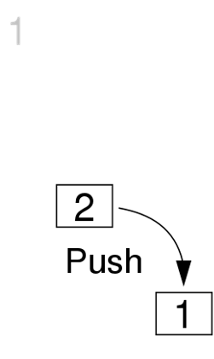
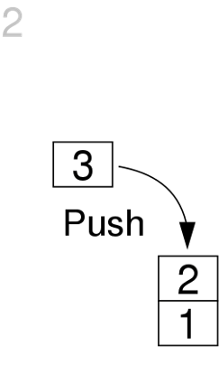
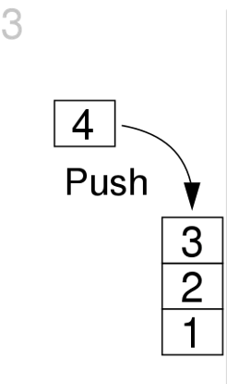
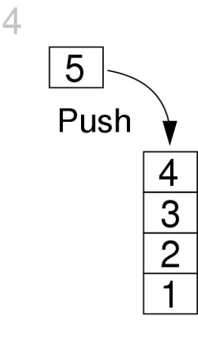
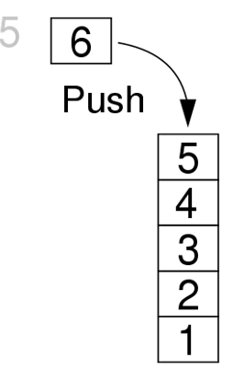
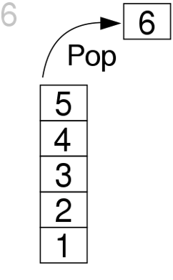
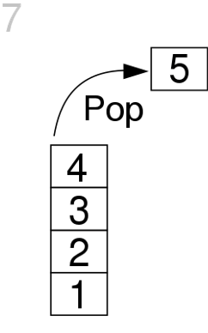
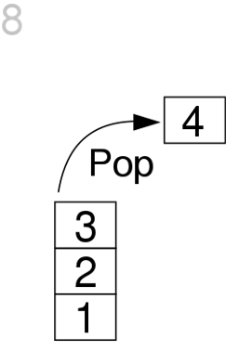
Stack in Action

Slide 19
When is a Stack Useful?
Undo operation
Function calls (structured programming)
Back button in a browser/phone
Implement certain math notations (infix, prefix, postfix)
Expression Evaluation, Expression Conversion
Memory Management

Slide 20
Implementing a stack
A stack supports the following operations:
push(): add an element on top of the stack
pop(): removes the topmost/recently inserted element from the stack.
isEmpty(): checks whether the stack is empty.
isFull(): checks whether the stack is full.
top(): Displays the topmost element of the stack.
peek(): View the top element on the stack
The difference between peek and pop is that the peek method just returns the topmost element; where pop method return the topmost element and that element is deleted from the stack.

Slide 21
Implementing stack in c
Using array:
Use an array to store all the items.
Use an integer variable to keep track of which item was pushed last.
Handle edge cases:
  Can not remove an item when the stack is empty.
  Can not add more items when the stack is full.

Slide 22
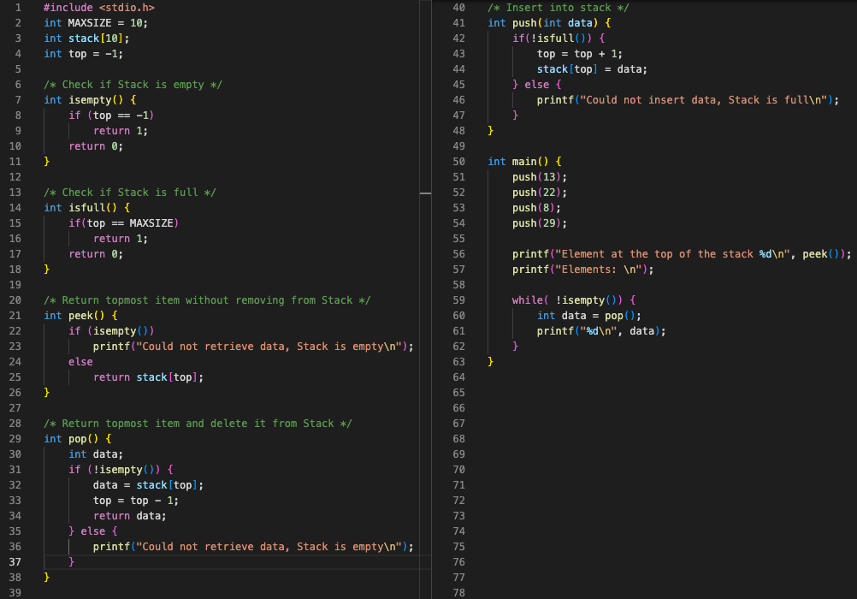

Slide 23
Implementing Stack in C
Using linked list:
A linked list is a collection of nodes where each node contains a data element and a reference (pointer) to the next node.
Dynamic memory allocation allows for efficient memory usage.
Node Structure:
  Each node in the linked list represents an element in the stack.
  Node structure contains:
    Data: Holds the actual value.
    Next pointer: Points to the next node in the list.

Slide 24
Stack Operations in Linked List
Push Operation:
  Allocate a new node.
  Set the data value.
  Update pointers to maintain the list.
Pop Operation:
  Retrieve the top element.
  Remove the top node.
  Update pointers accordingly.

Slide 25
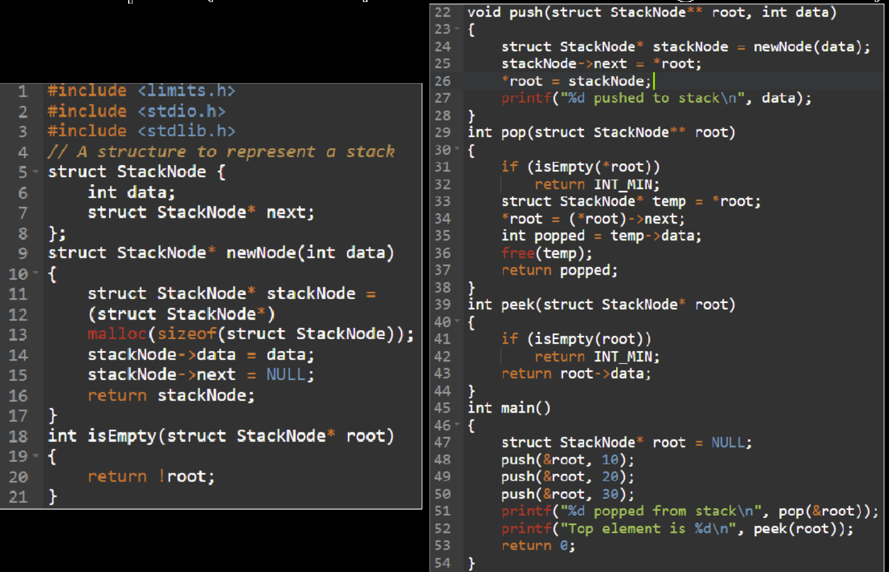

Slide 26
Valid Parentheses Checking Using Stack
Scan each character in an expression one-by-one
If the character is an open parenthesis: ( { [
  Push() it onto stack.
If the character is a closing parenthesis: ) } ]
  Peek() to see if the last inserted open parenthesis is a matching one.
  If it is, then pop() it.
  Otherwise, the expression is invalid.
If the stack is not empty after all characters are scanned, then the expression is invalid.

Slide 27
Stack use: arithmetic expression evaluation
Infix, Postfix and Prefix notations are three different but equivalent ways of writing arithmetic expressions.
Infix: operator goes in the middle.
  Implicit assumptions about which operations are done first (e.g. multiply before adding)
  parentheses ( ) to allow users to override these rules.
Prefix: operator comes first.
Postfix: operator comes last.
  Any infix expr can be written
  as Postfix.
  Can be evaluated left-to-right.
  No need for parentheses.
If we think about it, Postfix notation has some advantages.
Infix | Prefix | Postfix
3 + 5 | + 3 5 | 3 5 +
(2 + 4) * ( 7 - 1 ) | * + 2 4 - 7 1 | 2 4 + 7 1 - *
x + y + z * i | + x + y * z i | x y + z i * +

Slide 28
Postfix evaluation
Let us assume that we somehow know the Postfix for a given Infix expression.
We can use a Stack to evaluate the expression:
Next item is an operand:
  Push it to stack.
Next item is an operator:
  Pop two items.
  Apply the operator on the two popped items.
  Push the result back to the Stack.
Infix | 4 | + | 5 | * | 6
Postfix | 4 | 5 | 6 | * | +

Slide 29
Postfix Evaluation
4
Next item is an operand:
  Push it to stack.
Next item is an operator:
  Pop two items.
  Apply the operator on the two popped items.
  Push the result back to the Stack.
Postfix | 4 | 5 | 6 | * | +
 | ^

Slide 30
Postfix Evaluation
5
4
Next item is an operand:
  Push it to stack.
Next item is an operator:
  Pop two items.
  Apply the operator on the two popped items.
  Push the result back to the Stack.
Postfix | 4 | 5 | 6 | * | +
 |  | ^

Slide 31
Postfix Evaluation
6
5
4
Next item is an operand:
  Push it to stack.
Next item is an operator:
  Pop two items.
  Apply the operator on the two popped items.
  Push the result back to the Stack.
Postfix | 4 | 5 | 6 | * | +
 |  |  | ^

Slide 32
Postfix Evaluation
30
4
Next item is an operand:
  Push it to stack.
Next item is an operator:
  Pop two items.
  Apply the operator on the two popped items.
  Push the result back to the Stack.
Postfix | 4 | 5 | 6 | * | +
 |  |  |  | ^
...
a = pop(); // 5
b = pop(); // 6
if (op == ‘+’)
push(a + b);
else if (op == ‘*’)
push(a * b); // Result = 30
...

Slide 33
Postfix Evaluation
34
Next item is an operand:
  Push it to stack.
Next item is an operator:
  Pop two items.
  Apply the operator on the two popped items.
  Push the result back to the Stack.
Postfix | 4 | 5 | 6 | * | +
 |  |  |  |  | ^
...
a = pop(); // 30
b = pop(); // 4
if (op == ‘+’)
push(a + b);
else if (op == ‘*’)
push(a * b); // Result = 34
...
Check: 4 + 5 * 6 = 34

Slide 34
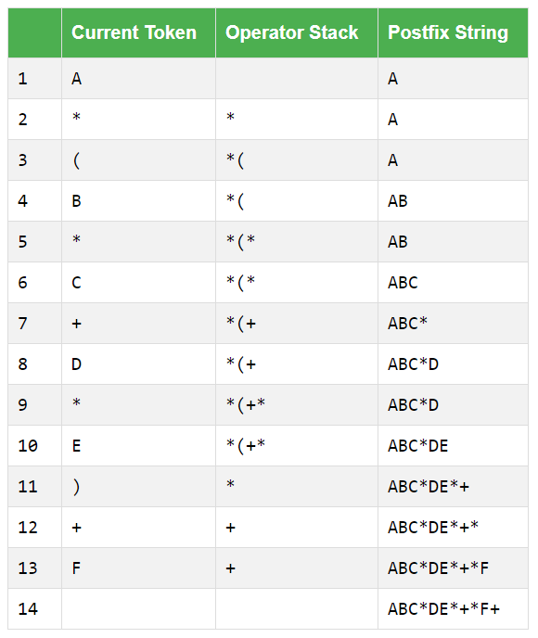
Infix-to-Postfix Conversion
Input expression: A*(B*C+D*E)+F
We will have two stacks: Operator and Postfix.
Next char is operand:
  Push to Postfix stack.
Next char is operator:
  Pop all higher-precedence operands from Operator stack and push to Postfix.
  Push char to Operator.
Next char is parenthesis:
  Opening: push to Operator
  Closing: Pop all operands from Operator and push to Postfix until a matching open parenthesis is found. Pop the matching parenthesis and discard it.

Slide 35
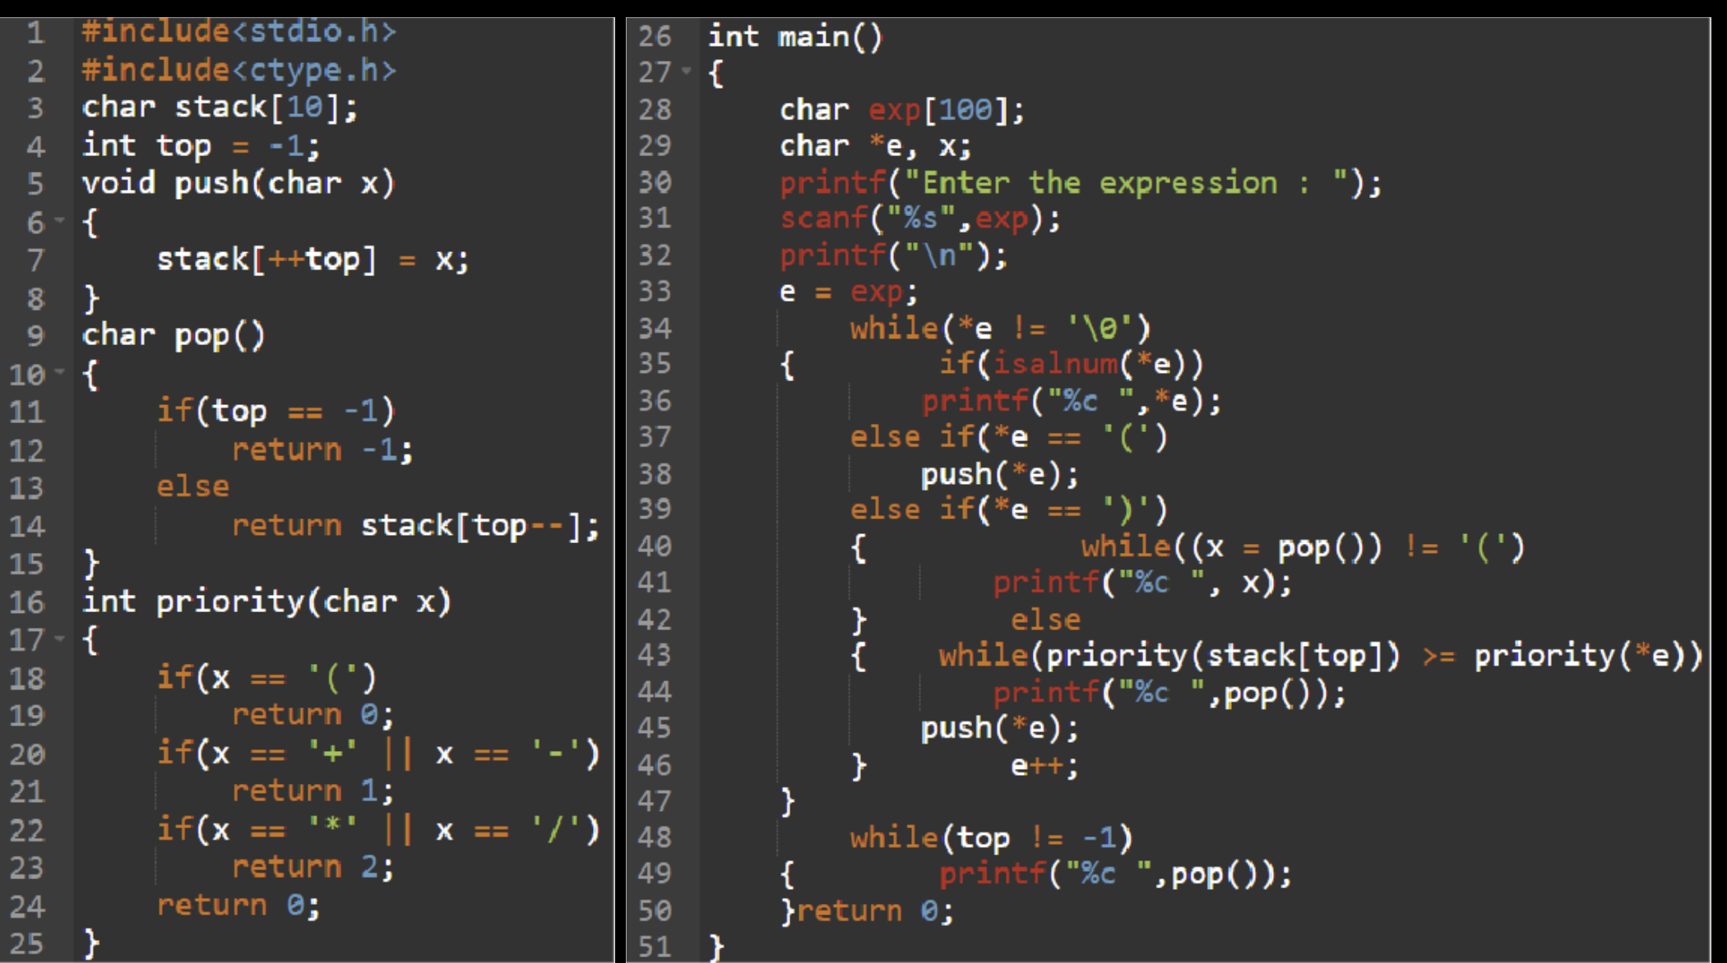

Slide 36
Lab Work – Using Stack to Check Parenthesis
Create a library implementing stack using linked list
Use the implemented stack to check validity of parenthesis
Input:
  Only line of input contains a non-empty string between 1 and 100 characters long, which consists only of characters “(”, “)”, “{”, “}”, “[” and “]”.
Output:
  Print if the given sequence of parenthesis is balanced or unbalanced.
Submit the zipped folder

