Slide 1
Lecture 02: Data movement and Memory Addressing

Slide 2
Assembly/Machine Code View
CPU
Memory
Registers
Addresses
Data
Code
Data
Stack
PC
Condition
Codes
Instructions
Programmer-Visible State
  PC: Program counter
    Address of next instruction
    Called “RIP” (x86-64)
  Register file
    Heavily used program data
  Condition codes
    Store status information about most recent arithmetic or logical operation
    Used for conditional branching
  Memory
    Byte addressable array
    Code and user data
    Stack to support procedures

Slide 3
X86 instructions
Three categories
Data Movement
Arithmetic/Logical (ALU) operations
Control‐Flow
We will not cover ALL x86 instructions (there are hundreds); there are numerous obscure ones.
We will cover many of the common instructions.
For full list of instructions see Intel’s instruction set reference.

Slide 4
verbiage
Opcode operand1, operand2, operand3
Opcode is the “name” of the instruction in assembly language, which does a certain kind of operation on the processor: for example, mov (which moves data), add, jmp, etc.
We will use this shorthand for instruction operands: op1, op2, op3
Which operands are required or optional depends on the opcode (covered in
the slides below for each of the opcodes or instructions that we will look at)
movq %rax, %rbx
Opcode with operand size suffix – movq
Operand1 (op1) ‐ rax
Operand2 (op2) ‐ rbx

Slide 5
Assembly Characteristics: Data Types
“Integer” data of 1, 2, 4, or 8 bytes
a) Data values
b) Addresses (untyped pointers)
Floating point data of 4, 8, or 10 bytes
Code: Byte sequences encoding series of instructions
No aggregate types such as arrays or structures
Just contiguously allocated bytes in memory

Slide 6
Assembly Characteristics: Operations (3 types)
Perform arithmetic function on register or memory data
Transfer data between memory and register
a) Load data from memory into register
b) Store register data into memory
Transfer control
a) Unconditional jumps to/from procedures
b) Conditional branches

Slide 7
Assembly Characteristics: Data Types
“Integer” data of 1, 2, 4, or 8 bytes
  Data values
  Addresses (untyped pointers)
Floating point data of 4, 8, or 10 bytes
(SIMD vector data types of 8, 16, 32 or 64 bytes)
Code: Byte sequences encoding series of instructions
No aggregate types such as arrays or structures
  Just contiguously allocated bytes in memory

Slide 8
x86-64 Integer Registers
%rax
%r8
%eax
%r8d
%rbx
%r9
%ebx
%r9d
%rcx
%r10
%ecx
%r10d
%rdx
%r11
%edx
%r11d
%rsi
%r12
%esi
%r12d
%rdi
%r13
%edi
%r13d
%rsp
%r14
%esp
%r14d
%rbp
%r15
%ebp
%r15d
  Can reference low-order 4 bytes (also low-order 1 & 2 bytes)
  Not part of memory (or cache)

Slide 9
Some History: IA32 Registers
Origin
(mostly obsolete)
%eax
%ax
%ah
%al
accumulate
%ecx
%cx
%ch
%cl
counter
%edx
%dx
%dh
%dl
data
general purpose
%ebx
%bx
%bh
%bl
base
%esi
source
index
%si
%edi
destination
index
%di
%esp
stack
pointer
%sp
%ebp
base
pointer
%bp
16-bit virtual registers
(backwards compatibility)

Slide 10
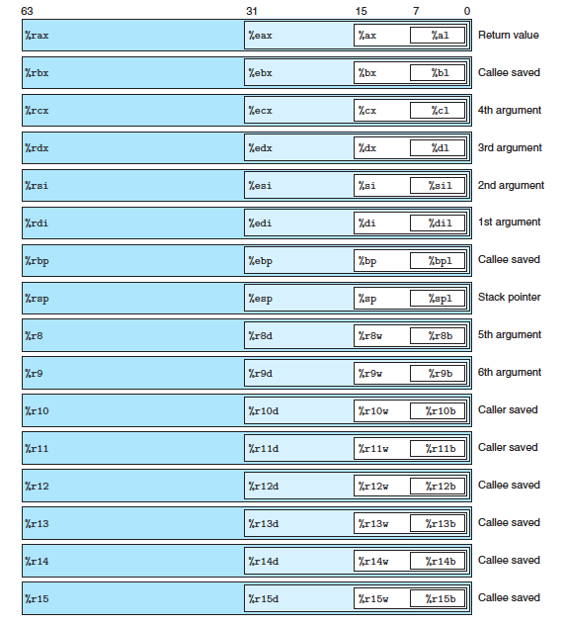
x86-64 Integer Registers
instructions can operate on data
of different sizes stored in the low-order bytes of the 16 registers. Byte-level
operations can access the least significant byte, 16-bit operations can access the
least significant 2 bytes, 32-bit operations can access the least significant 4 bytes,
and 64-bit operations can access entire registers.
X86-64 registers

Slide 11
Assembly Characteristics: Operations
Transfer data between memory and register
  Load data from memory into register
  Store register data into memory
Perform arithmetic function on register or memory data
Transfer control
  Unconditional jumps to/from procedures
  Conditional branches
  Indirect branches

Slide 12
Moving Data
%rax
%rcx
Moving Data
  movq Source, Dest
Operand Types
  Immediate: Constant integer data
    Example: $0x400, $-533
    Like C constant, but prefixed with ‘$’
    Encoded with 1, 2, or 4 bytes
  Register: One of 16 integer registers
    Example: %rax, %r13
    But %rsp reserved for special use
    Others have special uses for particular instructions
  Memory: 8 consecutive bytes of memory at address given by register
    Simplest example: (%rax)
    Various other “addressing modes”
%rdx
%rbx
%rsi
%rdi
%rsp
%rbp
%rN
Warning: Intel docs use
mov Dest, Source

Slide 13
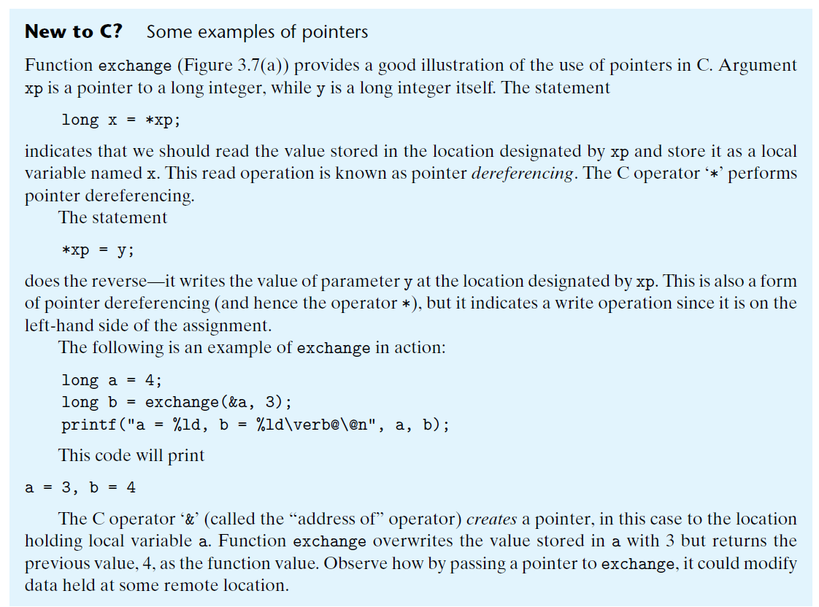

Slide 14
movq Operand Combinations
Source
Dest
Src,Dest
C Analog
Reg
movq $0x4,%rax
temp = 0x4;
Imm
Mem
movq $-147,(%rax)
*p = -147;
Reg
movq %rax,%rdx
temp2 = temp1;
movq
Reg
Mem
movq %rax,(%rdx)
*p = temp;
Mem
Reg
movq (%rax),%rdx
temp = *p;
Cannot do memory-memory transfer with a single instruction

Slide 15
Simple Memory Addressing Modes
Normal (R) Mem[Reg[R]]
  Register R specifies memory address
  Aha! Pointer dereferencing in C
  movq (%rcx),%rax
Displacement D(R) Mem[Reg[R]+D]
  Register R specifies start of memory region
  Constant displacement D specifies offset
  movq 8(%rbp),%rdx

Slide 16
Example of Simple Addressing Modes
void
whatAmI(<type> a, <type> b)
{
????
}
whatAmI:
movq (%rdi), %rax
movq (%rsi), %rdx
movq %rdx, (%rdi)
movq %rax, (%rsi)
ret
%rsi
%rdi

Slide 17
Example of Simple Addressing Modes
void swap
(long *xp, long *yp)
{
long t0 = *xp;
long t1 = *yp;
*xp = t1;
*yp = t0;
}
swap:
movq (%rdi), %rax
movq (%rsi), %rdx
movq %rdx, (%rdi)
movq %rax, (%rsi)
ret

Slide 18
Understanding Swap()
Memory
void swap
(long *xp, long *yp)
{
long t0 = *xp;
long t1 = *yp;
*xp = t1;
*yp = t0;
}
Registers
%rdi
%rsi
%rax
%rdx
Register Value
%rdi xp
%rsi yp
%rax t0
%rdx t1
swap:
movq (%rdi), %rax # t0 = *xp
movq (%rsi), %rdx # t1 = *yp
movq %rdx, (%rdi) # *xp = t1
movq %rax, (%rsi) # *yp = t0
ret

Slide 19
Understanding Swap()
Memory
Registers
Address
123
0x120
%rdi
0x120
0x118
%rsi
0x100
0x110
%rax
0x108
%rdx
456
0x100
swap:
movq (%rdi), %rax # t0 = *xp
movq (%rsi), %rdx # t1 = *yp
movq %rdx, (%rdi) # *xp = t1
movq %rax, (%rsi) # *yp = t0
ret

Slide 20
Understanding Swap()
Memory
Registers
Address
123
0x120
%rdi
0x120
0x118
%rsi
0x100
0x110
%rax
123
0x108
%rdx
456
0x100
swap:
movq (%rdi), %rax # t0 = *xp
movq (%rsi), %rdx # t1 = *yp
movq %rdx, (%rdi) # *xp = t1
movq %rax, (%rsi) # *yp = t0
ret

Slide 21
Understanding Swap()
Memory
Registers
Address
123
0x120
%rdi
0x120
0x118
%rsi
0x100
0x110
%rax
123
0x108
%rdx
456
456
0x100
swap:
movq (%rdi), %rax # t0 = *xp
movq (%rsi), %rdx # t1 = *yp
movq %rdx, (%rdi) # *xp = t1
movq %rax, (%rsi) # *yp = t0
ret

Slide 22
Understanding Swap()
Memory
Registers
Address
456
0x120
%rdi
0x120
0x118
%rsi
0x100
0x110
%rax
123
0x108
%rdx
456
456
0x100
swap:
movq (%rdi), %rax # t0 = *xp
movq (%rsi), %rdx # t1 = *yp
movq %rdx, (%rdi) # *xp = t1
movq %rax, (%rsi) # *yp = t0
ret

Slide 23
Understanding Swap()
Memory
Registers
Address
456
0x120
%rdi
0x120
0x118
%rsi
0x100
0x110
%rax
123
0x108
%rdx
456
123
0x100
swap:
movq (%rdi), %rax # t0 = *xp
movq (%rsi), %rdx # t1 = *yp
movq %rdx, (%rdi) # *xp = t1
movq %rax, (%rsi) # *yp = t0
ret

Slide 24
Simple Memory Addressing Modes
Normal (R) Mem[Reg[R]]
  Register R specifies memory address
  Aha! Pointer dereferencing in C
  movq (%rcx),%rax
Displacement D(R) Mem[Reg[R]+D]
  Register R specifies start of memory region
  Constant displacement D specifies offset
  movq 8(%rbp),%rdx

Slide 25
Complete Memory Addressing Modes
Most General Form
D(Rb,Ri,S) Mem[Reg[Rb]+S*Reg[Ri]+ D]
  D: Constant “displacement” 1, 2, or 4 bytes
  Rb: Base register: Any of 16 integer registers
  Ri: Index register: Any, except for %rsp
  S: Scale: 1, 2, 4, or 8 (why these numbers?)
Special Cases
(Rb,Ri) Mem[Reg[Rb]+Reg[Ri]]
D(Rb,Ri) Mem[Reg[Rb]+Reg[Ri]+D]
(Rb,Ri,S) Mem[Reg[Rb]+S*Reg[Ri]]

Slide 26
Operand specifiers
Source values can be given as constants or read from registers or memory.
Results can be stored in either registers or memory.
Thus, the different operand possibilities can be classified into three types.
The first type, immediate , is for constant values. In ATT format assembly code, these are written with a ‘$ ’ followed by an integer using standard C notation—for example, $-577 or $0x1F .
Different instructions allow different ranges of immediate values; the assembler will automatically select the most compact way of encoding a value.
The second type, register , denotes the contents of a register

Slide 27
Operand specifiers
The third type of operand is a memory reference, in which we access some memory location according to a computed address, often called the effective address .
Since we view the memory as a large array of bytes, we use the notation Mb [Addr ] to denote a reference to the b -byte value stored in memory starting at address Addr . To simplify things, we will generally drop the subscript b .

Slide 28
Operand specifiers
There are many different addressing modes allowing different forms of memory references. The most general form is shown at the bottom of the table with syntax Imm(rb,ri,s).
Such a reference has four components: an immediate offset Imm, a base register rb, an index register ri , and a scale factor s, where s must be 1, 2, 4, or 8. Both the base and index must be 64-bit registers.
The effective address is computed as Imm + R[rb]+ R[ri] . s. This general form is often seen when referencing elements of arrays

Slide 29
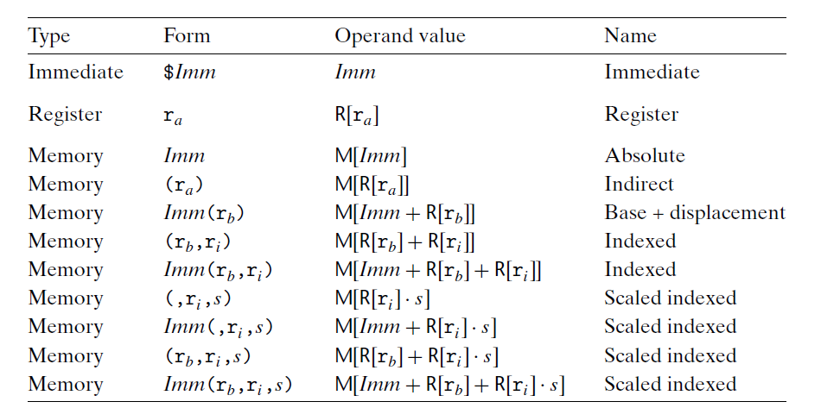
Operand forms. Operands can denote immediate (constant) values, register values, or values from memory. The scaling factors must be either 1, 2, 4, or 8.

Slide 30
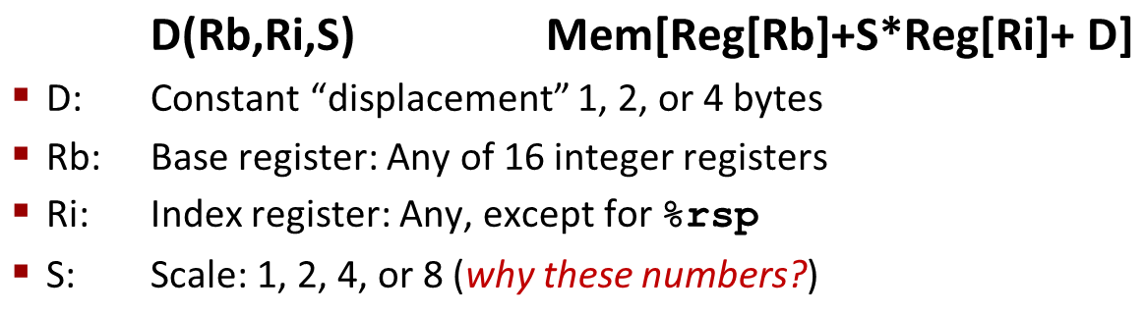
Address Computation Examples
%rdx | 0xf000
%rcx | 0x0100
Expression | Address Computation | Address
0x8(%rdx)
(%rdx,%rcx)
(%rdx,%rcx,4)
0x80(,%rdx,2)
Expression | Address Computation | Address
0x8(%rdx) | 0xf000 + 0x8 | 0xf008
(%rdx,%rcx) | 0xf000 + 0x100 | 0xf100
(%rdx,%rcx,4) | 0xf000 + 4*0x100 | 0xf400
0x80(,%rdx,2) | 2*0xf000 + 0x80 | 0x1e080
Notes:
0xf000 + 0x8 = 0xf008
0xf000 + 0x0100 = 0xf100
0xf000 + 4*0x0100 = 0xf400
2*0xf000 + 0x80 = 0x1d080

Slide 31
Address Computation Examples
%rdx | 0xf000
%rcx | 0x0100
Expression | Address Computation | Address
0x8(%rdx)
(%rdx,%rcx)
(%rdx,%rcx,4)
0x80(,%rdx,2)
Expression | Address Computation | Address
0x8(%rdx) | 0xf000 + 0x8 | 0xf008
(%rdx,%rcx) | 0xf000 + 0x100 | 0xf100
(%rdx,%rcx,4) | 0xf000 + 4*0x100 | 0xf400
0x80(,%rdx,2) | 2*0xf000 + 0x80 | 0x1e080
Notes:
0xf000 + 0x8 = 0xf008
0xf000 + 0x0100 = 0xf100
0xf000 + 4*0x0100 = 0xf400
2*0xf000 + 0x80 = 0x1d080

Slide 32
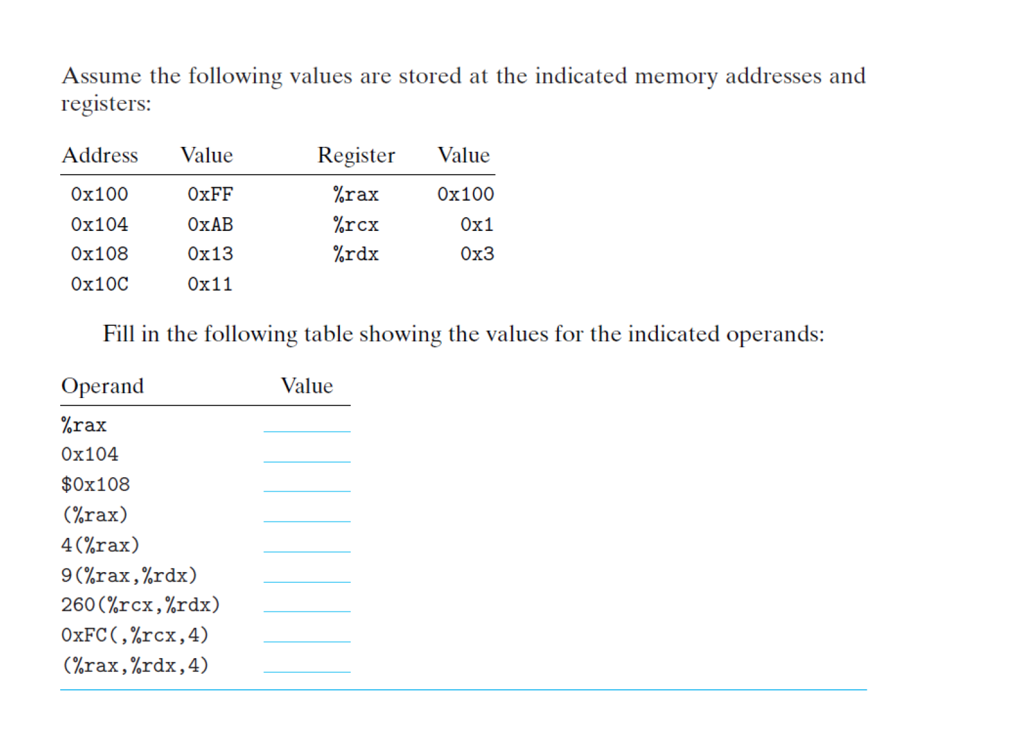
Practice

Slide 33
Data Size

Slide 34
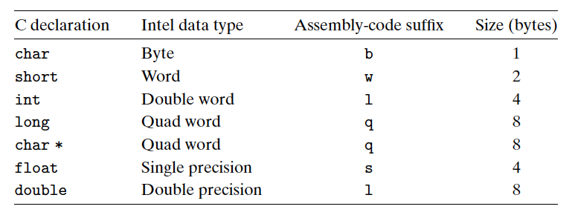
Sizes of C data types in x86-64
Due to its origins as a 16-bit architecture that expanded into a 32-bit one, Intel uses the term “word” to refer to a 16-bit data type. Based on this, they refer to 32-bit quantities as “double words,” and 64-bit quantities as “quad words.”
With a 64-bit machine, pointers are 8 bytes long.

Slide 35
Data Size
most assembly-code instructions generated by gcc have a single-character suffix denoting the size of the operand. For example, the data movement instruction has four variants: movb (move byte), movw (move word), movl (move double word), and movq (move quad word).
The suffix ‘l’ is used for double words, since 32-bit quantities are considered to be “long words.” The assembly code uses the suffix ‘l’ to denote a 4-byte integer as well as an 8-byte double-precision floating-point number. This causes no ambiguity, since floating-point code involves an entirely different set of instructions and registers.

Slide 36
Sizes of operands
In AT&T format, the size of the operands is specified with suffixes, q, l, w, and b appended to the opcode
q – quad word, or 64 bit operand
l – long word, or 32 bit operand
w – word, or 16 bit operand
b – byte, or 8 bit operand
Most instructions that we will use will have the q suffix for 64 bit operands, but we will make some use of 1 byte, 2 byte and 4 byte operands.
If you omit the suffix, the assembler will attempt to determine it from the operands involved, but this is dangerous (the assembler will not always generate a machine instruction that operates on data of the size you want). This can cause bugs which are extremely difficult to track down, so be sure to include the operand size suffix always!
Opcodes in the syntax information below are given without suffixes; you must add the appropriate suffix when you write assembly language instructions. The examples show opcodes with operand size suffixes.

Slide 37
Data format
Most assembly-code instructions generated by gcc have a single-character suffix denoting the size of the operand.
For example, the data movement instruction has four variants:
movb (move byte)
movw (move word)
movl (move double word)
movq (move quad word)

Slide 38
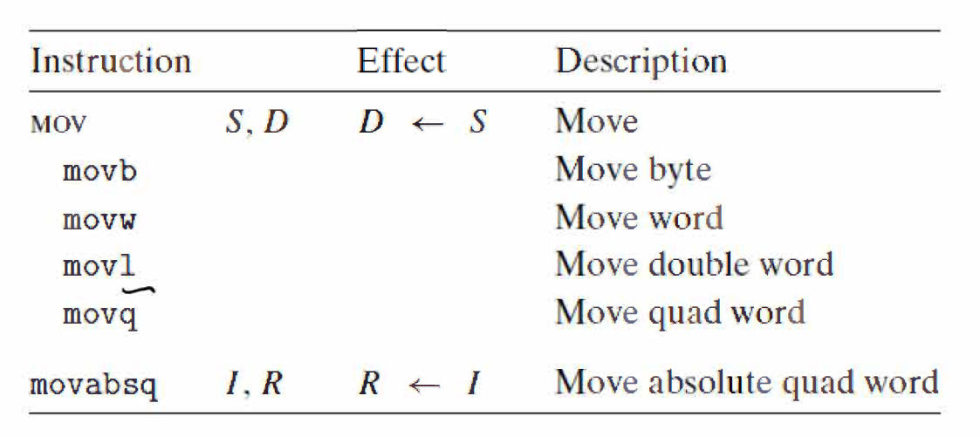
A final instruction documented here is for dealing with 64-bit immediate data. The regular movq instruction can only have immediate source operands that can be represented as 32-bit two’s-complement numbers. This value is then
sign extended to produce the 64-bit value for the destination. The movabsq instruction can have an arbitrary 64-bit immediate value as its source operand and can only have a register as a destination.

Slide 39
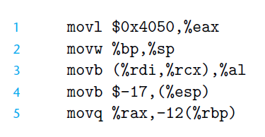
Practice
The following mov instruction examples show the five possible combinations
of source and destination types. Recall that the source operand comes first and
the destination second. Explain what happens at each line

Slide 40
Note
Register operands for these instructions can be the labeled portions of any of the 16 registers, where the size of the register must match the size designated by the last character of the instruction (‘b’, ‘w’, ‘l’, or ‘q’). For most cases, the mov instructions will only update the specific register bytes or memory locations indicated by the destination operand.
The only exception is that when movl has a register as the destination, it will also set the high-order 4 bytes of the register to 0. This exception arises from the convention, adopted in x86-64, that any instruction that generates a 32-bit value for a register also sets the high-order portion of the register to 0.

Slide 41
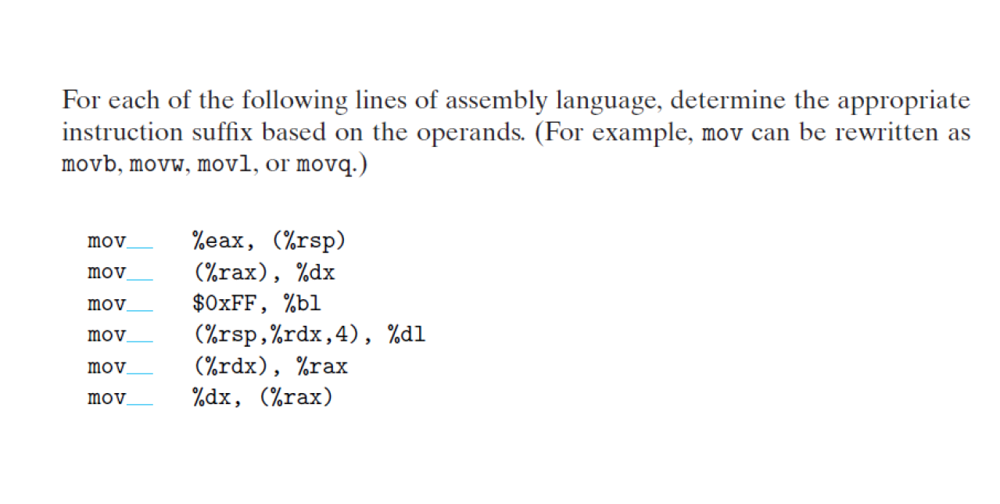
Practice

Slide 42
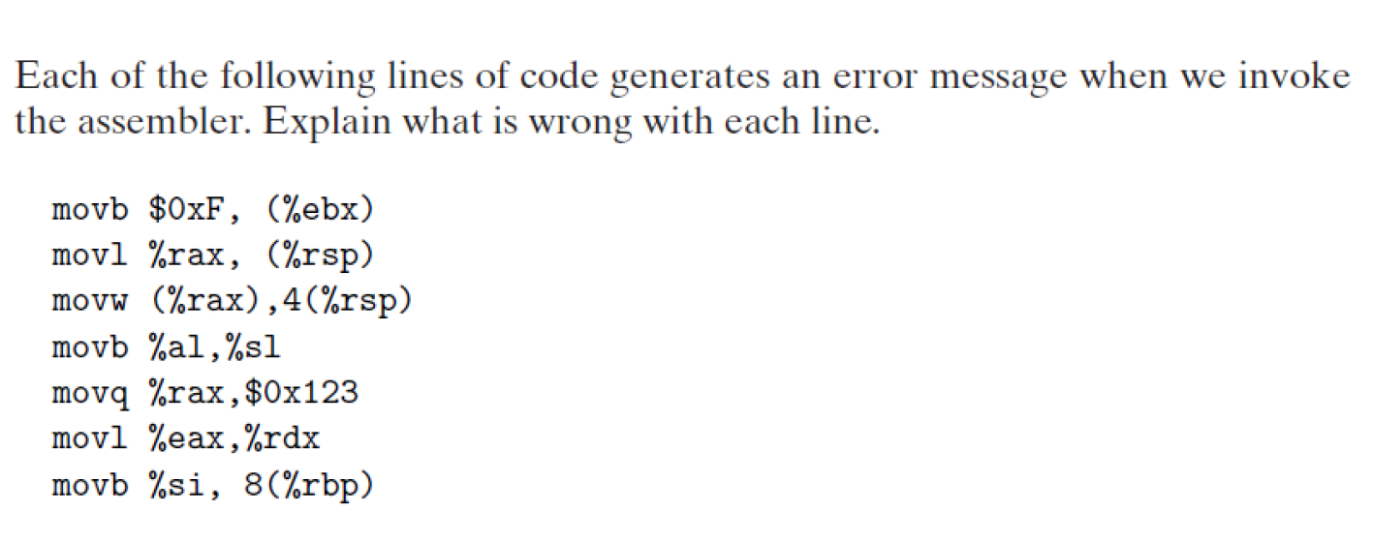
Practice

Slide 43
Example
movq 24(%rax,%rcx,4), %rdx
means read 8 bytes from this address: (%rax + 4*%rcx + 24)
and store it in %rdx

Slide 44
Example
movl 24(%rax,%rcx,4), %edx
means read 4 bytes from this address: (%rax + 4*%rcx + 24) and store it in %edx

Slide 45
Example
movw 24(%rax,%rcx,4), %dx
means read 2 bytes from this address: (%rax + 4*%rcx + 24)
and store it in %dx

Slide 46
Example
movb 24(%rax,%rcx,4), %dl
means read 1 byte from this address: (%rax + 4*%rcx + 24) and store it in %dl

Slide 47
Note that only suffix and destination register size changes for previous examples

Slide 48
Example
movq %rdx, 24(%rax,%rcx,4)
means write 8 bytes to this address: (%rax + 4*%rcx + 24) from %rdx
movl %edx, 24(%rax,%rcx,4)
means write 4 bytes to this address: (%rax + 4*%rcx + 24) from %edx
movw %dx, 24(%rax,%rcx,4)
means write 2 bytes to this address: (%rax + 4*%rcx + 24) from %dx
movb %dl, 24(%rax,%rcx,4)
means write 1 byte to this address: (%rax + 4*%rcx + 24) from %dl
(Note that only suffix and source register size changes here)

Slide 49
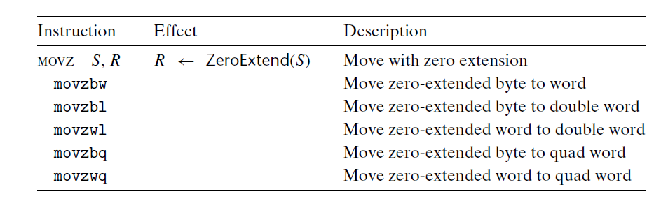
Zero-extending data movement instructions. These instructions have a
register or memory location as the source and a register as the destination.

Slide 50
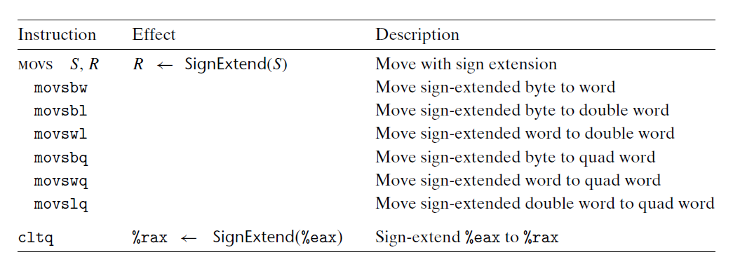
Sign-extending data movement instructions. The movs instructions have
a register or memory location as the source and a register as the destination. The cltq
instruction is specific to registers %eax and %rax.

Slide 51
Note
All of these instructions copy data from a source, which can be either a register or stored in memory, to a register destination. Instructions in the movz class fill out the remaining bytes of the destination with zeros, while those in the movs class fill them out by sign extension, replicating copies of the most significant bit of the source operand.
Observe that each instruction name has size designators as its final two characters—the first specifying the source size, and the second specifying the destination size. As can be seen, there are three instructions in each of these classes, covering all cases of 1- and 2-byte source sizes and 2- and 4-byte destination sizes, considering only cases where the destination is larger than the source, of course.

Slide 52
Note
Note the absence of an explicit instruction to zero-extend a 4-byte source value to an 8-byte destination. Such an instruction would logically be named movzlq, but this instruction does not exist. Instead, this type of data movement can be implemented using a movl instruction having a register as the destination.
This technique takes advantage of the property that an instruction generating a 4-byte value with a register as the destination will fill the upper 4 bytes with zeros. Otherwise, for 64-bit destinations, moving with sign extension is supported for all three source types, and moving with zero extension is supported for the two smaller source types.
Let’s discuss the cltq instruction. This instruction has no operands—it always uses register %eax as its source and %rax as the destination for the sign-extended result. It therefore has the exact same effect as the instruction movslq %eax, %rax, but it has a more compact encoding.

Slide 53
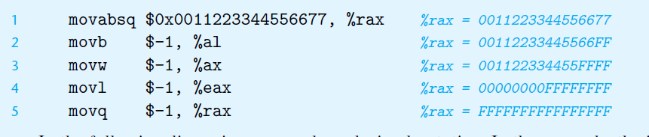
Understanding how data movement changes a destination register
As described, there are two different conventions regarding whether and how data movement instructions
modify the upper bytes of a destination register. This distinction is illustrated by the following
code sequence:

Slide 54
Note
In the following discussion, we use hexadecimal notation. In the example, the instruction on line 1 initializes register %rax to the pattern 0011223344556677. The remaining instructions have immediate value −1 as their source values. Recall that the hexadecimal representation of −1 is of the form FF. . .F, where the number of F’s is twice the number of bytes in the representation. The movb instruction (line 2) therefore sets the low-order byte of %rax to FF, while the movw instruction (line 3) sets the low-order 2 bytes to FFFF, with the remaining bytes unchanged. The movl instruction (line 4) sets the low-order 4 bytes to FFFFFFFF, but it also sets the high-order 4 bytes to 00000000. Finally, the movq instruction (line 5) sets the complete register to FFFFFFFFFFFFFFFF.

