Slide 1
Lecture 01
Course Overview
CS 3843 – Computer Organization

Slide 2
Part 01
Decimal, Binary, Hexadecimal
Bit Level Operations in C Language
Byte Ordering and Endianness of a machine
Integer Representation: Unsigned and 2’s Complement
Integer Arithmetic
Floating Point Representation

Slide 3
Textbook (Highly Recommended)
Randal E. Bryant and David R. O’Hallaron,
  Computer Systems: A Programmer’s Perspective, Third Edition (CS:APP3e), Pearson, 2016
  http://csapp.cs.cmu.edu
  This book really matters for the course!

Slide 4
Application Programs
Comp Hardware
System Software

Slide 5
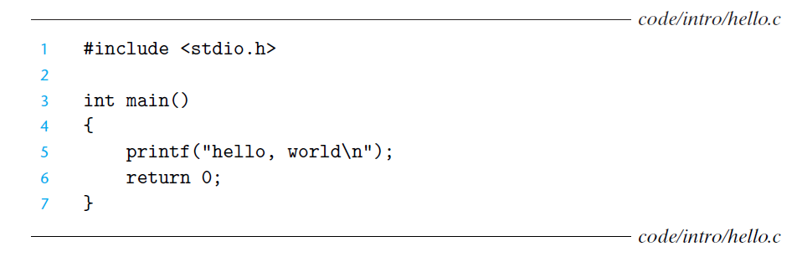
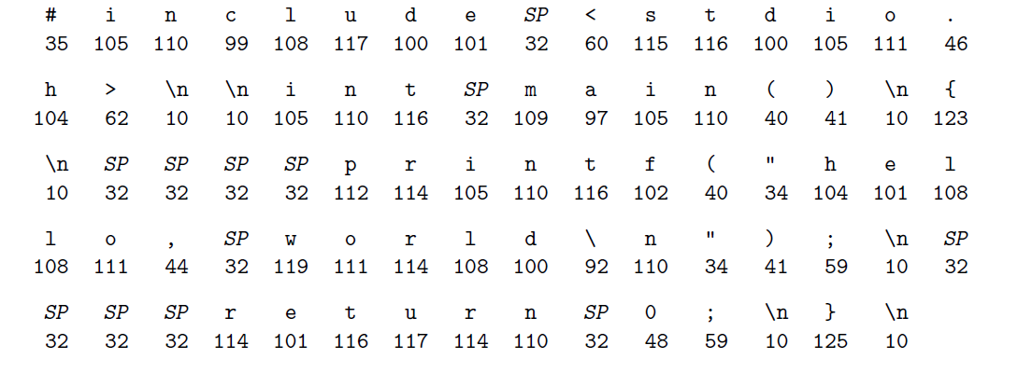
What happens to your C code

Slide 6
Information Is Bits + Context
The representation of hello.c illustrates a fundamental idea: All information in a system—including disk files, programs stored in memory, user data stored in memory, and data transferred across a network—is represented as a bunch of bits.
The only thing that distinguishes different data objects is the context in which we view them. For example, in different contexts, the same sequence of bytes might represent an integer, floating-point number, character string, or machine instruction.

Slide 7
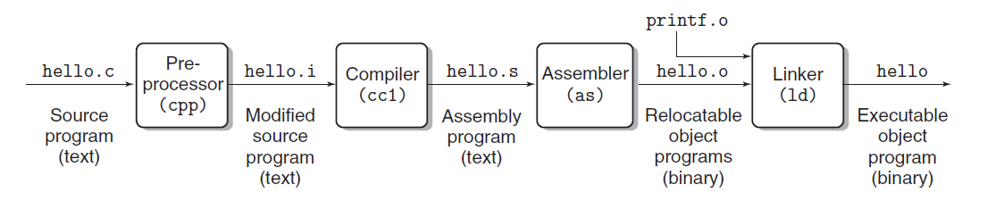
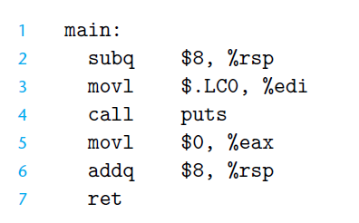
steps

Slide 8
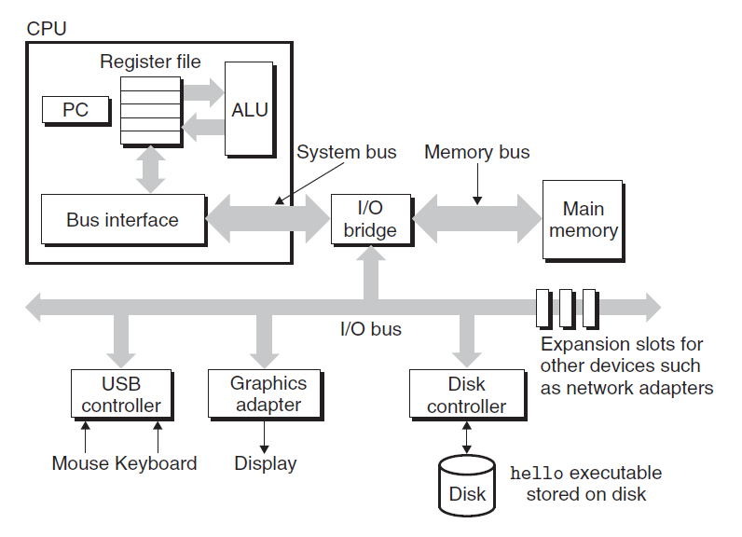
At hardware level

Slide 9
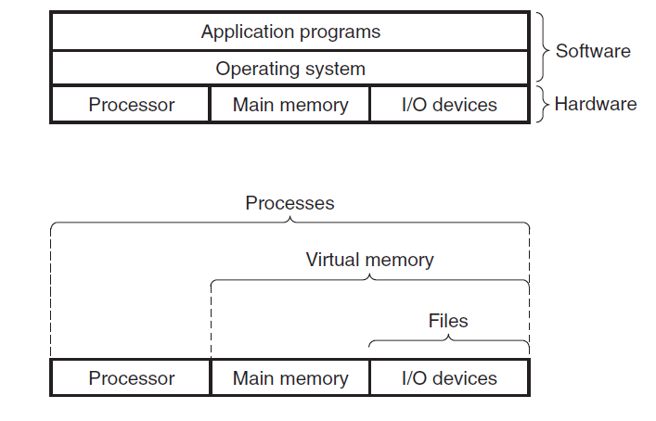
Working together

Slide 10
Abstraction Is Good But Don’t Forget Reality
Carnegie Mellon
Most CS and CE courses emphasize abstraction
  Abstract data types
  Asymptotic analysis
These abstractions have limits
  Especially in the presence of bugs
  Need to understand details of underlying implementations
Useful outcomes from taking 3843
  Become more effective programmers
    Able to find and eliminate bugs efficiently
    Able to understand and tune for program performance
  Prepare for later “systems” classes in CS & ECE
    Compilers, Operating Systems, Networks, Computer Architecture, Embedded Systems, Storage Systems, Reverse Engineering etc.

Slide 11
Note
Real-life Arithmetic and Computer Arithmetic is not same all the time
Integers: Overflow Problem
Floats: Round-off Problem

Slide 12
You’ve Got to Know Assembly
Carnegie Mellon
Chances are, you’ll never write programs in assembly
  Compilers are much better & more patient than you are
But: Understanding assembly is key to machine-level execution model
  Behavior of programs in presence of bugs
    High-level language models break down
  Tuning program performance
    Understand optimizations done / not done by the compiler
    Understanding sources of program inefficiency
  Implementing system software
    Compiler has machine code as target
    Operating systems must manage process state
  Creating / fighting malware
    x86 assembly is the language of choice!

Slide 13
Memory Matters
Carnegie Mellon
Memory is not unbounded
  It must be allocated and managed
  Many applications are memory dominated
Memory referencing bugs especially pernicious
  Effects are distant in both time and space
Memory performance is not uniform
  Cache and virtual memory effects can greatly affect program performance
  Adapting program to characteristics of memory system can lead to major speed improvements

Slide 14
Memory Referencing Errors
Carnegie Mellon
C and C++ do not provide any memory protection
  Out of bounds array references
  Invalid pointer values
  Abuses of malloc/free
Can lead to nasty bugs
  Whether or not bug has any effect depends on system and compiler
  Action at a distance
    Corrupted object logically unrelated to one being accessed
    Effect of bug may be first observed long after it is generated
How can I deal with this?
  Program in Java, Ruby, Python, ML, …
  Understand what possible interactions may occur
  Use or develop tools to detect referencing errors (e.g. Valgrind)

Slide 15
There’s more to performance than asymptotic complexity
Carnegie Mellon
Constant factors matter too!
And even exact op count does not predict performance
  Easily see 10:1 performance range depending on how code written
  Must optimize at multiple levels: algorithm, data representations, procedures, and loops
Must understand system to optimize performance
  How programs compiled and executed
  How to measure program performance and identify bottlenecks
  How to improve performance without destroying code modularity and generality

Slide 16
Memory System Performance Example
Carnegie Mellon
void copyij(int src[2048][2048],
int dst[2048][2048])
{
int i,j;
for (i = 0; i < 2048; i++)
for (j = 0; j < 2048; j++)
dst[i][j] = src[i][j];
}
void copyji(int src[2048][2048],
int dst[2048][2048])
{
int i,j;
for (j = 0; j < 2048; j++)
for (i = 0; i < 2048; i++)
dst[i][j] = src[i][j];
}
4.3ms
81.8ms
2.0 GHz Intel Core i7 Haswell
Hierarchical memory organization
Performance depends on access patterns
  Including how step through multi-dimensional array

Slide 17
Why The Performance Differs
copyij
copyji

Slide 18
Computers do more than execute programs
Carnegie Mellon
They need to get data in and out
  I/O system critical to program reliability and performance
They communicate with each other over networks
  Many system-level issues arise in presence of network
    Concurrent operations by autonomous processes
    Coping with unreliable media
    Cross platform compatibility
    Complex performance issues

Slide 19
Course Perspective
Carnegie Mellon
This Course is Programmer-Centric
  Purpose is to show that by knowing more about the underlying system, one can be more effective as a programmer
  Enable you to
    Write programs that are more reliable and efficient
    We will learn about the underlying machine from the programmer’s perspective.

Slide 20
Reading
Read/Scroll through book chapter 01
Take notes

