Slide 1

Lecture 4: Bits, Bytes, and Integers
Byte Ordering, Endianness

Slide 2
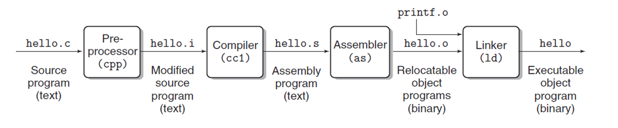

Slide 3
Rather than accessing individual bits in memory, most computers use blocks of 8 bits, or bytes, as the smallest addressable unit of memory. A machine-level program views memory as a very large array of bytes, referred to as virtual memory. Every byte of memory is identified by a unique number, known as its address, and the set of all possible addresses is known as the virtual address space.
As indicated by its name, this virtual address space is just a conceptual image presented to the machine-level program. The actual implementation uses a combination of dynamic random access memory (DRAM), flash memory, disk storage, special hardware, and operating system software to provide the program with what appears to be a monolithic byte array.

Slide 4
The compiler and run-time system partitions this memory space into more manageable units to store the different program objects, that is, program data, instructions, and control information.
Various mechanisms are used to allocate and manage the storage for different parts of the program. This management is all performed within the virtual address space. For example, the value of a pointer in C—whether it points to an integer, a structure, or some other program object—is the virtual address of the first byte of some block of storage.
The C compiler also associates type information with each pointer, so that it can generate different machine-level code to access the value stored at the location designated by the pointer depending on the type of that value. Although the C compiler maintains this type information, the actual machine-level program it generates has no information about data types. It simply treats each program object as a block of bytes and the program itself as a sequence of bytes.

Slide 5
Every computer has a word size, indicating the nominal size of pointer data. Since a virtual address is encoded by such a word, the most important system parameter determined by the word size is the maximum size of the virtual address space. That is, for a machine with a w-bit word size, the virtual addresses can range from 0 to
2^w − 1, giving the program access to at most 2^w bytes.
A 32-bit word size limits the virtual address space to 4 gigabytes (written 4 GB), that is, just over 4 × 10^9 bytes. Scaling up to a 64-bit word size leads to a virtual address space of 16 exabytes, or around 1.84 × 10^19 bytes.

Slide 6
Memory Technology
 |  | Capacity |  |  | Latency |  |  | Cost/GB
Registers |  | 1000s of bits |  | 20 ps |  |  | $$$$
SRAM |  | ~10KB – 10 MB |  | 1 – 10 ns |  |  | ~$1000
DRAM |  | ~ 10 GB |  | 80 ns |  |  | ~$10
 |  | ~ 100 GB |  | 100 us |  |  | ~$1
Flash*
 |  | ~ 1TB |  | 10 ms |  |  | ~$0.10
Hard Disk*
Processor Datapath
Memory Hierarchy
SRAM
DRAM
I/O Subsystems
Flash
Hard Disk
*non-volatile memory = retains contents when power is off

Slide 7









MEMORY HIERARCHY
HARD DISK
FLASH DRAM SRAM REGISTERS
speed
capacity

Slide 8
HOW BIG IS A….?
Bytes(8 Bits)
Kilobyte (1000 Bytes)
Megabyte (1 000 000 Bytes)
Gigabyte (1 000 000 000 Bytes)
Terabyte (1 000 000 000 000 Bytes)
10 Terabytes: The printed collection of the US Library of Congress (1995)
Petabyte (1 000 000 000 000 000 Bytes)
2 Petabytes: All US academic research libraries (1995)
Exabyte (1 000 000 000 000 000 000 Bytes)
5 Exabytes: All words ever spoken by human beings.
Zettabyte (1 000 000 000 000 000 000 000 Bytes)
Yottabyte (1 000 000 000 000 000 000 000 000 Bytes)
Xenottabyte (1 000 000 000 000 000 000 000 000 000 Bytes)
Shilentnobyte (1 000 000 000 000 000 000 000 000 000 000 Bytes)
Domegemegrottebyte (1 000 000 000 000 000 000 000 000 000 000 000 Bytes)
How much data do we create everyday?
https://www.forbes.com/sites/bernardmarr/2018/05/21/how-much-data-do-we-create-every-day-the-mi nd-blowing-stats-everyone-should-read/#42c30b860ba9
Source: http://pcbunn.cithep.caltech.edu/presentations/giod_status_sep97/tsld013.htm

Slide 9
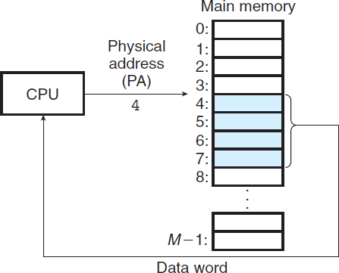
The main memory of a computer system is organized as an array of M contiguous byte-size cells. Each byte has a unique physical address (PA). The first byte has an address of 0, the next byte an address of 1, the next byte an address of 2,
and so on.

Slide 10
Content of memory OR values
0x100
75
0x104
29
0x108
43
Memory addresses

Slide 11
Byte-Oriented Memory Organization
00•••0
FF•••F
• • •
Programs refer to data by address
  Conceptually, envision it as a very large array of bytes
    In reality, it’s not, but can think of it that way
  An address is like an index into that array
    and, a pointer variable stores an address
Note: system provides private address spaces to each “process”
  Think of a process as a program being executed
  So, a program can clobber its own data, but not that of others

Slide 12
Machine Words
Any given computer has a “Word Size”
  Nominal size of integer-valued data
    and of addresses
  Until recently, most machines used 32 bits (4 bytes) as word size
    Limits addresses to 4GB (2³² bytes)
  Increasingly, machines have 64-bit word size
    Potentially, could have 18 EB (exabytes) of addressable memory
    That’s 18.4 X 10¹⁸
  Machines still support multiple data formats
    Fractions or multiples of word size
    Always integral number of bytes

Slide 13
Word-Oriented Memory Organization
32-bit
Words
64-bit
Words
Bytes
Addr.
Addresses Specify Byte Locations
  Address of first byte in word
  Addresses of successive words differ by 4 (32-bit) or 8 (64-bit)
0000
Addr
=
??
0001
0000
0002
Addr
=
??
0003
0000
0004
Addr
=
??
0005
0004
0006
0007
0008
Addr
=
??
0009
0008
0010
Addr
=
??
0011
0008
0012
Addr
=
??
0013
0012
0014
0015

Slide 14
Byte Ordering
So, how are the bytes within a multi-byte word ordered in memory?
Conventions
  Big Endian: Sun, PPC Mac, Internet
    Least significant byte has highest address
  Little Endian: x86, ARM processors running Android, iOS, and Windows
    Least significant byte has lowest address

Slide 15
Byte Ordering Example
Example
  Variable x has 4-byte value of 0x01234567
  Address given by &x is 0x100
Big Endian
0x100
0x101
0x102
0x103
01
23
45
67
01
23
45
67
Little Endian
0x100
0x101
0x102
0x103
67
45
23
01
67
45
23
01

Slide 16
Representing Integers
Decimal: 15213
Binary: 0011 1011 0110 1101
Hex: 3 B 6 D
int A = 15213;
long int C = 15213;
IA32, x86-64
Sun
IA32
x86-64
Sun
6D
00
3B
00
6D
6D
00
00
3B
3B
3B
00
00
6D
00
00
3B
00
00
6D
00
int B = -15213;
00
IA32, x86-64
Sun
00
00
93
FF
C4
FF
FF
C4
FF
93
Two’s complement representation

Slide 17
Examining Data Representations
Code to Print Byte Representation of Data
  Casting pointer to unsigned char * allows treatment as a byte array
typedef unsigned char *pointer;
void show_bytes(pointer start, size_t len){
size_t i;
for (i = 0; i < len; i++)
printf(”%p\t0x%.2x\n",start+i, start[i]);
printf("\n");
}
Printf directives:
%p: Print pointer
%x: Print Hexadecimal

Slide 18
show_bytes Execution Example
int a = 15213;
printf("int a = 15213;\n");
show_bytes((pointer) &a, sizeof(int));
Result (Linux x86-64):
int a = 15213;
0x7fffb7f71dbc 6d
0x7fffb7f71dbd 3b
0x7fffb7f71dbe 00
0x7fffb7f71dbf 00

Slide 19
Representing Pointers
int B = -15213;
int *P = &B;
Sun
IA32
x86-64
EF
FF
FB
2C
AC
28
F5
FF
3C
1B
FE
82
FD
7F
00
00
Different compilers & machines assign different locations to objects
Even get different results each time run program

Slide 20
A machine with a w-bit word size, the virtual addresses can range from 0 to 2^{w} − 1, giving the program access to at most 2^{w} bytes.
A 32-bit word size limits the virtual address space to 4 gigabytes (written 4 GB), that is, just over 4 × 10⁹ bytes. Scaling up to a 64-bit word size leads to a virtual address space of 16 exabytes, or around 1.84 × 10¹⁹ bytes.

Slide 21
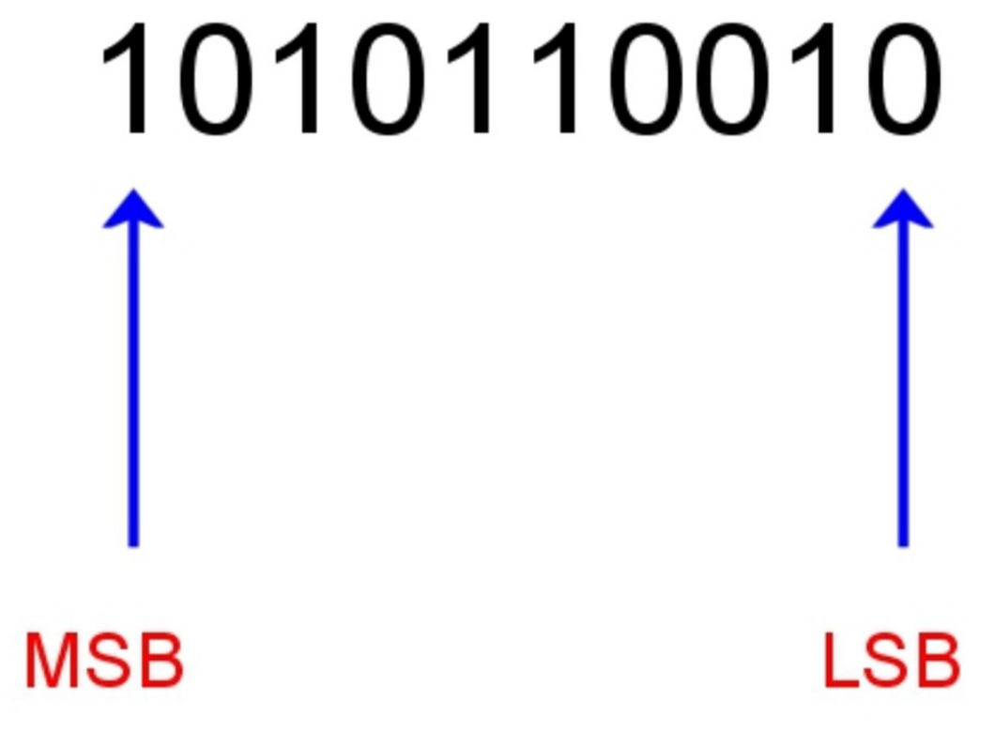
MSB: most significant bit/the leftmost digit
LSB: least significant bit/the rightmost digit

Slide 22
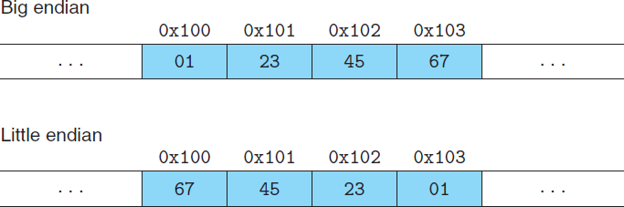
Addressing and Byte Ordering: Big Endian and Little Endian
For program objects that span multiple bytes, we must establish two conventions: what the address of the object will be, and how we will order the bytes in memory.
In virtually all machines, a multi-byte object is stored as a contiguous sequence of bytes, with the address of the object given by the smallest address of the bytes used. For example, suppose a variable x of type int has address 0x100; that is, the value of the address expression &x is 0x100. Then (assuming data type int has a 32-bit representation) the 4 bytes of x would be stored in memory locations 0x100, 0x101, 0x102, and 0x103.
Note that in the word 0x01234567 the high-order byte has hexadecimal value 0x01, while the low-order byte has value
0x67.
Where the least significant
byte comes first—is referred to as little endian. Where the most significant byte comes first—is referred to as big endian.

Slide 23
Note
Most Intel-compatible machines operate exclusively in little-endian mode. On the other hand, most machines from IBM and Oracle (arising from their acquisi tion of Sun Microsystems in 2010) operate in big-endian mode. Note that we said “most.” The conventions do not split precisely along corporate boundaries. For example, both IBM and Oracle manufacture machines that use Intel-compatible processors and hence are little endian. Many recent microprocessor chips are bi-endian, meaning that they can be configured to operate as either little- or big-endian machines. In practice, however, byte ordering becomes fixed once a particular operating system is chosen. For example, ARM microprocessors, used in many cell phones, have hardware that can operate in either little- or big-endian mode, but the two most common operating systems for these chips—Android (from Google) and IOS (from Apple)—operate only in little-endian mode
People get surprisingly emotional about which byte ordering is the proper one. In fact, the terms “little endian” and “big endian” come from the book Gulliver’s Travels by Jonathan Swift, where two warring factions could not agree as to how a soft-boiled egg should be opened—by the little end or by the big. Just like the egg issue, there is no technological reason to choose one byte ordering convention over the other, and hence the arguments degenerate into bickering about sociopolitical issues. As long as one of the conventions is selected and adhered to consistently, the choice is arbitrary

Slide 24
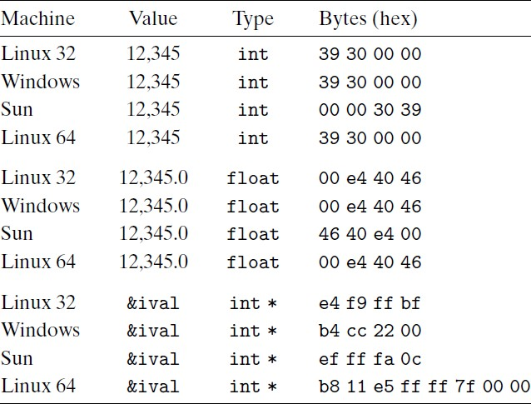
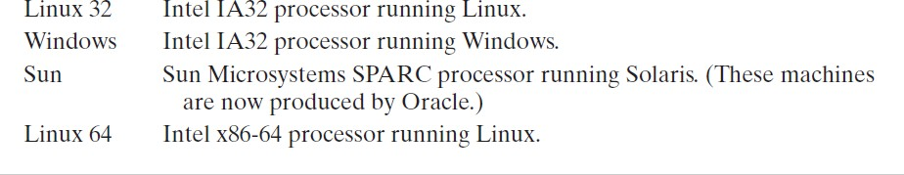
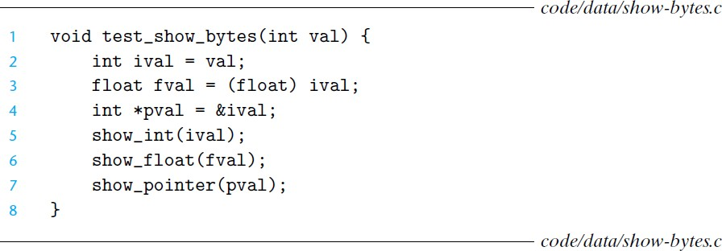
Example
Byte representations of different data values. Results for int and float
are identical, except for byte ordering. Pointer values are machine
dependent.
the pointer values are completely different. The different machine/operating system configurations use different conventions for storage allocation. One feature to note is that the
Linux 32, Windows, and Sun machines use 4-byte addresses, while the Linux 64 machine uses 8-byte addresses.

Slide 25
note
A fundamental concept of computer systems is that a program, from the perspective of the machine, is simply a sequence of bytes. The machine has no information about the original source program, except perhaps some auxiliary tables maintained to aid in debugging

