Slide 1
Recursion

Slide 2
When can we use Recursion?
If the optimal solution to our problem can be derived from the optimal solutions of the subproblems, then it might be possible to use recursion.
For example, let us say we are trying to find the factorial(n)
Let us assume we somehow know that z = factorial(n-1)
We can calculate factorial(n) by multiplying z and n.
But now we have to find factorial(n-1).
If we somehow knew the value of factorial(n-2)…

Slide 3
When can we use Recursion?
Of course, we can not recurse indefinitely.
Base criteria − There must be at least one base criteria or condition, such that, when this condition is met the function stops calling itself recursively.
In the case of factorial(n), at some point we will have to find factorial(1), which we know is equal to 1 (no further recursion needed).
Progressive approach − The recursive calls should progress in such a way that each time a recursive call is made it comes closer to the base criteria.
A few things to remember:
Recursion is well-suited to certain problems.
It is not always efficient - Sometimes using iteration (loops) can be faster.
Using Recursion can help improve clarity of the code.

Slide 4
Recursion in Action
Write a recursive function to calculate the factorial of an integer n.

Slide 5
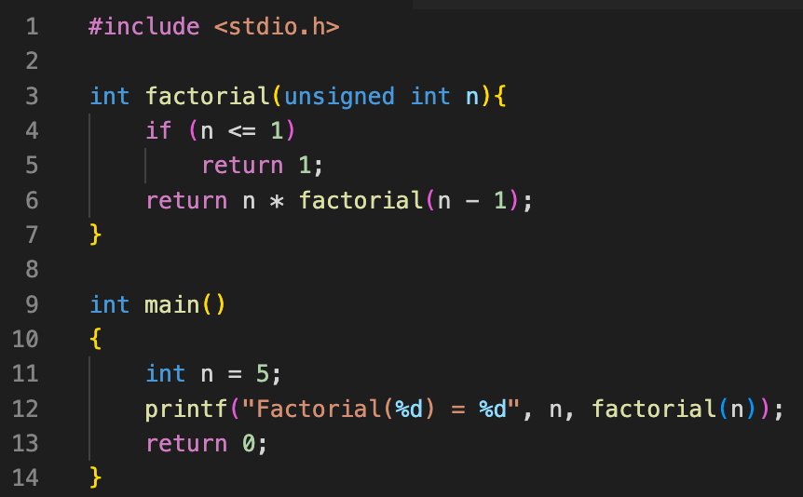
Recursion in Action
Write a recursive function that takes a non-negative integer n as input and calculates the factorial of n.

Slide 6
Recursion in Action
Write a recursive function that takes a non-negative integer n as input and calculates 2^{n}.

Slide 7
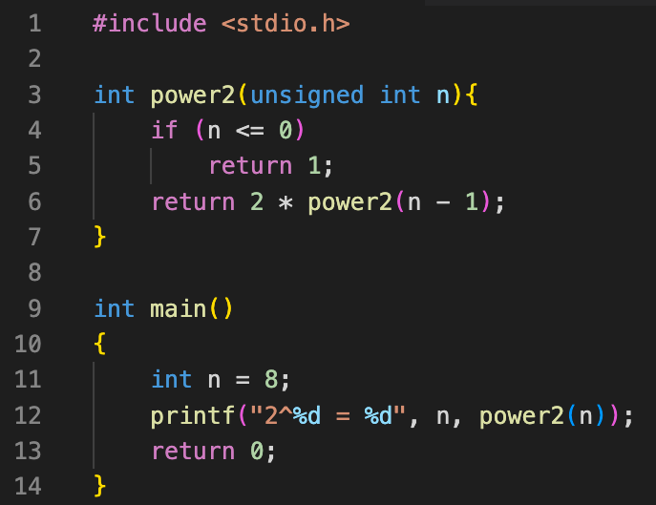
Recursion in Action
Write a recursive function that takes a non-negative integer n as input and calculates 2^{n}.
How many recursive calls does this function make?
Can we do better?

Slide 8
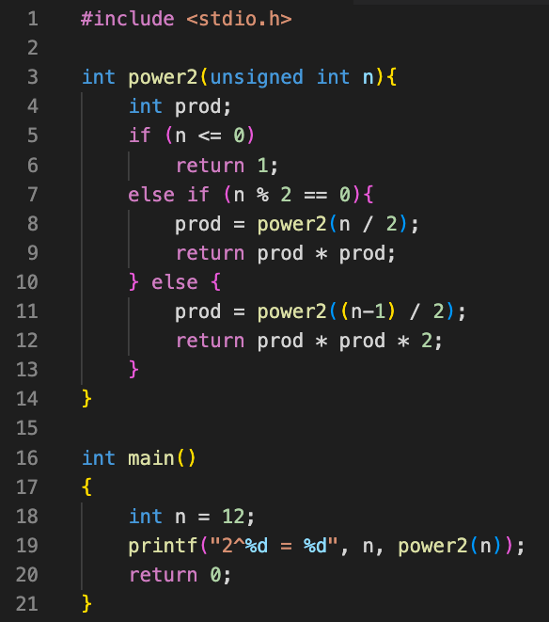
Recursion in Action
Write a recursive function that takes a non-negative integer n as input and calculates 2^{n}.
How many recursive calls does this function make?
Can we do better?
How about now?

Slide 9
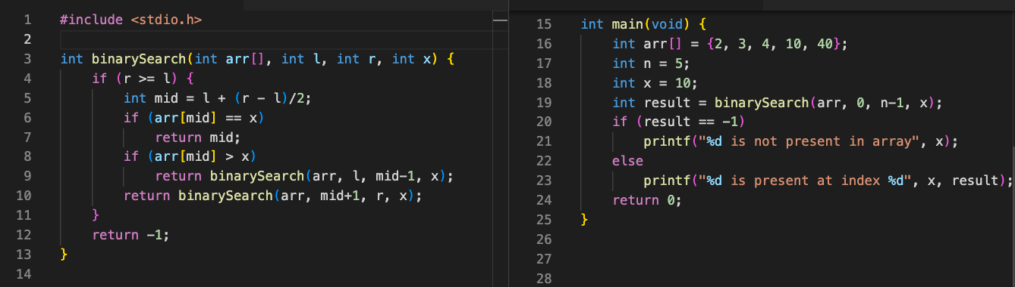
Recursive Binary Search

Slide 10
Tower of Hanoi
Start: (n = 3)
Set up:
3 rods: A, B, C
n rings (1, 2, … n).
Objective: move n rings from A to C with the help of B
Rules:
Move only one ring at a time.
Can not place a larger ring on top of a smaller ring at any given point.
Which and how many moves to reach goal?
3
2
1
A
B
C
Goal:
3
2
1
A
B
C

Slide 11
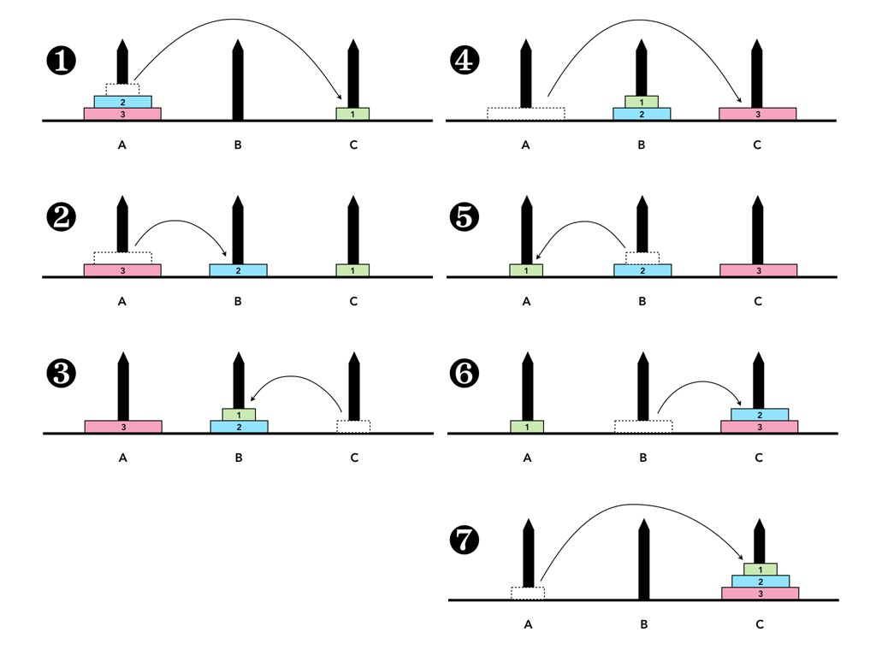
Tower of Hanoi (n = 3)
Which moves? S(n, source, dest)
How many moves? H(n, source, dest)
For n = 3:
S(3, A, C) =
{(1, A, C),
(2, A, B),
(1, C, B),
(3, A, C),
(1, B, A),
(2, B, C),
(1, A, C)}
H(3, A, C) = 7

Slide 12
Tower of Hanoi: Recursive Approach
How to move n rings from A to C with the help of B:
move n-1 rings to B (somehow)
Move ring n to C
Move n-1 rings to C (somehow)
S(n, A, C) = ?? + {(n, A, C)} + ??
H(n, A, C) = ?? + 1 + ??
6
6
5
5
5
5
4
4
3
3
2
2
1
1
A
B
C
A
B
C
Somehow…
Somehow…
Easy
6
6
5
5
5
5
4
4
3
3
1
2
2
1
A
B
C
A
B
C

Slide 13
Tower of Hanoi: Recursive Approach
How to move n rings from A to C with the help of B:
move n-1 rings to B (somehow)
Move ring n to C
Move n-1 rings to C (somehow)
S(n, A, C) = ?? + {(n, A, C)} + ??
H(n, A, C) = ?? + 1 + ??
Steps 1, 3 are smaller versions of the Tower of Hanoi problem.
6
6
5
5
5
5
4
4
3
3
2
2
1
1
A
B
C
A
B
C
Solve for n-1,
A to B
Solve for n-1,
B to C
Easy
6
6
5
5
5
5
4
4
3
3
1
2
2
1
A
B
C
A
B
C

Slide 14
Tower of Hanoi: Recursive Approach
How to move n rings from A to C with the help of B:
Solve ToH for moving n-1 rings from A to B with the help of C
Move ring n to C
Solve ToH for moving n-1 rings from B to C with the help of A
S(n, A, C) = S(n-1, A, B)
+ {(n, A, C)}
+ S(n-1, B, C)
H(n, A, C) = H(n-1, A, B)
+ 1
+ H(n-1, B, C)
Now we have two smaller ToH problems to solve.
6
6
5
5
5
5
4
4
3
3
2
2
1
1
A
B
C
A
B
C
Solve for n-1,
A to B
Solve for n-1,
B to C
Easy
6
6
5
5
5
5
4
4
3
3
1
2
2
1
A
B
C
A
B
C

Slide 15
Tower of Hanoi: Recursive Approach
At each step, we have to solve smaller versions of ToH to solve the bigger one.
When do we stop?
If n = 1, then there is only 1 ring (smallest).
A single move required to move the smallest ring from source to destination.
No more recursion.
6
6
5
5
5
5
4
4
3
3
2
2
1
1
A
B
C
A
B
C
Solve for n-1,
A to B
Solve for n-1,
B to C
Easy
6
6
5
5
5
5
4
4
3
3
1
2
2
1
A
B
C
A
B
C

Slide 16
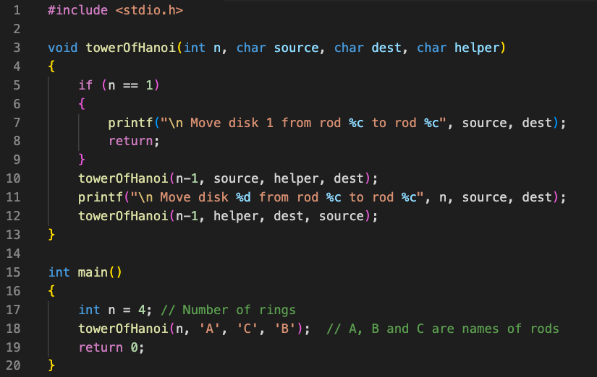
Tower of Hanoi: Recursive Approach

Slide 17
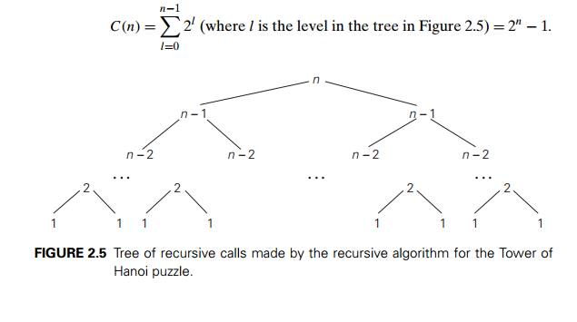
Tower of Hanoi: Time Complexity

