Slide 1
Lecture 03
CS 3843 – Computer Organization

Slide 2

03: Bits, Bytes, and Integers
Book Chapter: 2
C Basics; Bit Level Operations in C; Shift Operations

Slide 3
MUST KNOW
A single 0 or 1 is called a bit. 1011 is four bits. Eight bits, like 11000101, are called a byte
1 byte = 8 bits
4 bytes = 32 bits
8 bytes = 64 bits

Slide 4
Example Data Representations in C
C Data Type | Typical 32-bit | Typical 64-bit | x86-64
char | 1 byte | 1 byte | 1 byte
short | 2 bytes | 2 bytes | 2 bytes
int | 4 bytes | 4 bytes | 4 bytes
long | 4 bytes | 8 bytes | 8 bytes
float | 4 bytes | 4 bytes | 4 bytes
double | 8 bytes | 8 bytes | 8 bytes
 | − | −
pointer | 4 bytes | 8 bytes | 8 bytes

Slide 5
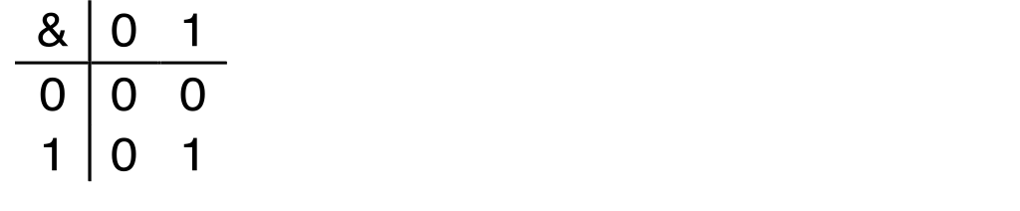
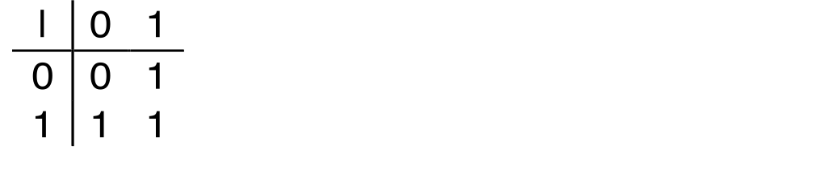
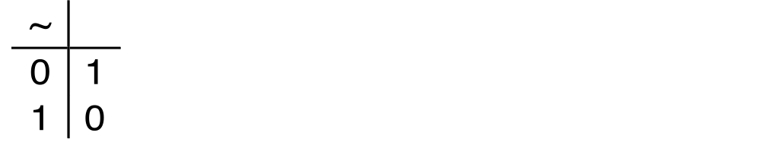
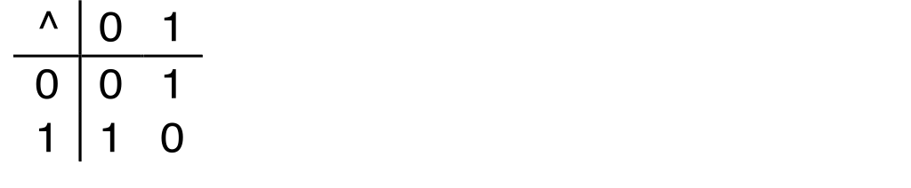
Boolean Algebra
Developed by George Boole in 19th Century
  Algebraic representation of logic
    Encode “True” as 1 and “False” as 0
And
A&B = 1 when both A=1 and B=1
Or
A|B = 1 when either A=1 or B=1
Not
~A = 1 when A=0
Exclusive-Or (Xor)
A^B = 1 when either A=1 or B=1, but not both

Slide 6
General Boolean Algebras
Operate on Bit Vectors
  Operations applied bitwise
01101001
& 01010101
01000001
01101001
| 01010101
01111101
01101001
^ 01010101
00111100
~ 01010101
10101010
01000001
01111101
00111100
10101010

Slide 7
Example: Representing & Manipulating Sets
Representation
  Width w bit vector represents subsets of {0, …, w–1}
  a_{j} = 1 if j ∈ A
    01101001 { 0, 3, 5, 6 }
    76543210
    01010101 { 0, 2, 4, 6 }
    76543210
Operations
  & Intersection 01000001 { 0, 6 }
  | Union 01111101 { 0, 2, 3, 4, 5, 6 }
  ^ Symmetric difference 00111100 { 2, 3, 4, 5 }
  ~ Complement 10101010 { 1, 3, 5, 7 }

Slide 8
Bit-Level Operations in C
Operations &, |, ~, ^ Available in C
Apply to any “integral” data type
long, int, short, char, unsigned
View arguments as bit vectors
Arguments applied bit-wise
Examples
~0x41 -> 0xBE
~010000012 -> 101111102
~0x00 -> 0xFF
~000000002 -> 111111112
0x69 & 0x55 -> 0x41
011010012 & 010101012 -> 010000012
0x69 | 0x55 -> 0x7D
011010012 | 010101012 -> 011111012

Slide 9
Contrast: Logic Operations in C
Contrast to Logical Operators
  &&, ||, !
    View 0 as “False”
    Anything nonzero as “True”
    Always return 0 or 1
    Early termination
Examples (char data type)
  !0x41 -> 0x00
  !0x00 -> 0x01
  !!0x41 -> 0x01
  0x69 && 0x55 -> 0x01
  0x69 || 0x55 -> 0x01
  p && *p (avoids null pointer access)

Slide 10
Contrast: Logic Operations in C
Contrast to Logical Operators
  &&, ||, !
    View 0 as “False”
    Anything nonzero as “True”
    Always return 0 or 1
Examples (char data type)
  !0x41 -> 0x00
  !0x00 -> 0x01
  !!0x41 -> 0x01
  0x69 && 0x55 -> 0x01
  0x69 || 0x55 -> 0x01

Slide 11
Contrast: Logic Operations in C
Contrast to Logical Operators
  &&, ||, !
    View 0 as “False”
    Anything nonzero as “True”
    Always return 0 or 1
    Early termination
Examples (char data type)
  !0x41 -> 0x00
  !0x00 -> 0x01
  !!0x41 -> 0x01
  0x69 && 0x55 -> 0x01
  0x69 || 0x55 -> 0x01
  p && *p (avoids null pointer access)
Watch out for && vs. & (and || vs. |)…
one of the more common oopsies in
C programming

Slide 12
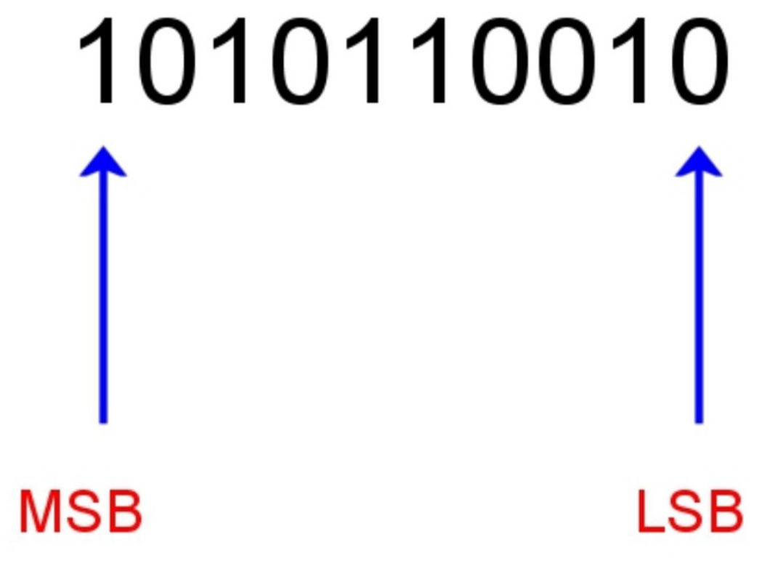
MSB: most significant bit/the leftmost digit
LSB: least significant bit/the rightmost digit

Slide 13
Shift Operations
Left Shift: x << y
Shift bit-vector x left y positions
Throw away extra bits on left
Fill with 0’s on right
Right Shift: x >> y
Shift bit-vector x right y positions
Throw away extra bits on right
Logical shift
Fill with 0’s on left
Arithmetic shift
Replicate most significant bit on left
Undefined Behavior
Shift amount < 0 or ≥ word size
Argument x | 01100010
<< 3 | 00010000
Log. >> 2 | 00011000
Arith. >> 2 | 00011000
00010
011000
011000
Argument x | 10100010
<< 3 | 00010000
Log. >> 2 | 00101000
Arith. >> 2 | 11101000
00010
101000
101000

Slide 14
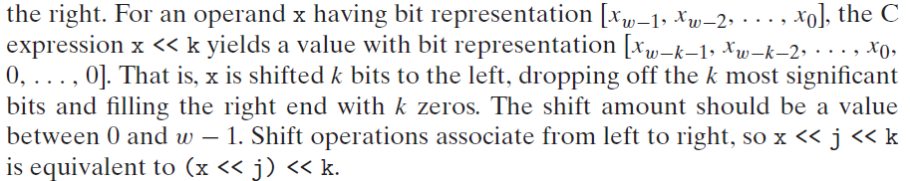
Bit shifting-left

Slide 15

When we represent values in binary, we can do what is
called “shifting” bits either to the right or to the left.
○Left shift example
Binary value:
Left shift 2 places:
0111 0101
1101 0100 (fill with 0’s)

Slide 16
There is a corresponding right shift operation, written in C as x >> k, but it has a slightly subtle behavior. Generally, machines support two forms of right shift
Logical: A logical right shift fills the left end with k zeros, giving a result [0,..., 0, x _{w-1}, x _{w-2},...x_{k} ].
Arithmetic: An arithmetic right shift fills the left end with k repetitions of the most significant bit, giving a result [x_{w-1},...,x_{w-1}, x_{w-1}, x_{w-2},...x_{k}]. This convention might seem peculiar, but as we will see, it is useful for operating on signed integer data.

Slide 17
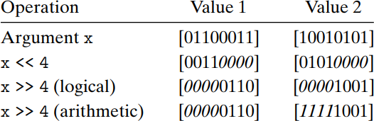
Bit Shifting
The C standards do not precisely define which type of right shift should be used with signed numbers—either arithmetic or logical shifts may be used. This unfortunately means that any code assuming one form or the other will potentially encounter portability problems. In practice, however, almost all compiler/machine combinations use arithmetic right shifts for signed data, and many programmers assume this to be the case. For unsigned data, on the other hand, right shifts must be logical.

Slide 18
C Language Help
1) Head-First C by David Griffiths and Dawn Griffiths

Slide 19
Reading/What to do
Read: Book Chapter 02 (pg 31 to 57)
Take Notes
Explore the related practice problems
Explore the related HW
Explore the related online quiz

