Slide 1
LAB Activities and Grading
Review of the lecture topics and related codes
Some problem solving
2 quizzes – one before midterm, one before final
  10 points each

Slide 2
Complexity Analysis
Informal Review

Slide 3
Complexity
Use a stopwatch (Naive approach).
  Problems:
    Different CPU architecture, CPU load, other factors may affect measurement differently.
    Some programs may take days/months to finish.
Formal approach:
  Analyze the program
  Express time and memory requirement as a function of input size n, f(n).
    Time complexity.
    Space complexity.
Notes:
The naïve approach for measuring the complexity of an algorithm is to measure how long it take using a stopwatch.
But this approach does not work when you consider there are different hardware, cpu architecture, other loads on the cpu.
The formal approach is to analyze the algo and express it as a function of input size n.
U have to analyze two types of complexity of an algo – the time it takes and the total memory it needs.

Slide 4
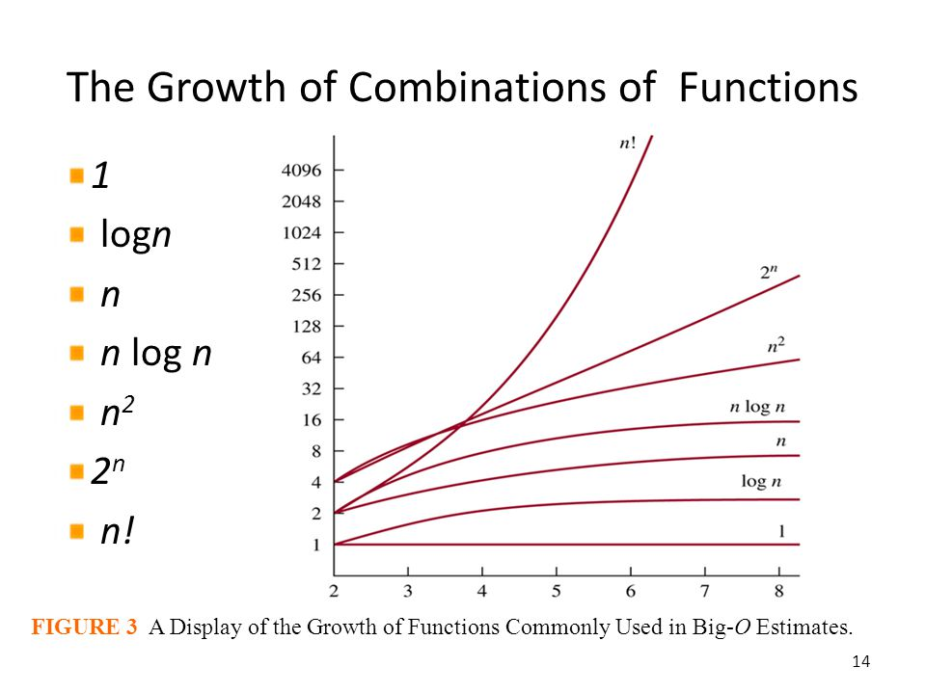
Growth of Functions
Let’s say we have two programs.
First program performs n operations.
Second program performs n² operations.
Which one is faster?
What if the first program performs 1000n operations?
Notes:
When you are analyzing a function based on the input size n, u have to analyze the growth of the functions over input size.
Lets say we have two programs.
One performs n operations.
The second performs n square operations.
So, which one is faster?
What if the first program performs 1000n operations?
If you notice at this graph of growth of function, you will see that after the input size n grows larger than 1000, n squared will always take more time

Slide 5
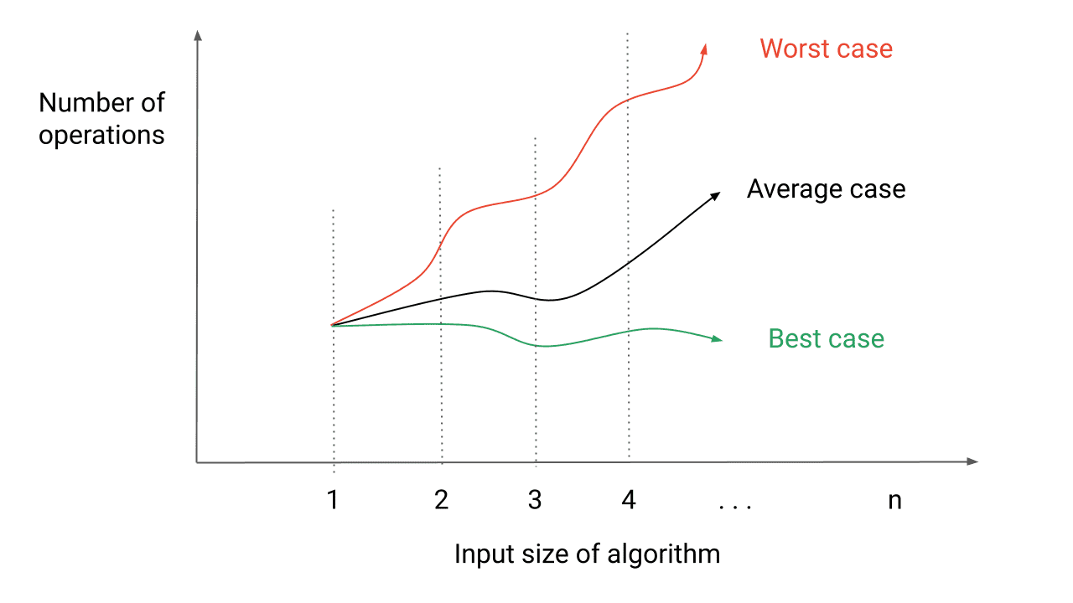
Growth of Functions
For sufficiently large n, n² >= cn for any c >= 1.
In fact, the highest power n will always dominate the growth of f(n).
Big-O: O(f(n)) describes the upper bound of f(n) [worst-case scenario].
Big-Omega: Ω(f(n)) describes the lower bound of f(n) [best-case scenario].
Big-Theta: Θ(f(n)) describes the exact bound of f(n) [both Big-O and Big-Omega].
Informally, Big-O is is usually the highest order term of n in f(n).
f(n) = 10n²+5n+10, O(f(n)) = O(n²)
f(n) = nlogn + n +20, O(f(n)) = O(nlogn)
f(n) = 100 , O(f(n)) = O(1)
Notes:
Overall, when the input size is large enough, a function with n squared in it will always take more time than a function in CN form
The highest power of n in a function will always dominate the growth of the function f(n)
There are different notation to describe the time and space complexity of a function
The big oh notation describes the upper bound of a function – the worst case scenario of it. This is basically the highest power of n in a function.
Big omega notatnio describes the lower bound of a function – which is the best case scenario of a function
And the big theta notation describes the exact bound of a function which is both big oh and big omega. By using big theta you get the average or typical bound of a function.

Slide 6
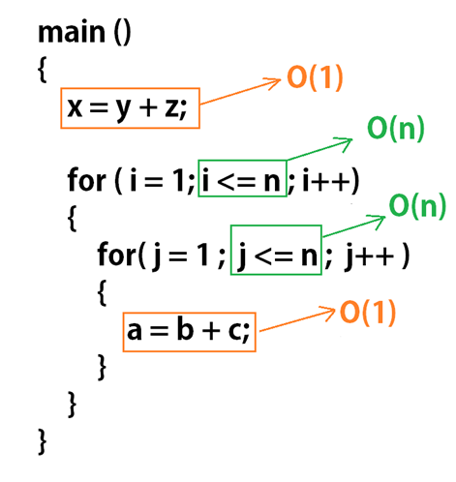
Complexity Analysis
For programs with loops:
We consider nested loops that iterate over n(or some variation of n).
For programs with recursions it is easier to draw a tree, analyze the cost at each tree level, and sum all of them.
Notes:
When analyzing the complexity of program with loops,
When we see nested loops, we consider it iterate over n times and multiply
And when we get program with recursion, calling the same function, it is better to draw a tree of the function calls and then analyze the cost at each tree level and add them all

Slide 7
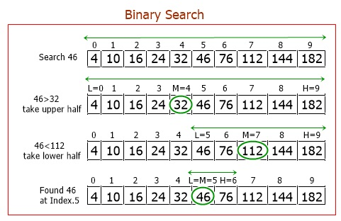
Complexity Analysis(Binary Search)
After every iteration the input array is halved.
Worst case is we find the element at the very last iteration.
How many iterations will it take to reach array size 1?
Time Complexity: O(logn)
Notes:
In a binary search, you search for an item in a sorted array.
After each iteration, the search array size is halved.
So this grows in 2 based log of input size.
In worst case, the element is found at the last iteration stage.
For this example of 10 elements how long would it take?
2 based log of 10 is 3 point something, so it would take max 3 iterations as you can see here.

Slide 8
Complexity Analysis - Sorting Algorithms
Bubble sort
Selection sort
Insertion sort
Merge sort
Quick sort

Slide 9
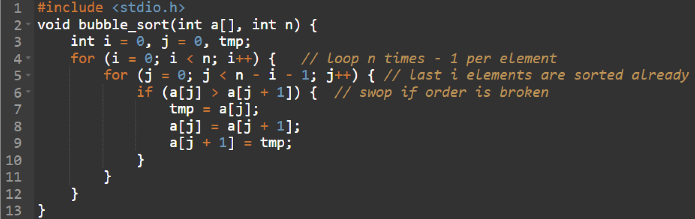
Bubble Sort
Repeatedly traverse the array, compare adjacent elements, and swap if they are in the wrong order.
Time Complexity:
  Best Case: O(n) - when the array is already sorted
  Worst Case: O(n²) - inefficient for larger datasets
  Average Case: O(n²)
Swap based sorting

Slide 10
Selection Sort
Initially sorted part is empty and unsorted part is the whole list
Iterate through the unsorted array, find the minimum element, and swap it with the first unsorted element and move the first element of the unsorted array to sorted list.
Repeat for the remaining unsorted list
Time complexity:
  Best case: O(n²) - comparisons are still made when the array is sorted
  Worst case: O(n²)
In place sorting

Slide 11
Insertion Sort
Iteratively selects an element from the unsorted part and inserts it into its correct position within the sorted sequence.
Time complexity:
  Best case: O(n) – when the array is already sorted and each element needs one comparison
  Worst case: O(n²)
  Average case: O(n²)
In-place sorting

Slide 12
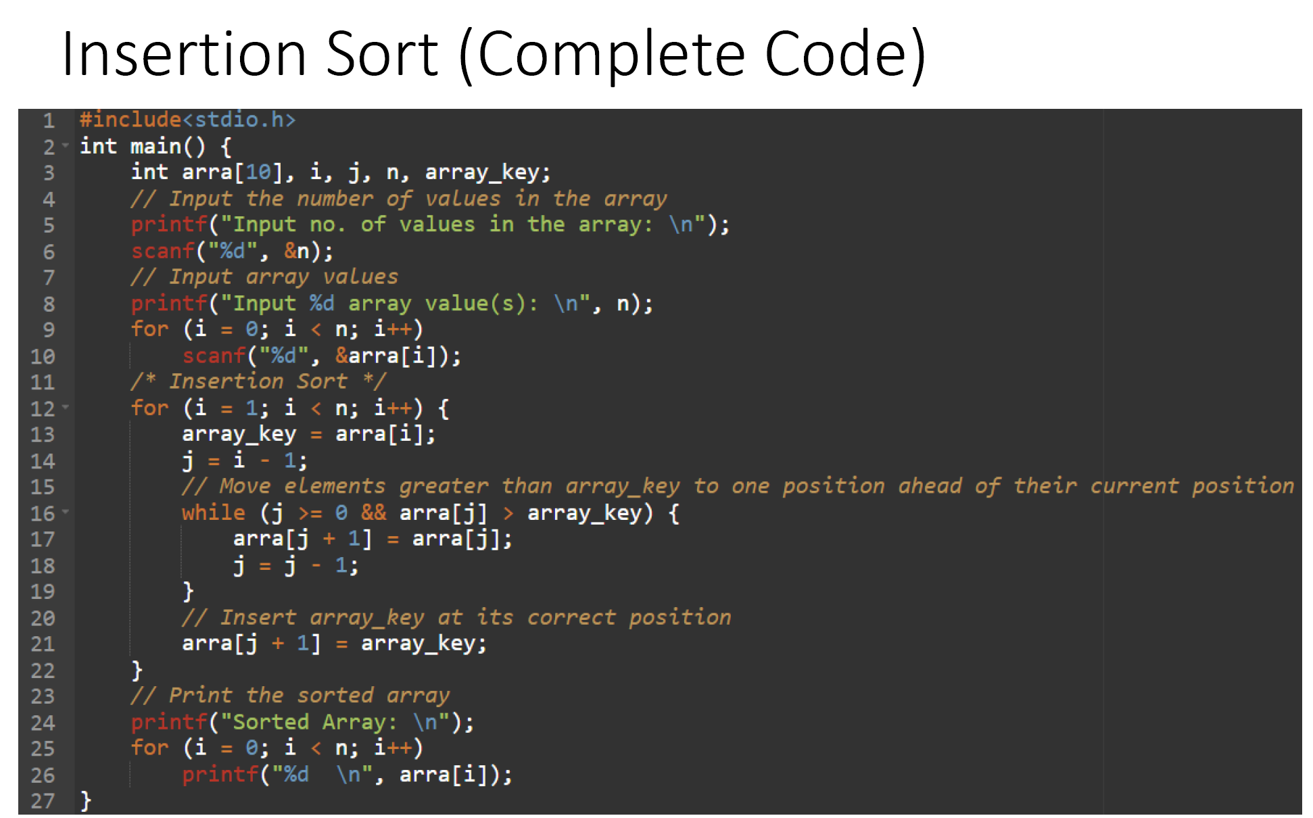

Slide 13
Merge Sort
A divide and conquer algorithm
Each problem is divided into two equally sized subproblems recursively and gets sorted when they are merged.
The merge time of a subproblem of size n is n takes O(n) time
Time complexity:
  Best Case: O(n log n)
  Worst Case: O(n log n)
In-place sorting

Slide 14
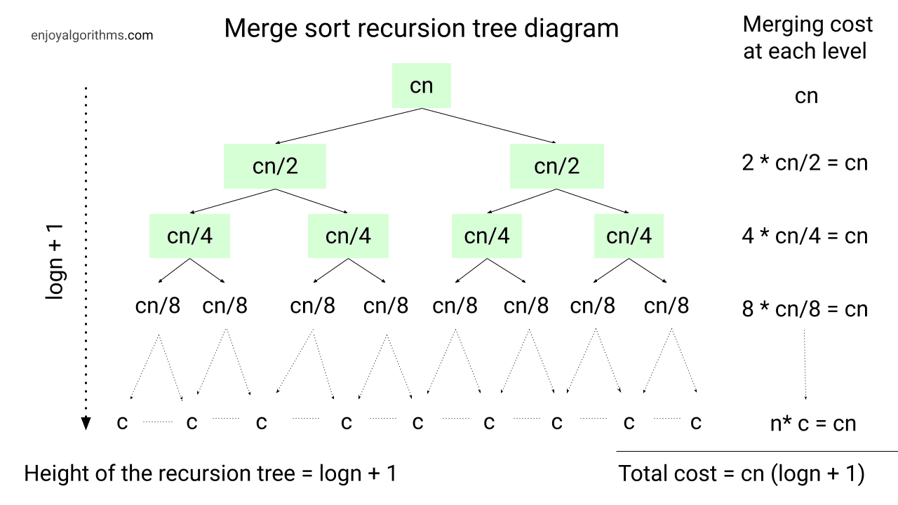
Merge Sort

Slide 15
Quick Sort
A divide and conquer algorithm
Partition the array into two segments based on comparing with a chosen pivot element
Recursively apply the same process to the subarrays
Combine sorted subarrays to produce the sorted array
Time complexity:
  Best Case: O(n log n) - pivot consistently divides the array into almost equal parts
  Worst case: O(n²) - pivot selection leads to unbalanced partitions
  Average Case: O(n log n) - balanced partitioning

Slide 16
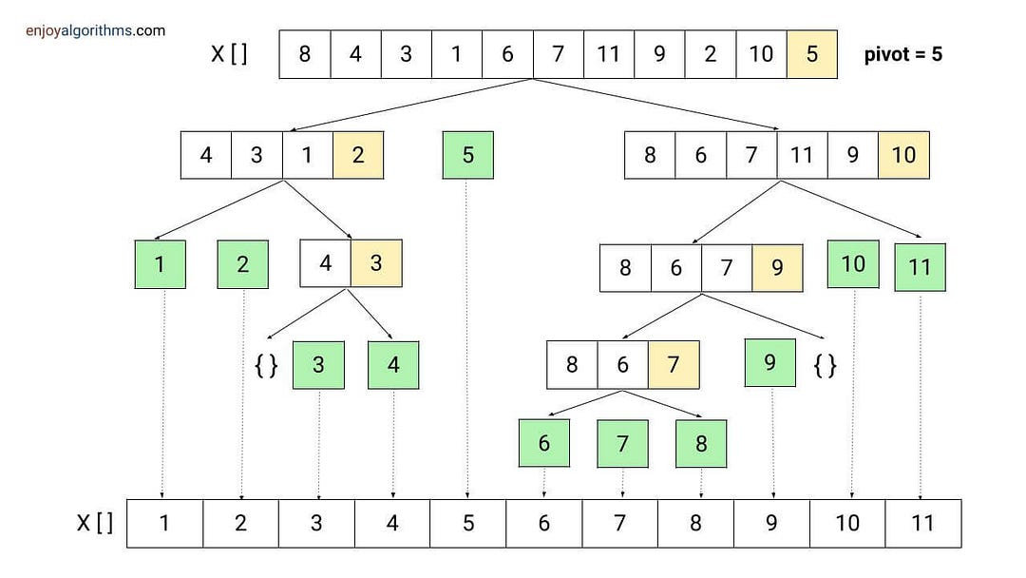
Quick Sort
Each problem is divided into two subproblems.
For balanced partition the the combined cost of each level would be O(n)
The height of the tree would be log(n)

Slide 17
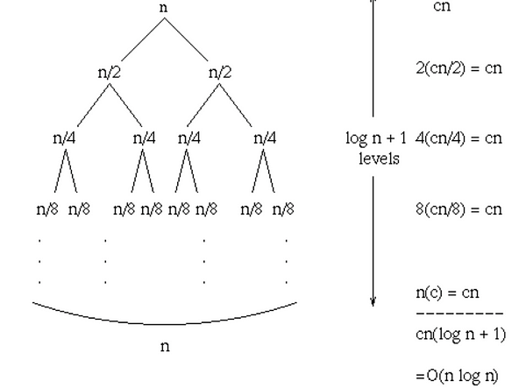
Quick Sort (Average case)
On average each recursion will split the array into roughly two equal halves.

Slide 18
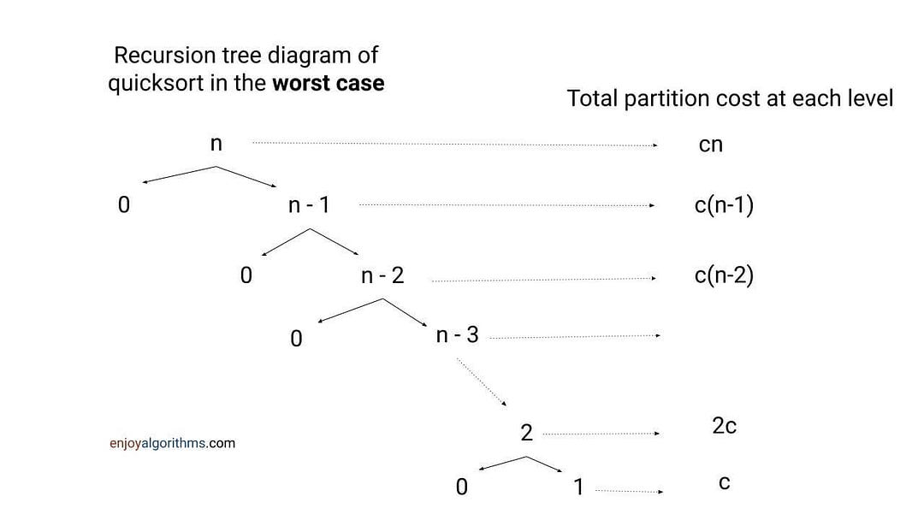
Quick Sort (Worst case)
If the array is already sorted then each split will result in two partitions of size 1 and n-1.

Slide 19
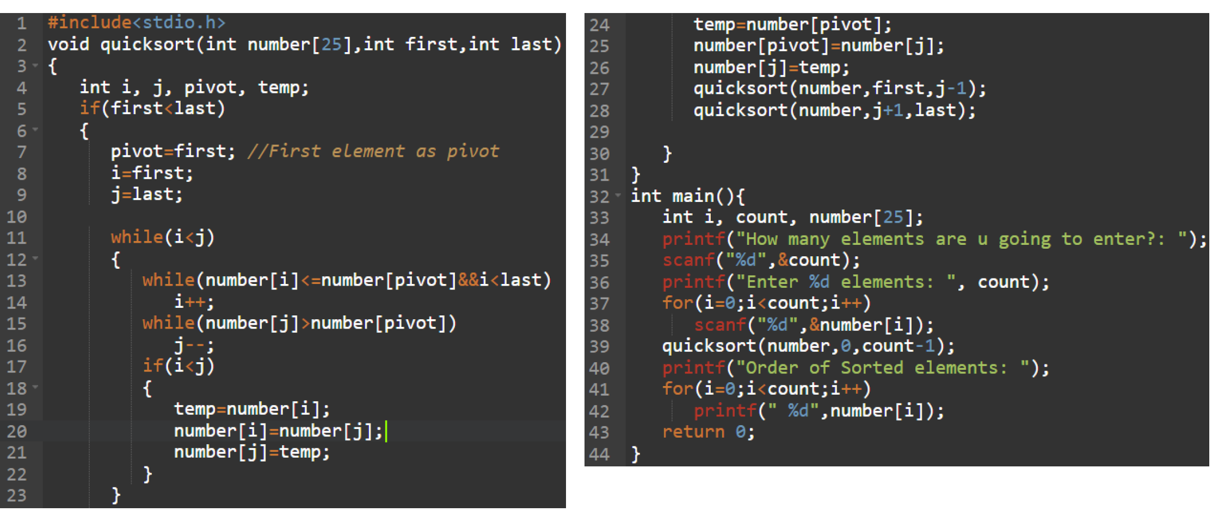

Slide 20
Creating Libraries

Slide 21
Libraries
Libraries in programming languages are collection of prewritten code that users can use and reuse to optimize tasks
This can be files, programs, routines, scripts, functions
This collection of reusable code is targeted for specific common problems
C Library
Header Files
Predefined functions

Slide 22
Header File
C source files that hold the definition of functions and data structures
Tells the compiler how to call some functionality
Contains the function prototypes, data types and constants used with the libraries
Files end in “.h”
Library
Where the actual functionality is implemented
Contain the function body

Slide 23
Library Categories
Static
  Collection of precompiled object files that are linked with a program at compile time
  They become part of the executable
  Location needs to be correct
Shared/Dynamic
  Compiled binaries linked at runtime, allowing code to be shared among multiple programs
  compiled into shared objects (“.so” on Unix/Linux, “.dll” on Windows)
  Memory Efficiency: Loaded into memory once, regardless of the number of programs using them
  Changes to the library don't require recompiling programs.

Slide 24
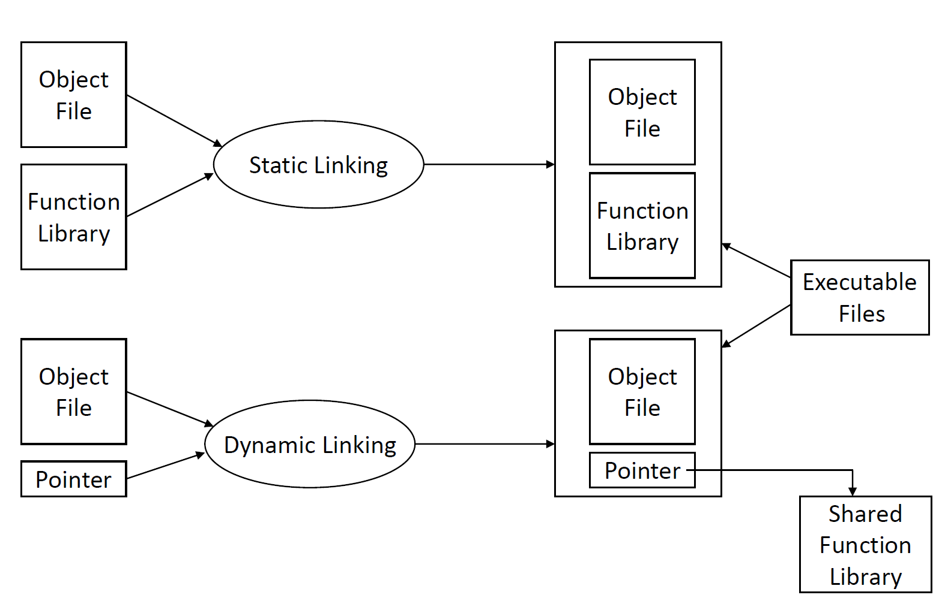
Library vs Header File (Static vs Dynamic)

Slide 25
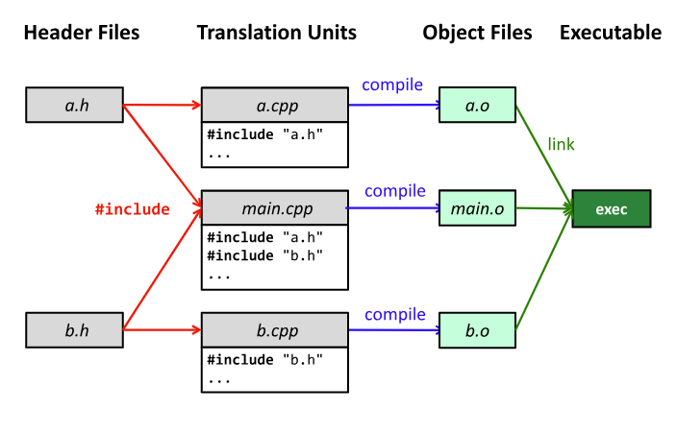

Slide 26
Standard C Library
Common functions that we don’t need to write ourselves
Provides a portable interface to many system calls
Function prototypes declared in standard header files
  #include <stdio.h>
  #include<time.h>
  #include<string.h>
  #include<stdlib.h>
  #include<math.h>

Slide 27
<stdio.h>
File Operations:
  FILE: The structure type representing a file stream.
  fopen(): Opens a file for reading or writing.
  fclose(): Closes a file.
  freopen(): Associates a new file with an existing stream.
Input Functions:
  scanf(): Reads formatted input from the standard input or a file.
  fscanf(): Reads formatted input from a specified file stream.
  sscanf(): Reads formatted input from a string.
Output Functions:
  printf(): Prints formatted output to the standard output.
  fprintf(): Prints formatted output to a specified file stream.
  sprintf(): Prints formatted output to a string.
Character Input/Output:
  getchar(): Reads a character from the standard input.
  putchar(): Writes a character to the standard output.
  fgetc(): Reads a character from a specified file stream.
  fputc(): Writes a character to a specified file stream.
String Input/Output:
  gets(): Reads a line of text from the standard input (deprecated due to security issues).
  fgets(): Reads a line of text from a specified file stream.
  puts(): Writes a string to the standard output.
  fputs(): Writes a string to a specified file stream.
Formatted Output:
  sprintf(): Writes formatted data to a string.
  snprintf(): Writes formatted data to a string with a specified maximum length.

Slide 28
<string.h>
String Manipulation Functions:
  strcpy(): Copies a string.
  strncpy(): Copies a specified number of characters from one string to another.
  strcat(): Concatenates (appends) one string to another.
  strncat(): Concatenates a specified number of characters from one string to another.
  strcmp(): Compares two strings.
  strncmp(): Compares a specified number of characters of two strings.
  strlen(): Returns the length of a string.
  strchr(): Finds the first occurrence of a character in a string.
  strrchr(): Finds the last occurrence of a character in a string.
  strstr(): Finds the first occurrence of a substring in a string.
String Copy and Concatenation with Memory Control:
  memcpy(): Copies a specified number of bytes from one memory location to another.
  memmove(): Copies a specified number of bytes from one memory location to another, handling overlapping regions.
  memset(): Sets a specified number of bytes to a given value.
Tokenization Functions:
  strtok(): Splits a string into tokens based on delimiters.
String Conversion Functions:
  atoi(): Converts a string to an integer.
  atol(): Converts a string to a long integer.
  atof(): Converts a string to a floating-point number.
Dynamic Memory Allocation:
  malloc(): Allocates a specified number of bytes of memory.
  calloc(): Allocates memory for an array of elements, initializing them to zero.
  realloc(): Changes the size of a previously allocated block of memory.
  free(): Deallocates memory previously allocated by malloc, calloc, or realloc.
Other Utility Functions:
  strerror(): Returns a pointer to the textual representation of the current errno value.
  strcmpi() (non-standard): Case-insensitive string comparison.
  strdup() (non-standard): Allocates memory and duplicates a string.
Character Classification:
  isalpha(): Checks if a character is an alphabetic character.
  isdigit(): Checks if a character is a digit.
  isalnum(): Checks if a character is alphanumeric.
  isspace(): Checks if a character is a whitespace character.
Memory Comparison:
  memcmp(): Compares two blocks of memory.

Slide 29
<math.h>
Trigonometric Functions:
  sin(): Sine function.
  cos(): Cosine function.
  tan(): Tangent function.
  asin(): Arcsine function.
  acos(): Arccosine function.
  atan(): Arctangent function.
  atan2(): Arctangent of the quotient of its arguments.
Hyperbolic Functions:
  sinh(): Hyperbolic sine function.
  cosh(): Hyperbolic cosine function.
  tanh(): Hyperbolic tangent function.
  asinh(): Inverse hyperbolic sine function.
  acosh(): Inverse hyperbolic cosine function.
  atanh(): Inverse hyperbolic tangent function.
Exponential and Logarithmic Functions:
  exp(): Exponential function (e^x).
  log(): Natural logarithm.
  log10(): Base-10 logarithm.
Power Functions:
  pow(): Power function.
  sqrt(): Square root function.
  cbrt(): Cube root function.
Rounding and Remainder Functions:
  ceil(): Round up to the nearest integer.
  floor(): Round down to the nearest integer.
  round(): Round to the nearest integer.
  trunc(): Truncate towards zero.
Absolute Value Functions:
  fabs(): Absolute value for floating-point.
  abs(): Absolute value for integers.
Angular and Hyperbolic Functions:
  fmod(): Returns the remainder of the division of two floating-point numbers.
Constants:
  M_PI: Pi (π) constant.
  M_E: Euler's number (e) constant.
  Other constants like M_SQRT2, M_SQRT3, etc.
Miscellaneous Functions:
  hypot(): Euclidean distance function.
  fmax(): Returns the greater of two floating-point numbers.
  fmin(): Returns the smaller of two floating-point numbers.

Slide 30
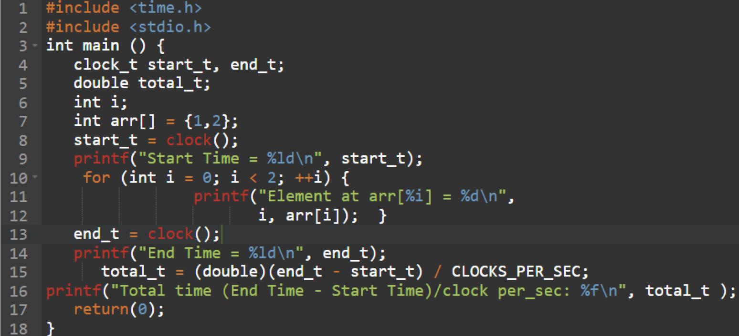
Standard Library Example

Slide 31
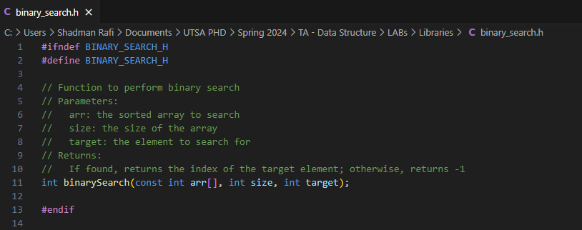
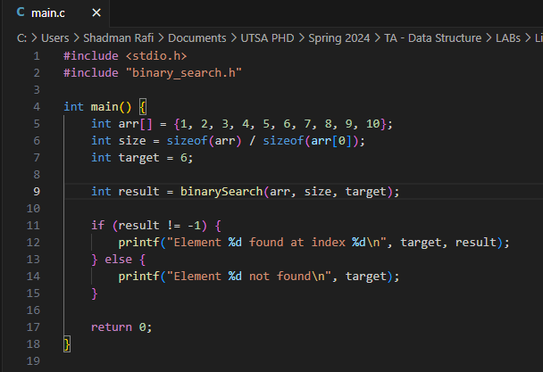
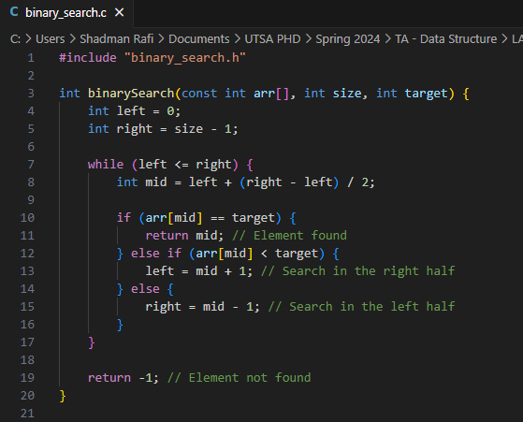
Writing your own library

Slide 32
Lab Work – Sorting and Binary Search:
Get an array of integer, the target integer, then sort the array and find the target using binary search
Create a library for binary search and a sorting algorithm to sort the array and use it in main file
Input:
  First line contains one integer n, the size of the array
  Second line contains n integers a_{i} , elements of the array
  Third line contains the search integer/key m
Output:
  Print the location of the search integer m in the given array. If not found, print -1.
Submit the zipped folder

