Slide 1
Queues and Linked Lists

Slide 2
Queues
We discussed the concept, implementation, and application of Stacks. A queue is another data structure.
A Queue supports the following operations:
enqueue(): add an item to the end of the queue
dequeue(): remove the oldest-inserted item from the queue
peek(): return the oldest-inserted inserted item in the queue without removing it.
In addition, a Queue can support the operations isempty(), isfull(), and peek(), which we added in our stack implementation.
Queue follows the following principle: first-in, first-out (FIFO).

Slide 3
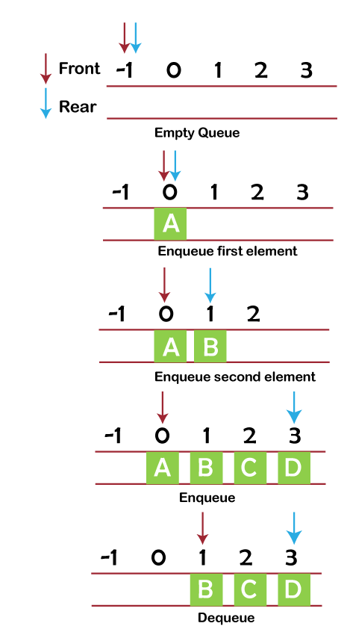
Implementing a Queue
Like Stacks, Queues can be implemented with arrays as well as using other methods.
To implement Queue operations in a C program, we can:
Use an array to store all the items.
Use two integer variables, front and rear to keep track of which item was pushed most/least recently.

Slide 4
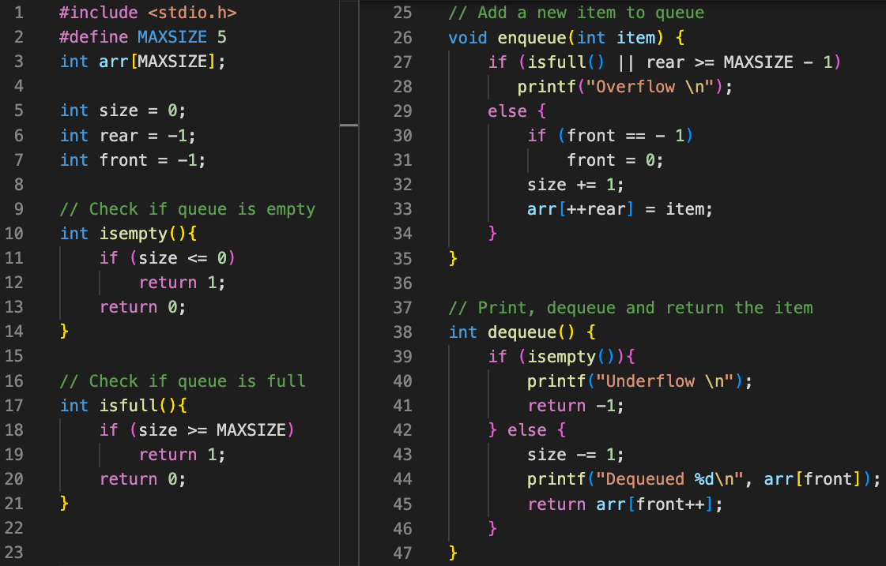
Naive
Implementation

Slide 5
Naive
Implementation
Initially, queue is empty.
↓ indicates front
↓ indicates rear
 | ↓↓
 | -1 | 0 | 1 | 2 | 3 | 4
Queue:

Slide 6
Naive
Implementation
Enqueue 23.
↓ indicates front
↓ indicates rear
 |  | ↓↓
 | -1 | 0 | 1 | 2 | 3 | 4
Queue: |  | 23

Slide 7
Naive
Implementation
Enqueue 18.
↓ indicates front
↓ indicates rear
 |  | ↓ | ↓
 | -1 | 0 | 1 | 2 | 3 | 4
Queue: |  | 23 | 18

Slide 8
Naive
Implementation
Enqueue 46.
↓ indicates front
↓ indicates rear
 |  | ↓ |  | ↓
 | -1 | 0 | 1 | 2 | 3 | 4
Queue: |  | 23 | 18 | 46

Slide 9
Naive
Implementation
Dequeue.
↓ indicates front
↓ indicates rear
 |  |  | ↓ | ↓
 | -1 | 0 | 1 | 2 | 3 | 4
Queue: |  |  | 18 | 46

Slide 10
Naive
Implementation
Enqueue 7.
↓ indicates front
↓ indicates rear
 |  |  | ↓ |  | ↓
 | -1 | 0 | 1 | 2 | 3 | 4
Queue: |  |  | 18 | 46 | 7

Slide 11
Naive
Implementation
Dequeue.
↓ indicates front
↓ indicates rear
 |  |  |  | ↓ | ↓
 | -1 | 0 | 1 | 2 | 3 | 4
Queue: |  |  |  | 46 | 7

Slide 12
Naive
Implementation
Dequeue.
↓ indicates front
↓ indicates rear
 |  |  |  |  | ↓↓
 | -1 | 0 | 1 | 2 | 3 | 4
Queue: |  |  |  |  | 7

Slide 13
Naive
Implementation
Enqueue 51.
↓ indicates front
↓ indicates rear
 |  |  |  |  | ↓ | ↓
 | -1 | 0 | 1 | 2 | 3 | 4
Queue: |  |  |  |  | 7 | 51

Slide 14
Naive
Implementation
Dequeue.
↓ indicates front
↓ indicates rear
 |  |  |  |  |  | ↓↓
 | -1 | 0 | 1 | 2 | 3 | 4
Queue: |  |  |  |  |  | 51

Slide 15
Naive
Implementation
Enqueue 4?
Can not do since
rear == MAXLEN -1.
But we still had space in the array we allocated…
↓ indicates front
↓ indicates rear
 |  |  |  |  |  | ↓↓
 | -1 | 0 | 1 | 2 | 3 | 4
Queue: |  |  |  |  |  | 51

Slide 16
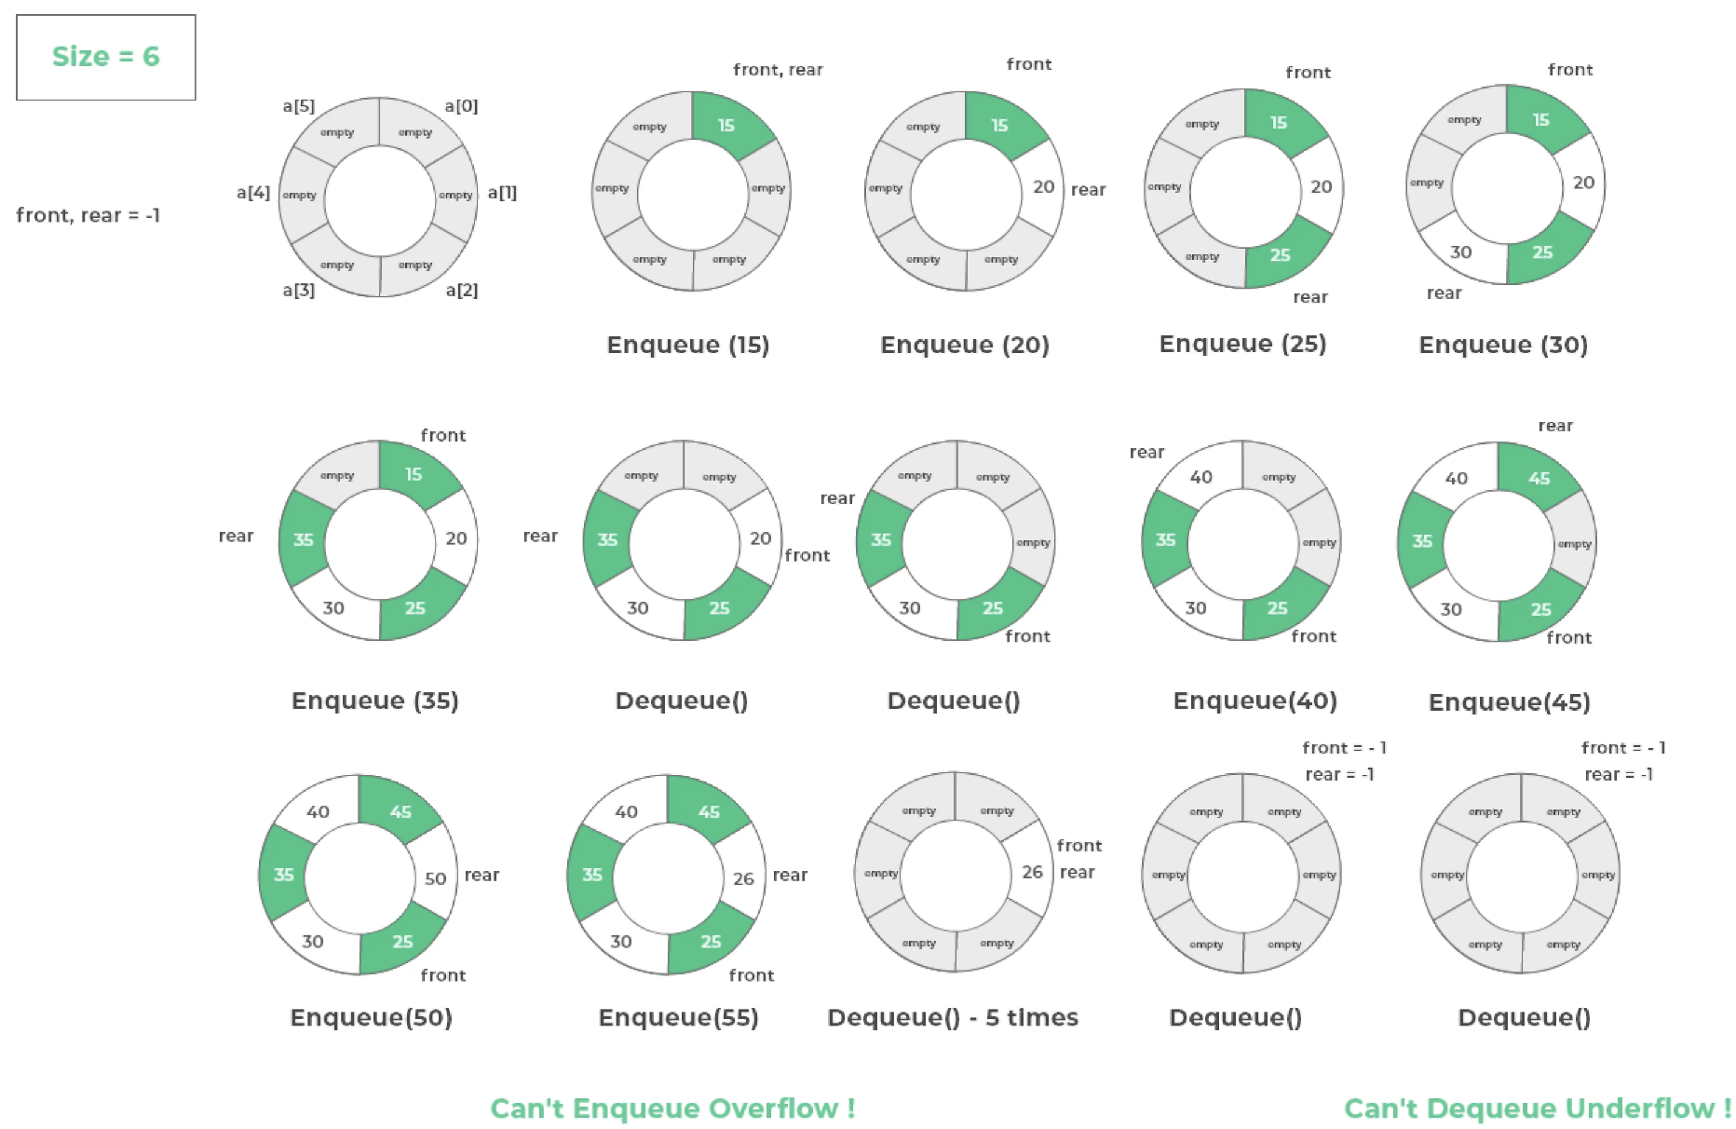
Circular Queues
A circular queue “wraps around”.
No overflow unless all of the memory is used up.
Can still be implemented using arrays (with clever management of front, rear and size).

Slide 17
Linked Lists
A Linked List is a linear data structure, in which the elements are not stored at “contiguous” memory locations.
But why?
Let’s first think about arrays, in which the elements are stored in contiguous locations.
This makes it easy to access elements. If we know the address of the first item in memory, the second item is right next to it (and so on).
 | 0 | 1 | 2 | 3 | 4 | 5 | 6 | 7
Array: | 12 | 45 | 21 | 33 | 89 | 74

Slide 18
Linked Lists
A Linked List is a linear data structure, in which the elements are not stored at “contiguous” memory locations.
But why?
Let’s first think about arrays, in which the elements are stored in contiguous locations.
This makes it easy to access elements. If we know the address of the first item in memory, the second item is right next to it (and so on).
But what if we want to insert
something in the middle?
Insert 11 at index 2
 | 0 | 1 | 2 | 3 | 4 | 5 | 6 | 7
Array: | 12 | 45 | 11 | 21 | 33 | 89 | 74
 | “Move over!”

Slide 19
Linked Lists
Linked lists allow elements to be stored in memory without having to place them next to each other.
This approach has certain advantages.
But how do we keep track of where the elements are stored?
Solution: each element (node) has two components:
Actual data
Whereabouts (memory address) of the next item
Node
Head
Data | Next
Data | Next
Data | Next
Data | NULL

Slide 20
Linked Lists
memory
1020
1024
1028
Linked lists allow elements to be stored in memory without having to place them next to each other.
This approach has certain advantages.
But how do we keep track of where the elements are stored?
Solution: each element (node) has two components:
Actual data
Whereabouts (memory address) of the next item
Keep in mind: visual representations of linked list may differ from reality.
2 | 4156
3344
3348
334C
3350
1 | 1024
4 | NULL
4152
4156
415A
3 | 334C
1 | Next
2 | Next
3 | Next
4 | NULL

Slide 21
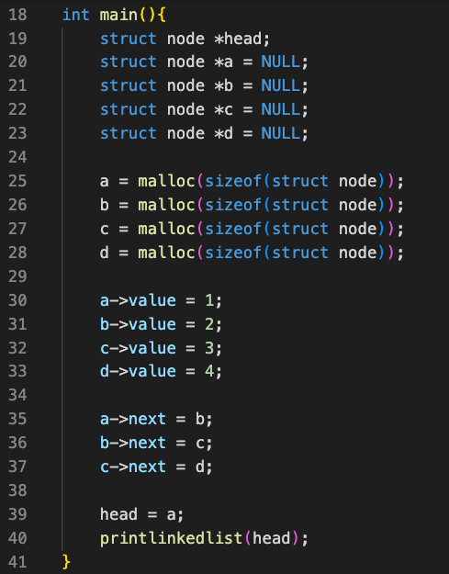
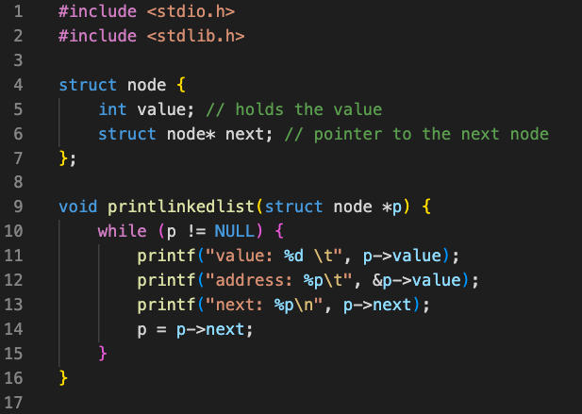
Implementing a Linked List
Structures+Pointers particularly suitable for Linked List implementation.
Memory must be allocated explicitly using malloc.

Slide 22
Linked List Operations
Traversal: covered in previous slide.
Insertion:
1. Create new node.
2. Update pointers.
No need to move other nodes!
9 | Next
1 | Next
2 | Next
3 | Next
4 | NULL
9 | Next
1 | Next
2 | Next
3 | Next
4 | NULL

Slide 23
Linked List Operations
Deletion:
Update pointers.
What if we are deleting head/tail?
What happens to the deleted node?
Ignore deleted node (can be dangerous if done repeatedly, memory leak).
Call free() and explicitly relinquish memory used by deleted node.
1 | Next
2 | Next
3 | Next
4 | NULL
1 | Next
2 | Next
3 | Next
4 | NULL

Slide 24
Lab Activity
Balanced parenthesis checking using circular queue:
Implement circular queue using linked list
Check if any given parenthesis sequence is balanced using circular queue
Input:
  A string s with length <100 containing a sequence of parenthesis
Output:
  “True” if the input sequence is balanced, “False” otherwise

