Slide 1

06: Bits, Bytes, and Integers
Book Chapter: 02
Integer Arithmetic Operations

Slide 2
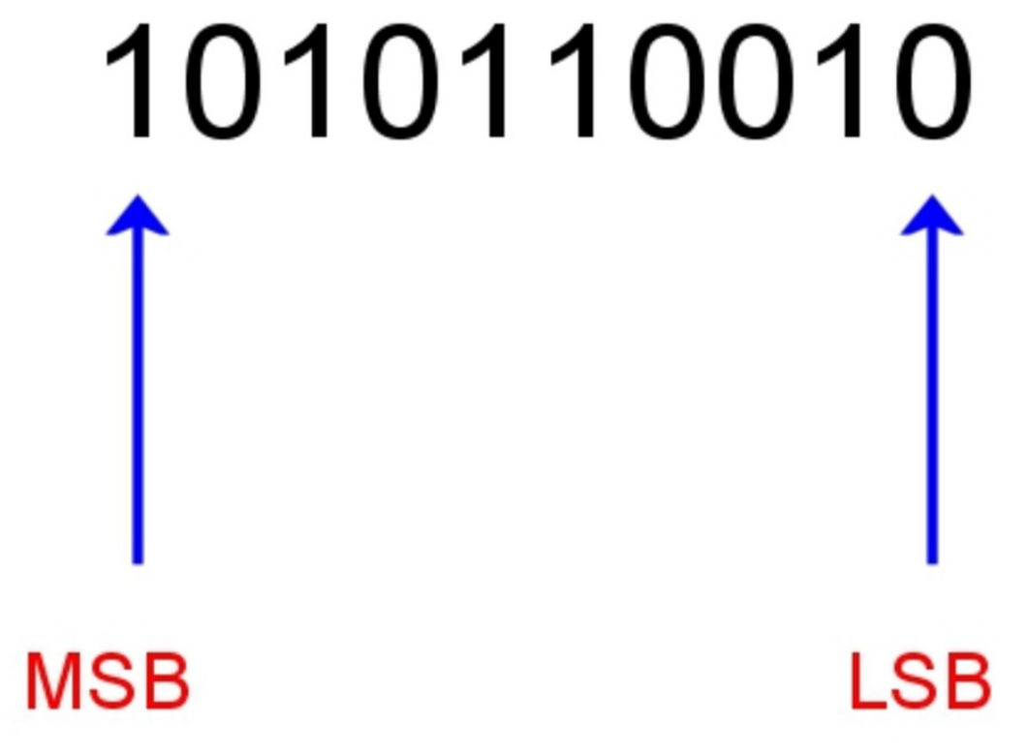
MSB: most significant bit/the leftmost digit
LSB: least significant bit/the rightmost digit

Slide 3
Unsigned Addition
u
Operands: w bits
• • •
+
v
• • •
True Sum: w+1 bits
u + v
• • •
Discard Carry: w bits
UAdd_{w}(u , v)
• • •
Standard Addition Function
  Ignores carry output
Implements Modular Arithmetic
  s = UAdd_{w}(u , v) = u + v mod 2^{w}

Slide 4
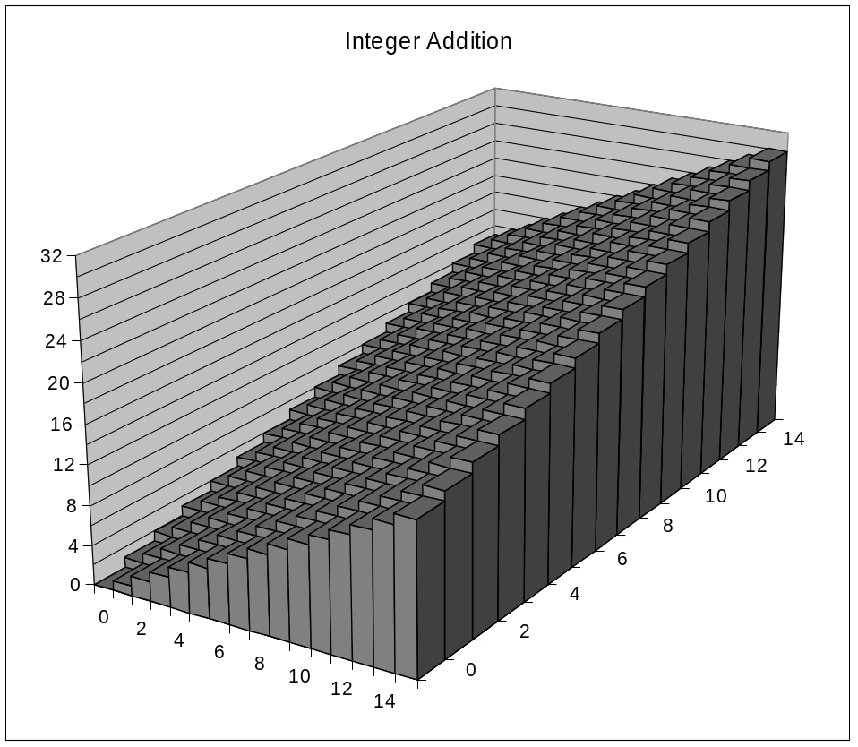
Visualizing (Mathematical) Integer Addition
Integer Addition
  4-bit integers u, v
  Compute true sum Add₄(u , v)
  Values increase linearly with u and v
  Forms planar surface
Add₄(u , v)
v
u

Slide 5
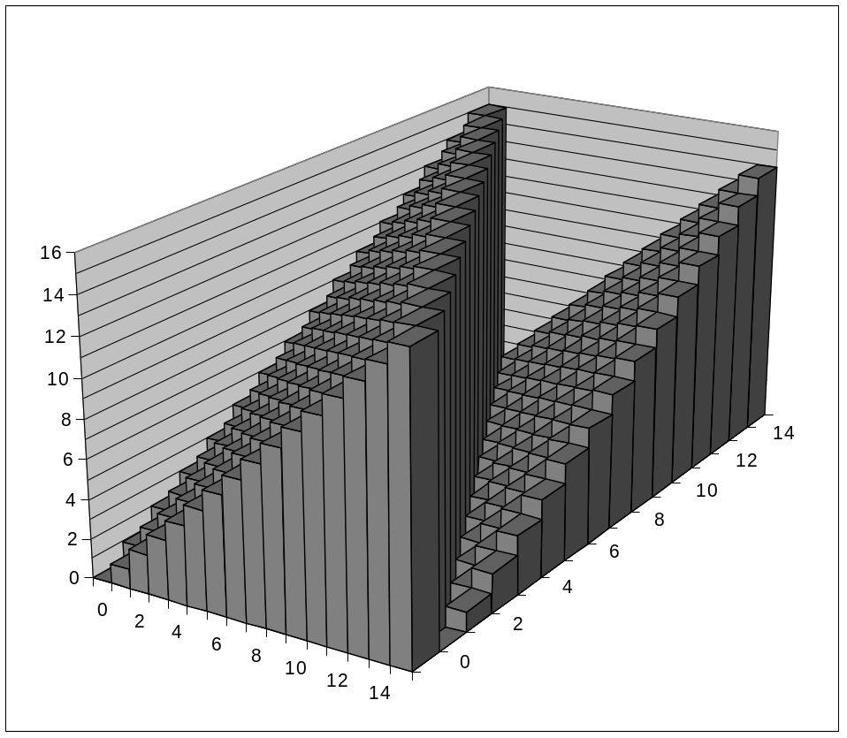
Visualizing Unsigned Addition
Wraps Around
  If true sum ≥ 2^{w}
  At most once
Overflow
UAdd₄(u , v)
True Sum
2^{w+1}
Overflow
2^{w}
v
0
Modular Sum
u

Slide 6
Two’s Complement Addition
Operands: w bits
u
• • •
+
v
• • •
True Sum: w+1 bits
u + v
• • •
Discard Carry: w bits
TAdd_{w}(u , v)
• • •
TAdd and UAdd have Identical Bit-Level Behavior
  Signed vs. unsigned addition in C:
  int s, t, u, v;
  s = (int) ((unsigned) u + (unsigned) v);
  t = u + v
  Will give s == t

Slide 7
TAdd Overflow
Functionality
  True sum requires w+1 bits
  Drop off MSB
  Treat remaining bits as 2’s comp. integer
True Sum
0 111…1
2^{w}–1
PosOver
TAdd Result
0 100…0
2^{w –1}–1
011…1
0 000…0
0
000…0
1 011…1
–2^{w –1}
100…0
1 000…0
–2^{w}
NegOver

Slide 8
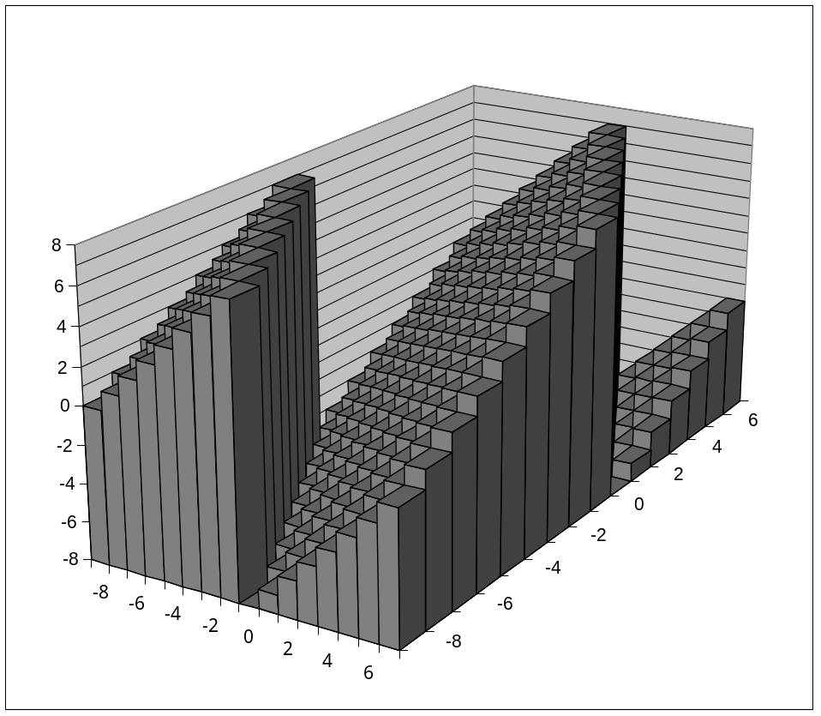
Visualizing 2’s Complement Addition
NegOver
Values
  4-bit two’s comp.
  Range from -8 to +7
Wraps Around
  If sum ≥ 2^{w–1}
    Becomes negative
    At most once
  If sum < –2^{w–1}
    Becomes positive
    At most once
TAdd₄(u , v)
v
u
PosOver

Slide 9
Negative Overflow: When you added two negative numbers and get a positive number as a result
Positive Overflow: When you added two positive numbers and get a negative number as a result
3rd Case: When the 2’s complement sum equals the integer sum x+y.

Slide 10
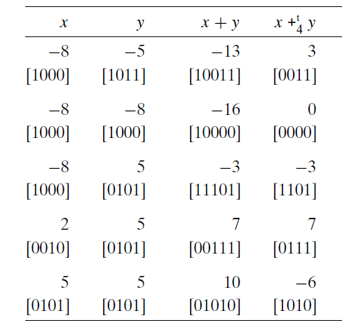
Negative Overflow
Negative Overflow
Positive Overflow
Two’s-complement addition examples. The bit-level representation of
the 4-bit two’s-complement sum can be obtained by performing binary addition of the
operands and truncating the result to 4 bits.

Slide 11
Multiplication
Goal: Computing Product of w-bit numbers x, y
  Either signed or unsigned
But, exact results can be bigger than w bits
  Unsigned: up to 2w bits
    Result range: 0 ≤ x * y ≤ (2^{w} – 1) ² = 2^{2w} – 2^{w+1} + 1
  Two’s complement min (negative): Up to 2w-1 bits
    Result range: x * y ≥ (–2^{w–1})*(2^{w–1}–1) = –2^{2w–2} + 2^{w–1}
  Two’s complement max (positive): Up to 2w bits, but only for (TMin_{w})²
    Result range: x * y ≤ (–2^{w–1}) ² = 2^{2w–2}
So, maintaining exact results…
  would need to keep expanding word size with each product computed
  is done in software, if needed
    e.g., by “arbitrary precision” arithmetic packages

Slide 12
Unsigned Multiplication in C
u
• • •
Operands: w bits
*
v
• • •
True Product: 2*w bits
u · v
• • •
• • •
UMult_{w}(u , v)
Discard w bits: w bits
• • •
Standard Multiplication Function
  Ignores high order w bits
Implements Modular Arithmetic
  UMult_{w}(u , v) = u · v mod 2^{w}

Slide 13
Signed Multiplication in C
u
• • •
Operands: w bits
*
v
• • •
True Product: 2*w bits
u · v
• • •
• • •
TMult_{w}(u , v)
Discard w bits: w bits
• • •
Standard Multiplication Function
  Ignores high order w bits
  Some of which are different for signed vs. unsigned multiplication
  Lower bits are the same

Slide 14
Power-of-2 Multiply with Shift
Operation
  u << k gives u * 2^{k}
  Both signed and unsigned
Examples
  u << 3 == u * 8
  (u << 5) – (u << 3) == u * 24
  Most machines shift and add faster than multiply
    Compiler generates this code automatically
k
u
• • •
Operands: w bits
*
2^{k}
0
•••
0
1
0
•••
0
0
True Product: w+k bits
u · 2^{k}
• • •
0
•••
0
0
Discard k bits: w bits
UMult_{w}(u , 2^{k})
•••
0
•••
0
0
TMult_{w}(u , 2^{k})

Slide 15
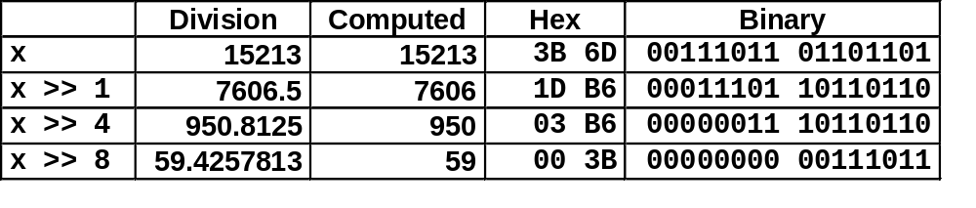
Unsigned Power-of-2 Divide with Shift
Quotient of Unsigned by Power of 2
  u >> k gives ⎣ u / 2^{k} ⎦
  Uses logical shift
k
u
•••
•••
Binary Point
Operands:
/
2^{k}
0
•••
0
1
0
•••
0
0
Division:
u / 2^{k}
0
.
0
•••
0
0
•••
•••
Result:
⎣ u / 2^{k} ⎦
0
0
•••
0
0
•••

Slide 16
Arithmetic: Basic Rules
Addition:
  Unsigned/signed: Normal addition followed by truncate,
  same operation on bit level
  Unsigned: addition mod 2^{w}
    Mathematical addition + possible subtraction of 2^{w}
  Signed: modified addition mod 2^{w} (result in proper range)
    Mathematical addition + possible addition or subtraction of 2^{w}
Multiplication:
  Unsigned/signed: Normal multiplication followed by truncate, same operation on bit level
  Unsigned: multiplication mod 2^{w}
  Signed: modified multiplication mod 2^{w} (result in proper range)

Slide 17
Why Should I Use Unsigned?
Don’t use without understanding implications
  Easy to make mistakes
    unsigned i;
    for (i = cnt-2; i >= 0; i--)
    a[i] += a[i+1];
  Can be very subtle
    #define DELTA sizeof(int)
    int i;
    for (i = CNT; i-DELTA >= 0; i-= DELTA)
    . . .

Slide 18
Negation: Complement & Increment
Claim: Following Holds for 2’s Complement
  ~x + 1 == -x
Complement
  Observation: ~x + x == 1111…111 == -1
Complete Proof?
x
1
0
0
1
1
1
0
1
+
~x
0
1
1
0
0
0
1
0
-1
1
1
1
1
1
1
1
1

Slide 19
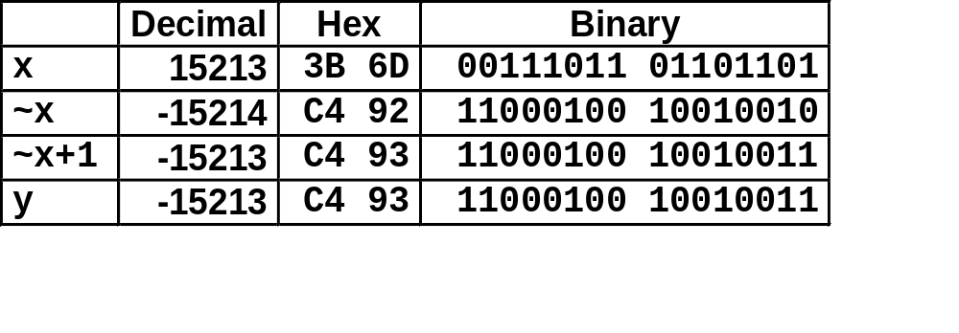
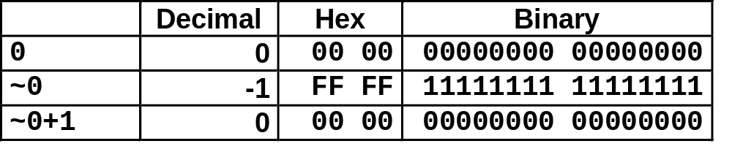
Complement & Increment Examples
x = 15213
x = 0

Slide 20
Notes
C supports both signed and unsigned
Java only supports signed (2’s complement form)
Adding two positive number can yield a negative result
The comparison x<y can yield a different result than the comparison x-y <0.
You can get a negative number as result by multiplying two positive numbers.
Real life arithmetic and computer arithmetic are not same
These properties are artifacts of the finite nature of computer arithmetic
Understanding the nuances of computer arithmetic can help programmers write more reliable code.

Slide 21
Notes
Asymmetry – keep that in mind always
Test your cases with Tmin/Tmax/Umax/0/1/-1
T w-bit two’s complement sum of two numbers has the exact same bit-level representation as the unsigned sum. In fact, most computers use the same machine instruction to perform either unsigned or unsigned addition
The bit-level representation of the product operation is identical for both unsigned and 2’s complement multiplication

Slide 22
Notes
Historically, the integer multiply instruction on many machines was fairly slow, requiring 10 or more clock cycles, whereas other integer operations—such as addition, subtraction, bit-level operations, and shifting—required only 1 clock cycle. Even on the Intel Core i7 Haswell we use as our reference machine, integer multiply requires 3 clock cycles. As a consequence, one important optimization used by compilers is to attempt to replace multiplications by constant factors with combinations of shift and addition operations.
Integer division on most machines is even slower than integer multiplication—requiring 30 or more clock cycles.

Slide 23
Read: Book Chapter 02 (pg 84 to 107)
Take Notes
Explore the related practice problems
Explore the related HW
Explore the related online quiz

