Slide 1
Part 03: Lecture 01: Computer Organization and Systems

Slide 2
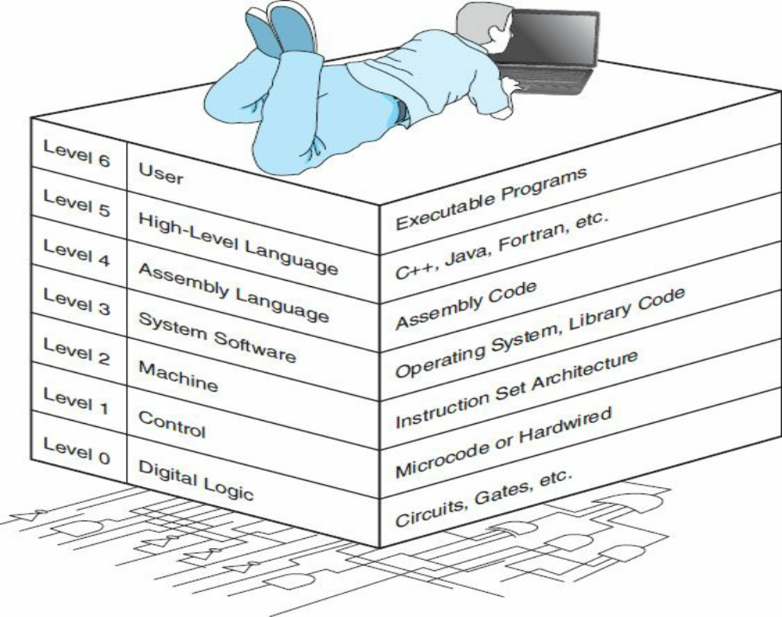
THE COMPUTER LEVEL HIERARCHY

Slide 3
THE COMPUTER LEVEL HIERARCHY
Level 6, the User Level, is composed of applications and is the level with which everyone is most familiar. At this level, we run programs such as word processors, graphics packages, or games. The lower levels are nearly invisible from the User Level.
Level 5, the High-Level Language Level, consists of languages such as C, C++, Fortran, Lisp, Pascal, and Prolog. These languages must be translated (using either a compiler or an interpreter) to a language the machine can understand. Compiled languages are translated into assembly language and then assembled into machine code. (They are translated to the next lower level.) The user at this level sees very little of the lower levels. Even though a programmer must know about data types and the instructions available for those types, he or she need not know about how those types are actually implemented.

Slide 4
THE COMPUTER LEVEL HIERARCHY
Level 4, the Assembly Language Level, encompasses some type of assembly language. As previously mentioned, compiled higher-level languages are first translated to assembly, which is then directly translated to machine language. This is a one-to-one translation, meaning that one assembly language instruction is translated to exactly one machine language instruction. By having separate levels, we reduce the semantic gap between a high-level language, such as C++, and the actual machine language (which consists of 0s and 1s).
Level 3, the System Software Level, deals with operating system instructions. This level is responsible for multiprogramming, protecting memory, synchronizing processes, and various other important functions. Often, instructions translated from assembly language to machine language are passed through this level unmodified.

Slide 5
THE COMPUTER LEVEL HIERARCHY
Level 2, the Instruction Set Architecture (ISA), or Machine Level, consists of the machine language recognized by the particular architecture of the computer system. Programs written in a computer’s true machine language on a hardwired computer (see below) can be executed directly by the electronic circuits without any interpreters, translators, or compilers.
Level 1, the Control Level, is where a control unit makes sure that instructions are decoded and executed properly and that data is moved where and when it should be. The control unit interprets the machine instructions passed to it, one at a time, from the level above, causing the required actions to take place. Control units can be designed in one of two ways: They can be hardwired or they can be microprogrammed.

Slide 6
THE COMPUTER LEVEL HIERARCHY
Level 0, the Digital Logic Level, is where we find the physical components of the computer system: the gates and wires. These are the fundamental building blocks, the implementations of the mathematical logic, that are common to all computer systems.

Slide 7
THE VON NEUMANN MODEL
Today’s version of the stored-program machine architecture satisfies at least the following
characteristics:
• Consists of three hardware systems: A central processing unit (CPU) with a control unit, an arithmetic logic unit (ALU), registers (small storage areas), and a program counter; a main memory system, which holds programs that control the computer’s operation; and an I/O system.
• Capacity to carry out sequential instruction processing.
• Contains a single path, either physically or logically, between the main memory system and the control unit of the CPU, forcing alternation of instruction and execution cycles. This single path is often referred to as the von Neumann bottleneck.

Slide 8
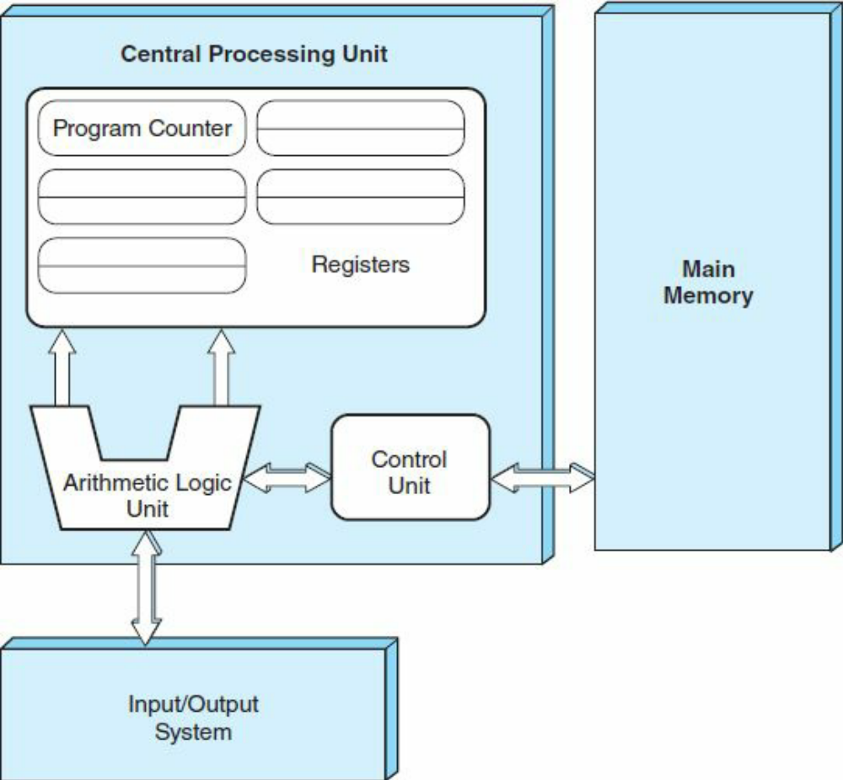
THE VON NEUMANN MODEL
Figure shows how these features work together in modern computer systems. Notice that the system shown in the figure passes all of its I/O through the arithmetic logic unit (actually, it passes through the accumulator, which is part of the ALU).
This architecture runs programs in what is known as the von Neumann execution cycle (also called the fetch-decode-execute cycle), which describes how the machine works.

Slide 9
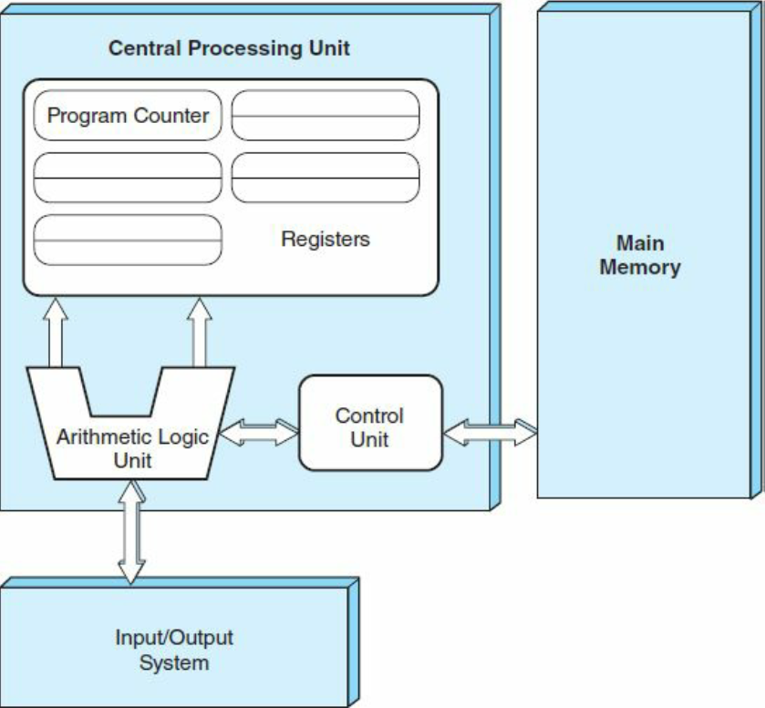
THE VON NEUMANN MODEL
One iteration of the cycle (fetch-decode-execute cycle) is as follows:
1. The control unit fetches the next program instruction from the memory, using the program counter to determine where the instruction is located.
2. The instruction is decoded into a language the ALU can understand.
3. Any data operands required to execute the instruction are fetched from memory and placed in registers in the CPU.
4. The ALU executes the instruction and places the results in registers or memory.

Slide 10
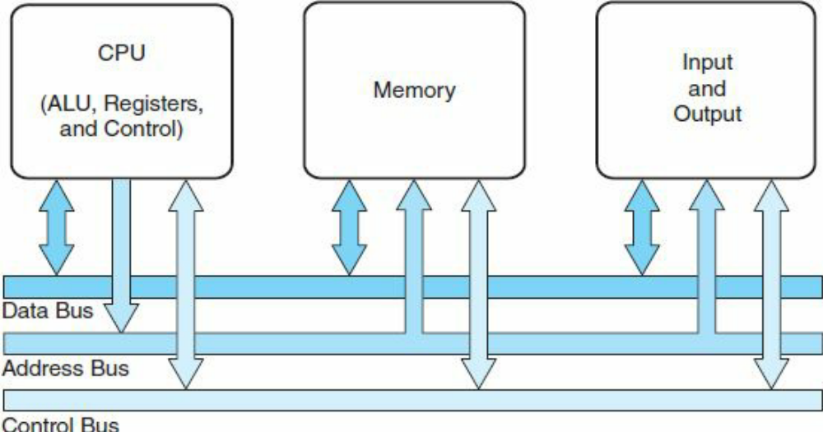
THE VON NEUMANN MODEL
The ideas present in the von Neumann architecture have been extended so that programs and data stored in a slow-to-access storage medium, such as a hard disk, can be copied to a fast-access, volatile storage medium such as RAM prior to execution.
This architecture has also been streamlined into what is currently called the system bus model, which is shown in Figure
The data bus moves data from main memory to the CPU registers (and vice versa).
The address bus holds the address of the data that the data bus is currently accessing.
The control bus carries the necessary control signals that specify how the information transfer is to take place.

Slide 11
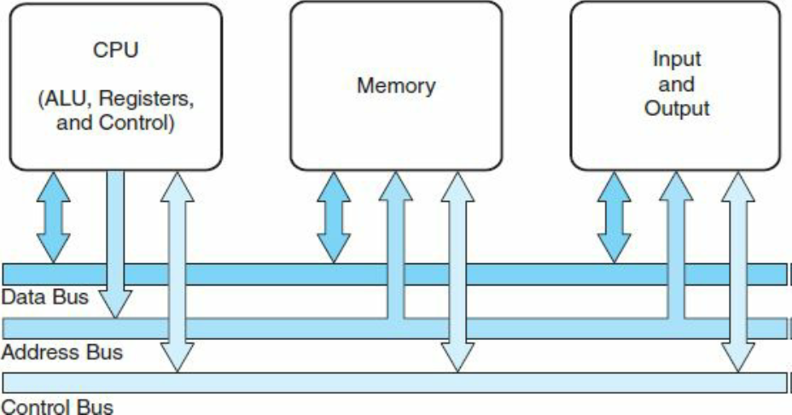
THE VON NEUMANN MODEL
Other enhancements to the von Neumann architecture include using index registers for addressing, adding floating-point data, using interrupts and asynchronous I/O, adding virtual memory, and adding general registers.

Slide 12
NON–VON NEUMANN MODELS
An architecture that does not store programs and data in memory or does not process a program sequentially would be considered a non–von Neumann machine.
A computer that has two buses, one for data and a separate one for instructions, would be considered a non–von Neumann machine. Computers designed using the Harvard architecture have two buses, thus allowing data and instructions to be transferred simultaneously, but also have separate storage for data and instructions.
Many modern general-purpose computers use a modified version of the Harvard architecture in which they have separate pathways for data and instructions but not separate storage.
Pure Harvard architectures are typically used in microcontrollers (an entire computer system on a chip), such as those found in embedded systems, as in appliances, toys, and cars.

Slide 13
NON–VON NEUMANN MODELS
Other non–von Neumann computers include digital signal processors (DSPs) and media processors, which can execute a single instruction on a set of data (instead of executing a single instruction on a single piece of data).
A number of different subfields fall into the non–von Neumann category, including neural networks (using ideas from models of the brain as a computing paradigm) implemented in silicon, cellular automata, cognitive computers (machines that learn by experience rather than through programming, including IBM’s SyNAPSE computer, a machine that models the human brain), quantum computation (a combination of computing and quantum physics), dataflow computation, and parallel computers.
These all have something in common—the computation is distributed among different processing units that act in parallel. They differ in how weakly or strongly the various components are connected. Of these, parallel computing is currently the most popular.

Slide 14
NON–VON NEUMANN MODELS
We have very few programming languages for the remaining (nonparallel) non–von Neumann platforms, and fewer people who really understand how to program in these environments efficiently. Examples of non–von Neumann languages include Lucid (for dataflow) and QCL (Quantum Computation Language) for quantum computers, as well as VHDL or Verilog (languages used to program FPGAs).

Slide 15
Reference
[1] The essentials of Computer Organization and Architecture (4th Ed) by Linda Null and Julia Lobur
[2] Computer Organization and Design: The Hardware Software Interface –(RISC V edition) by David A. Patterson and John L. Hennessy

Slide 16
CPU
Datapath
Control Unit

Slide 17
Central Processing Unit
Data Path: is a network of storage units (registers) and arithmetic and logic units (for performing various operations on data) connected by buses (capable of moving data from place to place) where the timing is controlled by clocks.
Control Unit: A module responsible for sequencing operations and making sure the correct data are where they need to be at the correct time.
Together, these components perform the tasks of the CPU: fetching instructions, decoding them,
and finally performing the indicated sequence of operations. The performance of a machine is directly affected by the design of the datapath and the control unit.

Slide 18
The Registers
Registers are used in computer systems as places to store a wide variety of data, such as addresses, program counters, and data necessary for program execution.
Put simply, a register is a hardware device that stores binary data.
Registers are located on the processor so information can be accessed very quickly.
D flip-flops can be used to implement registers. One D flipflop is equivalent to a 1-bit register, so a collection of D flip-flops is necessary to store multi-bit values. For example, to build a 16-bit register, we need to connect 16 D flip-flops together.
These collections of flip-flops must be clocked to work in unison. At each pulse of the clock, input enters the register and cannot be changed (and thus is stored) until the clock pulses again.

Slide 19
The Registers
Data processing on a computer is usually done on fixed-size binary words stored in registers. Therefore, most computers have registers of a certain size. Common sizes include 16, 32, and 64 bits.
The number of registers in a machine varies from architecture to architecture, but is typically a power of 2, with 16, 32, and 64 being most common. Registers contain data, addresses, or control information. Some registers are specified as “special purpose” and may contain only data, only addresses, or only control information. Other registers are more generic and may hold data, addresses, and control information at various times.
Information is written to registers, read from registers, and transferred from register to register.
Registers are not addressed in the same way memory is addressed (recall that each memory word has a unique binary address beginning with location 0). Registers are addressed and manipulated by the control unit itself.

Slide 20
The Registers
In modern computer systems, there are many types of specialized registers: registers to store information, registers to shift values, registers to compare values, and registers that count. There are “scratchpad” registers that store temporary values, index registers to control program looping, stack pointer registers to manage stacks of information for processes, status (or flag) registers to hold the status or mode of operation (such as overflow, carry, or zero conditions), and general-purpose registers that are the registers available to the programmer.
Most computers have register sets, and each set is used in a specific way. For example, the Pentium architecture has a data register set and an address register set. Certain architectures have very large sets of registers that can be used in quite novel ways to speed up execution of instructions.

Slide 21
Arithmetic Logic Unit (ALU)
The arithmetic logic unit (ALU) carries out the logic operations (such as comparisons) and arithmetic operations (such as add or multiply) required during the program execution.
Generally, an ALU has two data inputs and one data output.
Operations performed in the ALU often affect bits in the status register (bits are set to indicate actions such as whether an overflow has occurred). The ALU knows which operations to perform because it is controlled by signals from the control unit.

Slide 22
The Control Unit
The control unit is the “policeman” or “traffic manager” of the CPU. It monitors the execution of all instructions and the transfer of all information.
The control unit extracts instructions from memory, decodes these instructions, making sure data are in the right place at the right time, tells the ALU which registers to use, services interrupts, and turns on the correct circuitry in the ALU for the execution of the desired operation.
The control unit uses a program counter register to find the next instruction for execution and a status register to keep track of overflows, carries, borrows, and the like.

Slide 23


Slide 24
The INPUT/OUTPUT Subsystem
Input and output (I/O) devices allow us to communicate with the computer system. I/O is the transfer of data between primary memory and various I/O peripherals.
Input devices such as keyboards, mice, card readers, scanners, voice recognition systems, and touch screens allow us to enter data into the computer.
Output devices such as monitors, printers, plotters, and speakers allow us to get information from the computer.

Slide 25
The INPUT/OUTPUT Subsystem
These devices are not connected directly to the CPU. Instead, there is an interface that handles the data transfers. This interface converts the system bus signals to and from a format that is acceptable to the given device. The CPU communicates to these external devices via I/O registers.
This exchange of data is performed in two ways.
In memory-mapped I/O, the registers in the interface appear in the computer’s memory map and there is no real difference between accessing memory and accessing an I/O device. Clearly, this is advantageous from the perspective of speed, but it uses up memory space in the system.
In instruction-based I/O, the CPU has specialized instructions that perform the input and output. Although this does not use memory space, it requires specific I/O instructions, which implies that it can be used only by CPUs that can execute these specific instructions.
Interrupts play a very important part in I/O, because they are an efficient way to notify the CPU that input or output is available for use.

Slide 26
The Bus
The CPU communicates with the other components via a bus. A bus is a set of wires that acts as a shared but common datapath to connect multiple subsystems within the system.
It consists of multiple lines, allowing the parallel movement of bits. Buses are low cost but very versatile, and they make it easy to connect new devices to each other and to the system.
At any one time, only one device (be it a register, the ALU, memory, or some other component) may use the bus. However, this sharing often results in a communications bottleneck. The speed of the bus is affected by its length as well as by the number of devices sharing it.
A bus can be point-to-point, connecting two specific component or it can be a common pathway that connects a number of devices, requiring these devices to share the bus

Slide 27
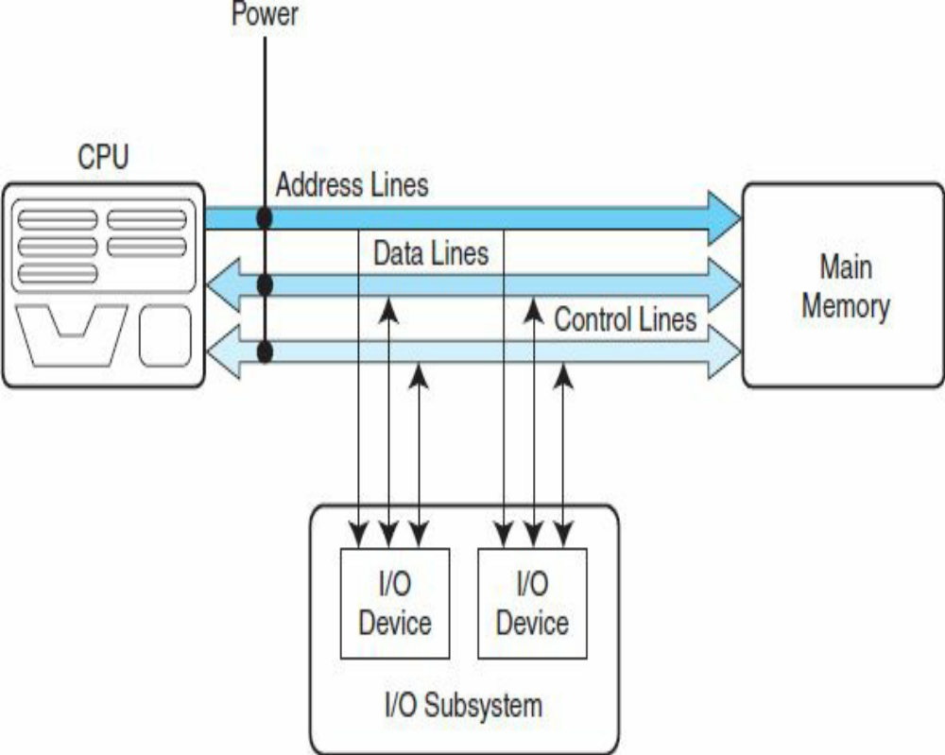
The Bus
A typical bus consisting of data lines, address lines, control lines, and power lines. Often the lines of a bus dedicated to moving data are called the data bus. These data lines contain the actual information that must be moved from one location to another.
Control lines indicate which device has permission to use the bus and for what purpose (reading or writing from memory or from an input/output [I/O] device, for example). Control lines also transfer acknowledgments for bus requests, interrupts, and clock synchronization signals. Address lines indicate the location (e.g., in memory) that the data should be either read from or written to.
The power lines provide the electrical power necessary. Typical bus transactions include sending an address (for a read or write), transferring data from memory to a register (a memory read), and transferring data to the memory from a register (a memory write).
In addition, buses are used for I/O reads and writes from peripheral devices. Each type of transfer occurs within a bus cycle, the time between two ticks of the bus clock.

Slide 28
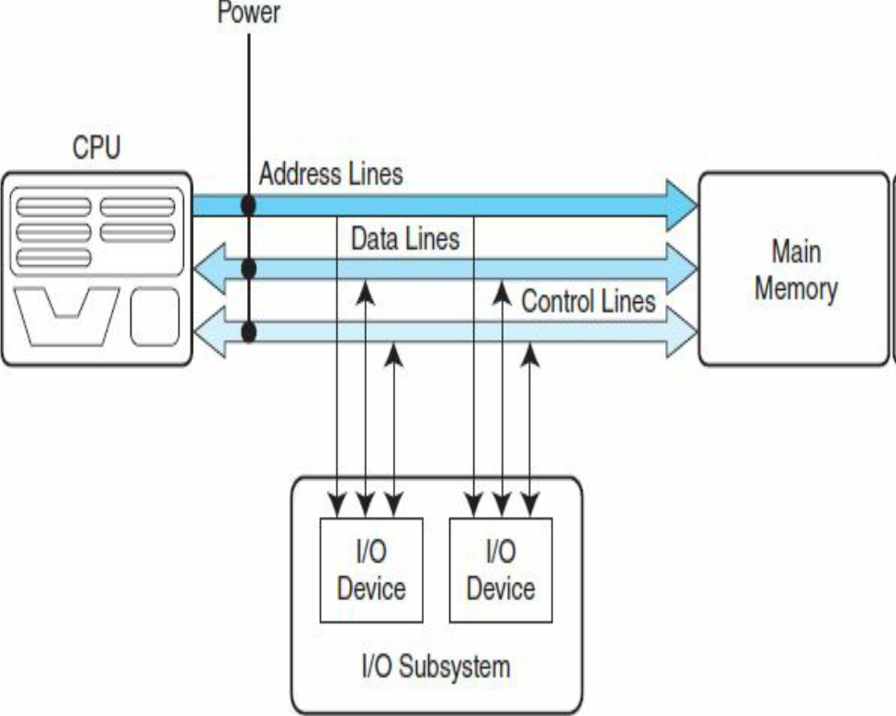
The Bus
Processor-memory buses are short, high-speed buses that are closely matched to the memory system on the machine to maximize the bandwidth (transfer of data) and are usually design specific.
I/O buses are typically longer than processor-memory buses and allow for many types of devices with varying bandwidths. These buses are compatible with many different architectures.
A backplane bus is actually built into the chassis of the machine and connects the processor, the I/O devices, and the memory (so all devices share one bus). Many computers have a hierarchy of buses, so it is not uncommon to have two buses (e.g., a processor-memory bus and an I/O bus) or more in the same system.
High-performance systems often use all three types of buses.

Slide 29
What Programmers Need to Know
Programmers interested in performance now need to understand the issues that have replaced the simple memory model of the 1960s: the parallel nature of processors and the hierarchical nature of memories.
Today’s programmers need to worry about energy efficiency of their programs running either on the PMD or in the Cloud, which also requires understanding what is below your code.
Programmers who seek to build competitive versions of software will therefore need to increase their knowledge of computer organization.

Slide 30
Understanding Program Performance
The performance of a program depends on a combination of the effectiveness of the:
algorithms used in the program
the software systems used to create and translate the program into machine instructions
the effectiveness of the computer in executing those instructions, which may include input/output (I/O) operations.

Slide 31
Understanding Program Performance
Algorithm | Determines both the number of source-level statements and the number of I/O operations executed
Programming language, compiler, and architecture | Determines the number of computer instructions for each source-level statement
Processor and memory system | Determines how fast instructions can be executed
I/O system (hardware and operating system) | Determines how fast I/O operations may be executed

Slide 32
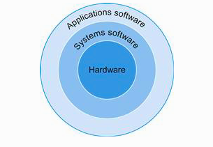
Below your program
There are many types of systems software, but two types of systems software are central to every computer system today: an operating system and a compiler. An operating system interfaces between a user’s program and the hardware and provides a variety of services and supervisory functions. Among the most important functions are:
■ Handling basic input and output operations
■ Allocating storage and memory
■ Providing for protected sharing of the computer among multiple applications using it simultaneously.”
Compilers perform another vital function: the translation of a program written in a high-level language, such as C, C++, Java, or Visual Basic into instructions that the hardware can execute. Given the sophistication of modern programming languages and the simplicity of the instructions executed by the hardware, the translation from a high-level language program to hardware instructions is complex.

Slide 33
Below your program
To actually speak to electronic hardware, you need to send electrical signals. The easiest signals for computers to understand are on and off, and so the computer alphabet is just two letters.
Just as the 26 letters of the English alphabet do not limit how much can be written, the two letters of the computer alphabet do not limit what computers can do.
The two symbols for these two letters are the numbers 0 and 1, and we commonly think of the computer language as numbers in base 2, or binary numbers. We refer to each “letter” as a binary digit or bit.
Computers will listen to our commands, which are called instructions. Instructions, which are just collections of bits that the computer understands and obeys, can be thought of as numbers.

Slide 34
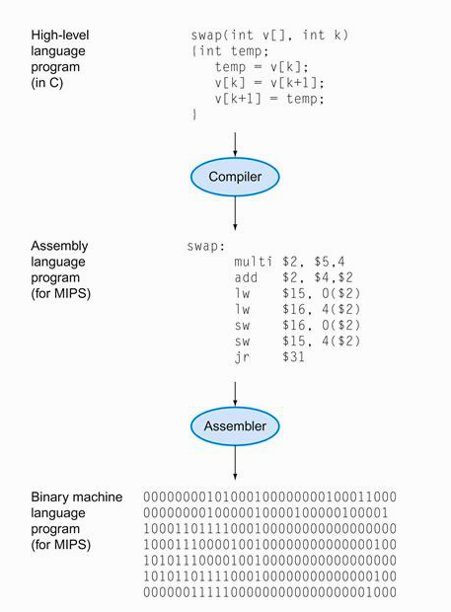
Below your program
Binary Digit: Also called a bit. One of the two numbers in base 2 (0 or 1) that are the components of information.
Instruction: A command that computer hardware understands and obeys.
Assembler: A program that translates a symbolic version of instructions into the binary version.
Assembly Language: A symbolic representation of machine instructions.
Machine Language: A binary representation of machine instructions.
High-Level Programming Language: A portable language such as C, C++, Java, or Visual Basic that is composed of words and algebraic notation that can be translated by a compiler into assembly language.

Slide 35
Under the Cover
The five classic components of a computer are input, output, memory, datapath, and control, with the last two sometimes combined and called the processor.
This organization is independent of hardware technology: you can place every piece of every computer, past and present, into one of these five categories.

Slide 36
The organization of the computer
Datapath: The component of the processor that performs arithmetic operations
Control: The component of the processor that commands the datapath, memory, and I/O devices according to the instructions of the program.
Central Processing Unit: Also called processor. The active part of the computer, which contains the datapath and control and which adds numbers, tests numbers, signals I/O devices to activate, and so on.

Slide 37
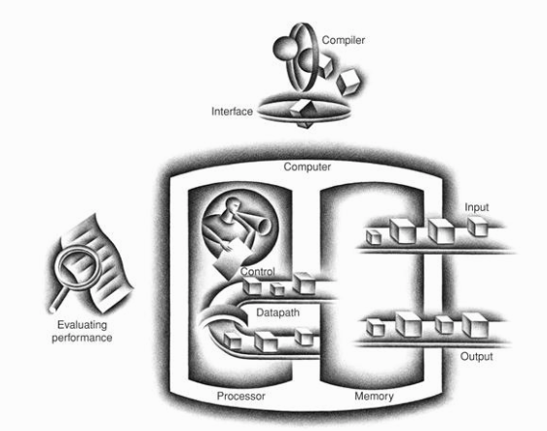


The organization of the computer
The processor gets instructions and data from memory. Input writes data to memory, and output reads data from memory.
Control sends the signals that determine the operations of the datapath, memory, input, and output.

Slide 38
The organization of the computer
Integrated Circuit: Also called a chip. A device combining dozens to millions of transistors.
Memory: The storage area in which programs are kept when they are running and that contains the data needed by the running programs.
Input: A mechanism through which the computer is fed information, such as a microphone.
Output: A mechanism that conveys the result of a computation to a user, such as a display, or to another computer.

Slide 39
“Through computer displays I have landed an airplane on the deck of a moving carrier, observed a nuclear particle hit a potential well, flown in a rocket at nearly the speed of light and watched a computer reveal its innermost workings.”
Ivan Sutherland, the “father” of computer graphics, Scientific American, 1984”

Slide 40
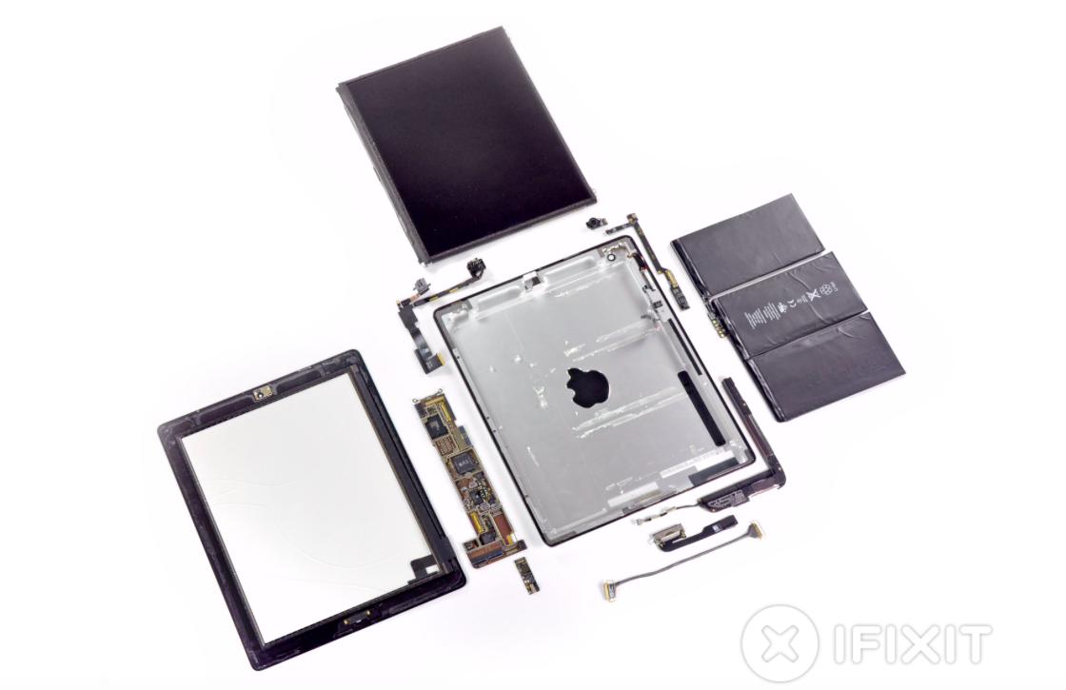


Slide 41
Components of the Apple iPad 2 A1395
The metal back of the iPad (with the reversed Apple logo in the middle) is in the center. At the top is the capacitive multitouch screen and LCD display.
To the far right is the 3.8 V, 25 watt-hour, polymer battery, which consists of three Li-ion cell cases and offers 10 hours of battery life.
To the far left is the metal frame that attaches the LCD to the back of the iPad.
The small components surrounding the metal back in the center are what we think of as the computer; they are often L-shaped to fit compactly inside the case next to the battery. Next figure shows a close-up of the L-shaped board to the lower left of the metal case, which is the logic printed circuit board that contains the processor and the memory.
Near the upper left corner of the case is another L-shaped component, which is a front-facing camera assembly that includes the camera, headphone jack, and microphone.
Near the right upper corner of the case is the board containing the volume control and silent/screen rotation lock button along with a gyroscope and accelerometer. These last two chips combine to allow the iPad to recognize 6-axis motion.
The tiny rectangle next to it is the rear-facing camera. Near the bottom right of the case is the L-shaped speaker assembly.
The cable at the bottom is the connector between the logic board and the camera/volume control board. The board between the cable and the speaker assembly is the controller for the capacitive touchscreen.

Slide 42
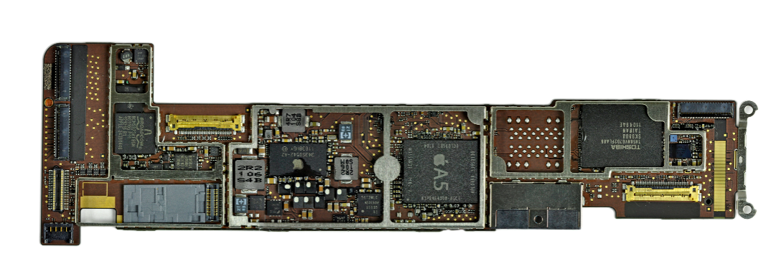


Texas Instruments CD3240B0 11AZ4JT G1 touchscreen line driver, working with the Broadcom BCM5973 and BCM5974 chips shown above.
Apple 1GHz A5 dual-core Processor with a 200MHz bus and 512 MB of Samsung manufactured RAM.
Toshiba TH58NVG7D2FLA89 16GB NAND Flash/nonvolatile storage
S6T2MLC N33C50V Power Management IC

Slide 43
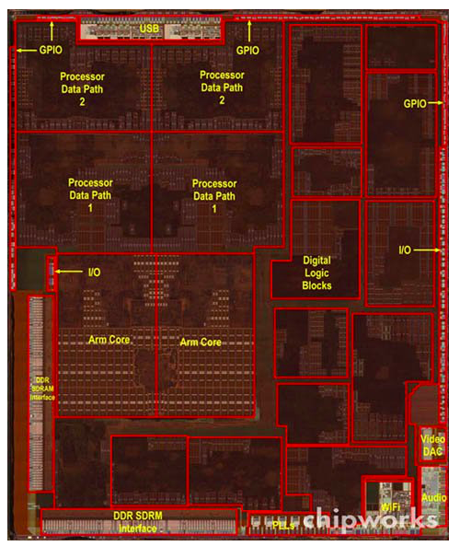
-Two ARM Cortex-A9 cores, each equipped with, about 4.5 megabits of cache memory
-The processor integrated circuit inside the A5 package. The size of chip is 12.1 by 10.1 mm, and it was manufactured originally in a 45-nm process
-It has two identical ARM processors or cores in the middle left of the chip and a PowerVR graphical processor unit (GPU) with four datapaths in the upper left quadrant.
-To the left and bottom side of the ARM cores are interfaces to main memory (DRAM)
-The A5 package also includes two memory chips, each with 2 gibibits of capacity, thereby supplying 512 MiB.

Slide 44
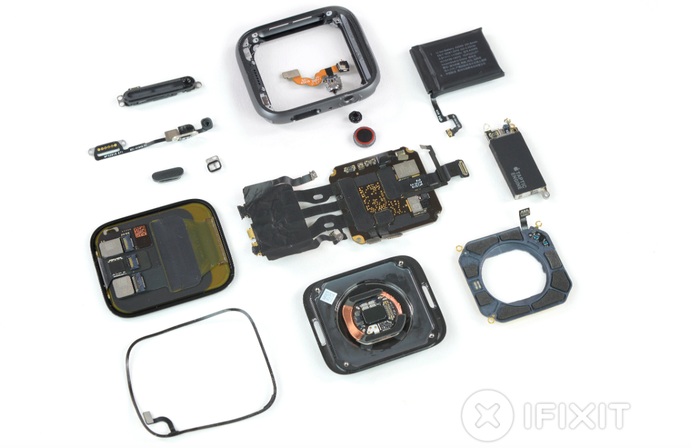
An wearable computer

Slide 45
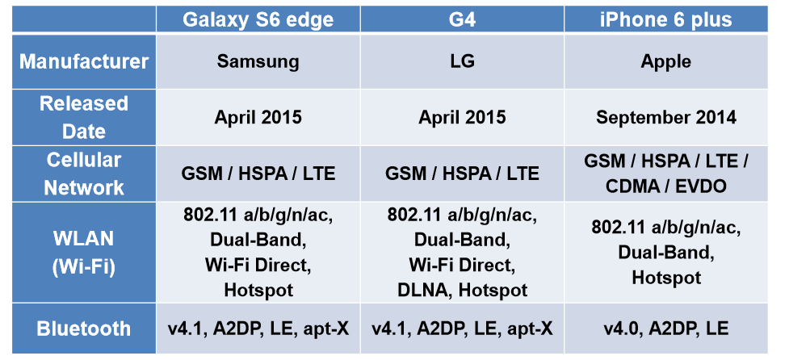
Reference: Jong-Moon Chung

Slide 46
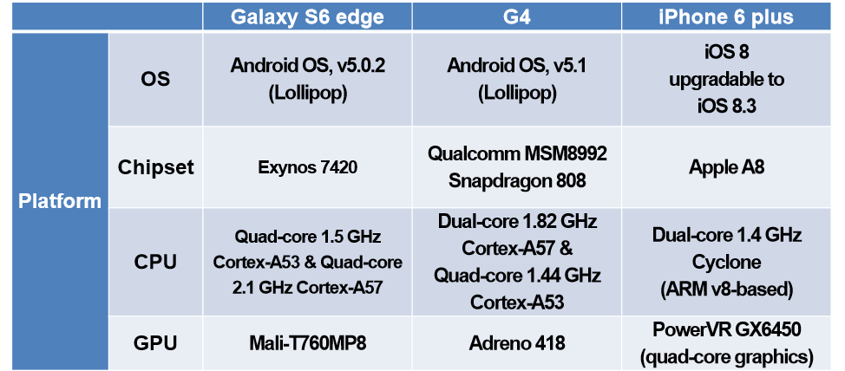
Reference: Jong-Moon Chung

Slide 47
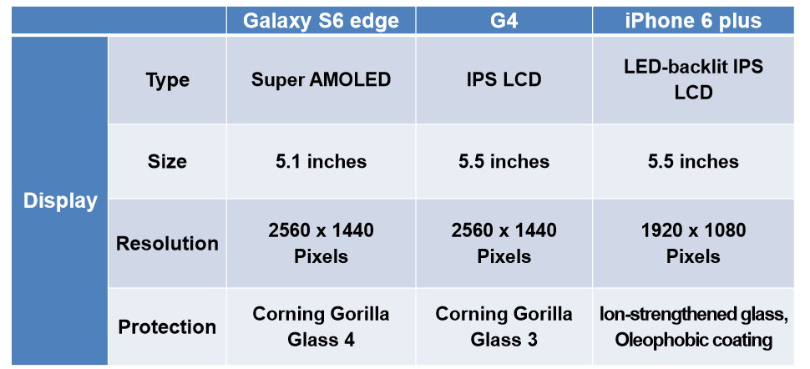
Reference: Jong-Moon Chung

Slide 48
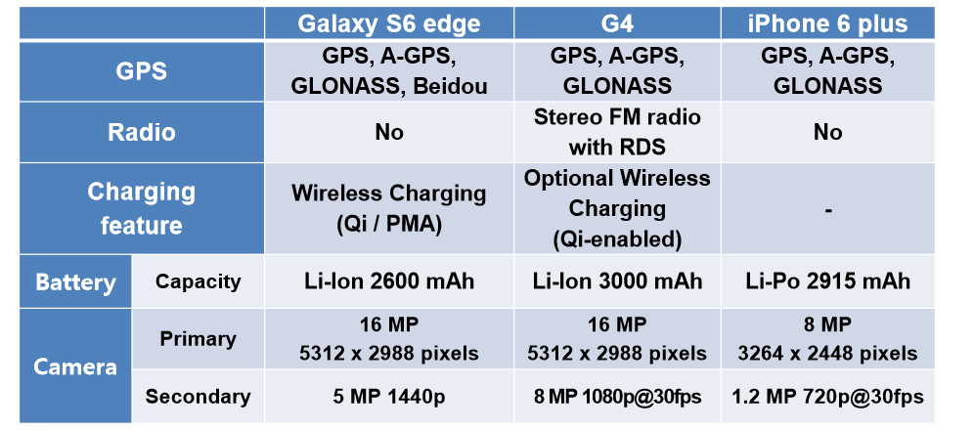
Reference: Jong-Moon Chung

Slide 49
The Von-Neumann Model
Fetch instruction per cycle
Central Processing Unit
Memory
Inputs/Outputs
datapath
Control FSM
Data is loaded from and results stored to memory

Slide 50
Note
We want unlimited amounts of fast memory
Accessing memory might be a bottleneck compared to fast evolving processor technology
There’s CPU-DRAM performance gap
Processor clock speed is more than 1GHz (<nsec); executing 1 instruction in 1nsec.
Memory has around 100nsec of cycles per memory access.
1/3 of instructions are load/store

Slide 51
Memory Technology
 | 1000s of bits | 20 ps | $$$$
SRAM | ~10KB – 10 MB | 1 – 10 ns | ~$1000
DRAM | ~ 10 GB | 80 ns | ~$10
Flash | ~ 100 GB | 100 us | ~$1
Hard Disk | ~ 1TB | 10 ms | ~$0.10
Capacity
Latency
Cost/GB
Processor Datapath
Registers
Memory Hierarchy
SRAM
DRAM
I/O Subsystems
Flash*
Hard Disk*
*non-volatile memory = retains contents when power is off

Slide 52
If the data your program needs are stored in a CPU register, then they can be accessed in 0 cycles during the execution of the instruction. If stored in a cache, 4 to 75 cycles. If stored in main memory, hundreds of cycles. And if stored in disk, tens of millions of cycles!

Slide 53
Example Memory
Hierarchy
L0:
Regs
CPU registers hold words retrieved from the L1 cache.
Smaller,
faster,
and
costlier
(per byte)
storage
devices
L1:
L1 cache
(SRAM)
L1 cache holds cache lines retrieved from the L2 cache.
L2:
L2 cache
(SRAM)
L2 cache holds cache lines
retrieved from L3 cache
L3:
L3 cache
(SRAM)
L3 cache holds cache lines
retrieved from main memory.
Larger,
slower,
and
cheaper
(per byte)
storage
devices
L4:
Main memory
(DRAM)
Main memory holds disk blocks retrieved from local disks.
L5:
Local secondary storage
(local disks)
Local disks hold files retrieved from disks
on remote servers
L6:
Remote secondary storage
(e.g., Web servers)

Slide 54
Random-Access Memory (RAM)
Key features
  RAM is traditionally packaged as a chip.
  Basic storage unit is normally a cell (one bit per cell).
  Multiple RAM chips form a memory.
RAM comes in two varieties:
  SRAM (Static RAM)
  DRAM (Dynamic RAM)

Slide 55
SRAM vs DRAM Summary
Trans. Access Needs Needs
per bit time refresh? EDC? Cost Applications
SRAM 4 or 6 1X No Maybe 100x Cache memories
DRAM 1 10X Yes Yes 1X Main memories,
frame buffers

Slide 56
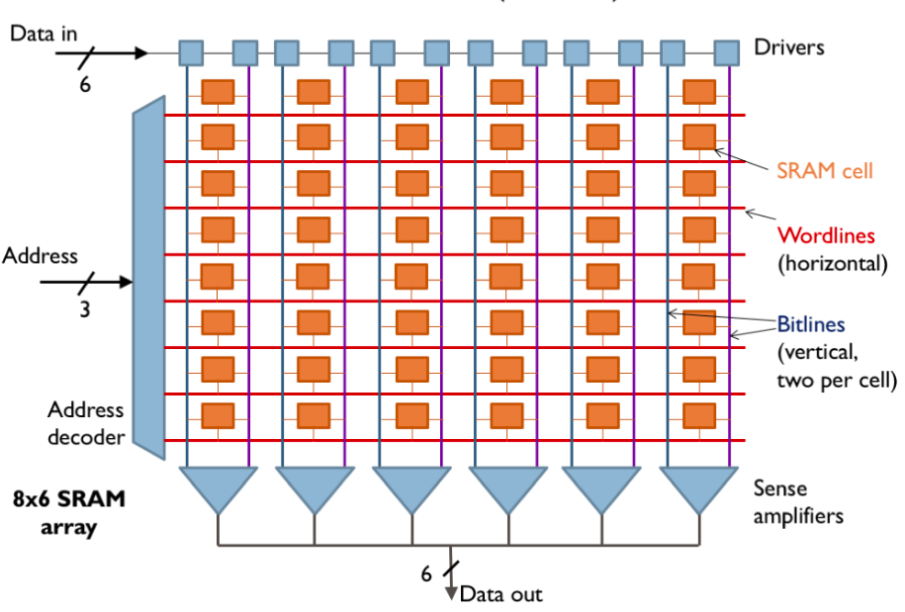
SRAM (Static RAM)
During read operations the bit lines carry the analog signals from the enabled bit cells to the sense amplifiers, which convert the analog signals to digital data.
During write operations incoming data is driven onto the bit lines to be stored into the enabled bit cells.

Slide 57
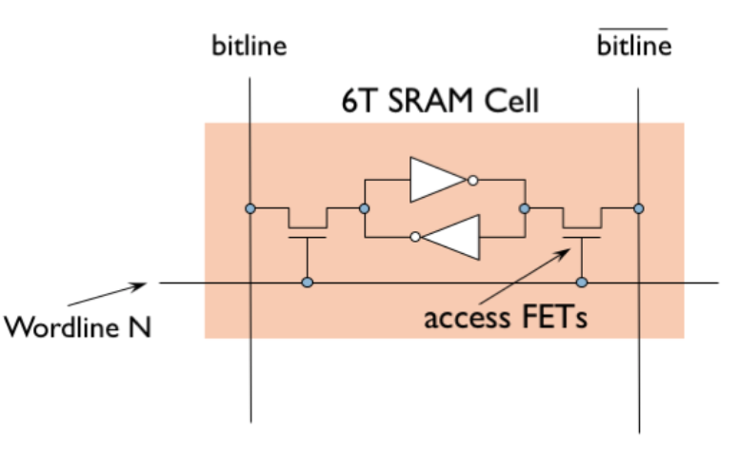
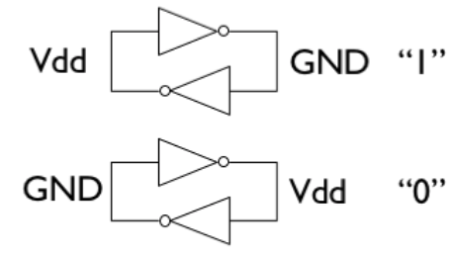
SRAM (Static RAM)
6-MOSFET cell (6-T cell to store a bit):
Two CMOS inverters (4 MOSFETs) forming a bistable element
Two access transistors
Bistable (two stable states) elements store a single bit

Slide 58
sRAM (Static RAM)
Either one read/cycle OR or write/cycle
We can do multiple reads / multiple writes by increasing wordlines and bitlines
Then we need to careful about the area/cost (height and width of the cell will increase).
What’s the minimum number of transistor to store a single bit?

Slide 59
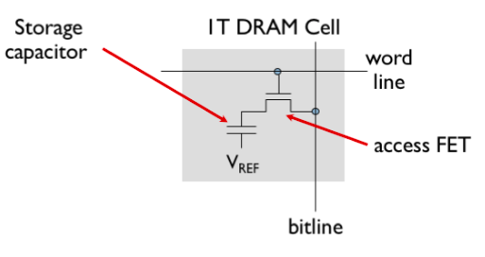
DRAM (Dynamic RAM)
~20x smaller area than SRAM
Wide rows
The first access to a row has a long latency, but subsequent accesses to the same row have very low latency.
Problem: Capacitor leaks charge, must be refreshed periodically (~milliseconds)
Read is destructive, once you read the data, it’s gone, need to rewrite the data
~2x-10x slower than SRAM

Slide 60
Non-Volatile Storage: FLASH
Use Floating gate transistors to store charge
Each cell holds multiple bits of information – very dense
Read access times for NOR flash memories are similar to that of DRAMs, several tens of nanoseconds
Read times for NAND flash memories are much longer, on the order of 10 microseconds.
Write times for all types of flash memories are quite long (10 – 100 us)
Limited number of writes( 100,000 to 1,000,000),charging/discharging the floating gate requires large voltages that damages transistors.

Slide 61
Nonvolatile Memories
DRAM and SRAM are volatile memories
  Lose information if powered off.
Nonvolatile memories retain value even if powered off
  Read-only memory (ROM): programmed during production
  Programmable ROM (PROM): can be programmed once
  Eraseable PROM (EPROM): can be bulk erased (UV, X-Ray)
  Electrically eraseable PROM (EEPROM): electronic erase capability
  Flash memory: EEPROMs. with partial (block-level) erase capability
    Wears out after about 100,000 erasings
Uses for Nonvolatile Memories
  Firmware programs stored in a ROM (BIOS, controllers for disks, network cards, graphics accelerators, security subsystems,…)
  Solid state disks (replace rotating disks in thumb drives, smart phones, mp3 players, tablets, laptops,…)
  Disk caches

Slide 62
The CPU-Memory Gap
The gap widens between DRAM, disk, and CPU speeds.
Disk
SSD
DRAM
CPU

Slide 63
Locality to the Rescue!
The key to bridging this CPU-Memory gap is a fundamental property of computer programs known as locality

Slide 64
Locality
Principle of Locality: Programs tend to use data and instructions with addresses near or equal to those they have used recently
Temporal locality:
  Recently referenced items are likely
  to be referenced again in the near future
Spatial locality:
  Items with nearby addresses tend
  to be referenced close together in time

Slide 65
Locality Example
Data references
  Reference array elements in succession (stride-1 reference pattern).
  Reference variable sum each iteration.
Instruction references
  Reference instructions in sequence.
  Cycle through loop repeatedly.
Spatial locality
Temporal locality
Spatial locality
Temporal locality
sum = 0;
for (i = 0; i < n; i++)
sum += a[i];
return sum;

Slide 66
General Cache Concept
Smaller, faster, more expensive
memory caches a subset of
the blocks
Cache
8
4
9
14
10
3
Data is copied in block-sized transfer units
4
10
Larger, slower, cheaper memory
viewed as partitioned into “blocks”
Memory
0
1
2
3
4
4
5
6
7
8
9
10
10
11
12
13
14
15

Slide 67
Cache Memories
Cache memories are small, fast SRAM-based memories managed automatically in hardware
  Hold frequently accessed blocks of main memory
CPU looks first for data in cache
Typical system structure:
CPU chip
Register file
ALU
Cache
memory
System bus
Memory bus
Main
memory
Bus interface
I/O
bridge

Slide 68
Intel Core i7 Cache Hierarchy
Processor package
Core 0
Core 3
L1 i-cache and d-cache:
  32 KB, 8-way,
  Access: 4 cycles
L2 unified cache:
  256 KB, 8-way,
  Access: 10 cycles
L3 unified cache:
  8 MB, 16-way,
  Access: 40-75 cycles
Block size: 64 bytes for all caches.
Regs
Regs
L1
d-cache
L1
i-cache
L1
d-cache
L1
i-cache
…
L2 unified cache
L2 unified cache
L3 unified cache
(shared by all cores)
Main memory

Slide 69
Memory Hierarchies
Some fundamental and enduring properties of hardware and software:
  Fast storage technologies cost more per byte, have less capacity, and require more power (heat!).
  The gap between CPU and main memory speed is widening.
  Well-written programs tend to exhibit good locality.
These fundamental properties complement each other beautifully.
They suggest an approach for organizing memory and storage systems known as a memory hierarchy.

Slide 70
Caches
Cache: A small, interim storage component that transparently retains data from recently accessed locations
-very fast access if data is cached, otherwise slower access to other larger cache, main memory
-exploits the locality principle
-multiple level of caches
-caching widely applied beyond hardware( web cache)

Slide 71

Revisiting the Memory Hierarchy
 |  | Access Time | Capacity | Managed by
On the datapath | Registers | 1 cycle | 1 KB | Software/Compiler
On-Chip | L1 cache | 2-4 cycles | 32 KB | Hardware
On-Chip | L2 cache | 10 cycles | 256 KB | Hardware
On-Chip | L3 Cache | 40 cycles | 10 MB | Hardware
Off-Chip | Main Memory | 200 cycles | 10 GB | Software/OS
Off-Chip | Flash Drive | 10-100us | 100 GB | Software/OS
Mechanical Devices | Hard Disk | 10 ms | 1 TB | Software/OS
Hardware Caches vs Software Caches
Same objective: provide the “illusion” of a large, fast, cheap memory
Different implementation, different tradeoffs

Slide 72
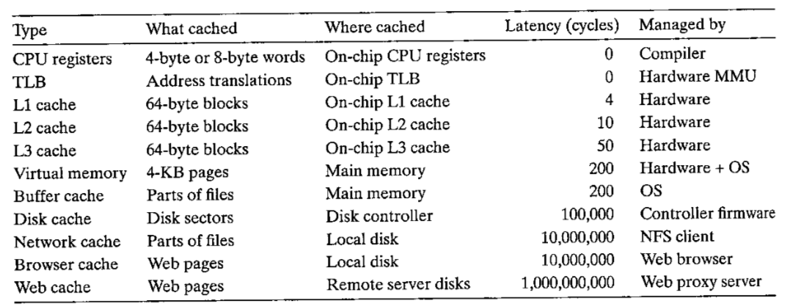
The ubiquity of cache of Modern computing
Everything is a cache for something else

Slide 73
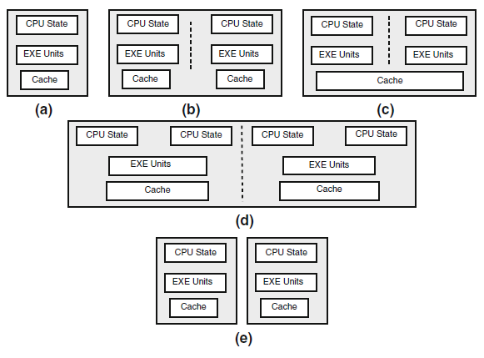
Various Organizations
Different ways for exploiting parallelism over various system organization: a) Single
core, b) Multicore with separate caches, c) Multicore with shared cache, d) Multicore with
simultaneous threading, e) Multiprocessor

Slide 74
Note
The main memory is a temporary storage device that holds both a program and the data it manipulates while the processor is executing the program.
Physically, main memory consists of a collection of dynamic random access memory(DRAM) chips.
Logically, memory is organized as a linear array of bytes, each with its own unique address (array index) starting at zero.
In general, each of the machine instructions that constitute a program can consist of a variable number of bytes.

Slide 75
Note
The central processing unit (CPU), or simply processor, is the engine that interprets (or executes) instructions stored in main memory.
At its core is a word-size storage device (or register) called the program counter (PC).
At any point in time, the PC points at (contains the address of) some machine-language instruction in main memory

Slide 76
Assembly/Machine Code View
CPU
Memory
Registers
Addresses
Data
Code
Data
Stack
PC
Condition
Codes
Instructions
Programmer-Visible State
  PC: Program counter
    Address of next instruction
    Called “RIP” (x86-64)
  Register file
    Heavily used program data
  Condition codes
    Store status information about most recent arithmetic or logical operation
    Used for conditional branching
  Memory
    Byte addressable array
    Code and user data
    Stack to support procedures

