Slide 1
Lecture 01-Introduction

Slide 2
Topics
Why Assembly
History of X86-64
Role of Compiler
The lifecycle of the C Program

Slide 3
C/Java code
Compiler
Assembly code

Slide 4
Note
Writing program in assembly language – in early days of computers
Productive and reliable – writing program in C/Java
Type checking provided by compiler – helps to detect error
Compiler – ensures that we reference and manipulate data consistently

Slide 5
Note
Modern optimizing compilers – makes sure the code is as much efficient as the assembly language
High level language program – compiled and executed on several machines
Assembly language program – highly machine specific

Slide 6
So, why should we spend our time learning assembly language?
Even though compilers do most of the work in generating assembly code, being able to read and understand it is an important skill for serious programmers.
By invoking the compiler with appropriate command-line parameters, the compiler will generate a file showing its output in assembly-code form.

Slide 7
By reading this code, we can understand the optimization capabilities of the compiler and analyze the underlying inefficiencies in the code.
programmers seeking to maximize the performance of a critical section of code often try different variations of the source code, each time compiling and examining the generate assembly code to get a sense of how efficiently the program will run
abstraction provided by a high-level language hides information about the run-time behavior of a program that we need to understand. For example, when writing concurrent programs using a thread package,

Slide 8
As another example, many of the ways programs can be attacked, allowing malware to infest a system, involve nuances of the way programs store their run-time control information. Many attacks involve exploiting weaknesses in system programs to overwrite information and thereby take control of the system.
Understanding how these vulnerabilities arise and how to guard against them requires a knowledge of the machine-level representation of programs.
The need for programmers to learn machine code has shifted over the years from one of being able to write programs directly in assembly code to one of being able to read and understand the code generated by compilers.

Slide 9
Compiler
rearrange execution order
Eliminate unneeded computation
Replace slow operation with faster ones
Change recursive computation into iteration

Slide 10
Our choice of machine language – x86-64
This is the machine language for most of the processors found in today’s laptop and desktop machines, as well as those that power very large data centers and supercomputers.
CISC ISA
If you are not worried about power and heat, CISC is Ok.
IA32, the 32-bit predecessor to x86-64, was introduced by Intel in 1985.
x86 microprocessor can also execute IA32 programs in a backward compatibility mode. As a result, many application programs are still based on IA32.

Slide 11
Intel x86 Processors
Dominate laptop/desktop/server market
Evolutionary design
  Backwards compatible up until 8086, introduced in 1978
  Added more features as time goes on
Complex instruction set computer (CISC)
  Many different instructions with many different formats
    But, only small subset encountered with Linux programs
  Hard to match performance of Reduced Instruction Set Computers (RISC)
  But, Intel has done just that!
    In terms of speed. Less so for low power.

Slide 12
Intel x86 Evolution: Milestones
Name Date Transistors MHz
8086 1978 29K 5-10
  First 16-bit Intel processor. Basis for IBM PC & DOS
  1MB address space
386 1985 275K 16-33
  First 32 bit Intel processor , referred to as IA32
  Added “flat addressing”, capable of running Unix
Pentium 4E 2004 125M 2800-3800
  First 64-bit Intel x86 processor, referred to as x86-64
Core 2 2006 291M 1060-3333
  First multi-core Intel processor
Core i7 2008 731M 1600-4400
  Four cores

Slide 13
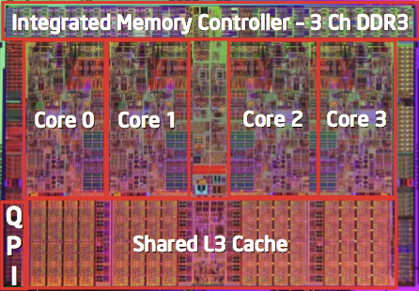
Intel x86 Processors, cont.
Machine Evolution
  386 1985 0.3M
  Pentium 1993 3.1M
  Pentium/MMX 1997 4.5M
  PentiumPro 1995 6.5M
  Pentium III 1999 8.2M
  Pentium 4 2000 42M
  Core 2 Duo 2006 291M
  Core i7 2008 731M
Added Features
  Instructions to support multimedia operations
  Instructions to enable more efficient conditional operations
  Transition from 32 bits to 64 bits
  More cores

Slide 14
Intel x86 Processors, cont.
Past Generations
  1st Pentium Pro 1995 600 nm
  1st Pentium III 1999 250 nm
  1st Pentium 4 2000 180 nm
  1st Core 2 Duo 2006 65 nm
Recent & Upcoming Generations
  Nehalem 2008 45 nm
  Sandy Bridge 2011 32 nm
  Ivy Bridge 2012 22 nm
  Haswell 2013 22 nm
  Broadwell 2014 14 nm
  Skylake 2015 14 nm
  Kaby Lake 2016 14 nm
  Coffee Lake 2017? 14 nm
  Cannonlake 2018? 10 nm
Process technology
Process technology dimension
= width of narrowest wires
(10 nm ≈ 100 atoms wide)

Slide 15
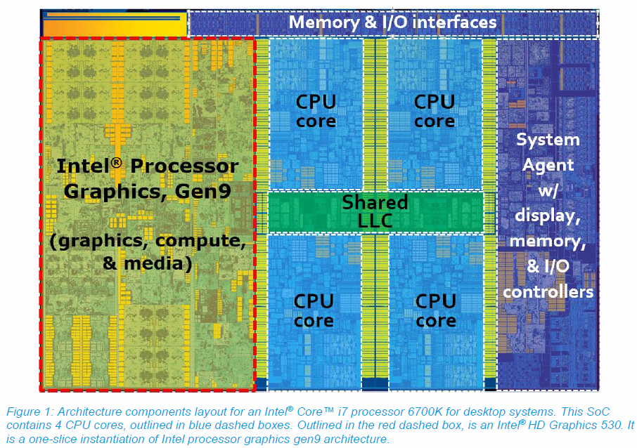
2017 State of the Art: Skylake
Mobile Model: Core i7
  2.6-2.9 GHz
  45 W
Desktop Model: Core i7
  Integrated graphics
  2.8-4.0 GHz
  35-91 W
Server Model: Xeon
  Integrated graphics
  Multi-socket enabled
  2-3.7 GHz
  25-80 W

Slide 16
x86 Clones: Advanced Micro Devices (AMD)
Historically
  AMD has followed just behind Intel
  A little bit slower, a lot cheaper
Then
  Recruited top circuit designers from Digital Equipment Corp. and other downward trending companies
  Built Opteron: tough competitor to Pentium 4
  Developed x86-64, their own extension to 64 bits
Recent Years
  Intel got its act together
    Leads the world in semiconductor technology
  AMD has fallen behind
    Relies on external semiconductor manufacturer

Slide 17
Intel’s 64-Bit History
2001: Intel Attempts Radical Shift from IA32 to IA64
  Totally different architecture (Itanium)
  Executes IA32 code only as legacy
  Performance disappointing
2003: AMD Steps in with Evolutionary Solution
  x86-64 (now called “AMD64”)
Intel Felt Obligated to Focus on IA64
  Hard to admit mistake or that AMD is better
2004: Intel Announces EM64T extension to IA32
  Extended Memory 64-bit Technology
  Almost identical to x86-64!
All but low-end x86 processors support x86-64
  But, lots of code still runs in 32-bit mode

Slide 18

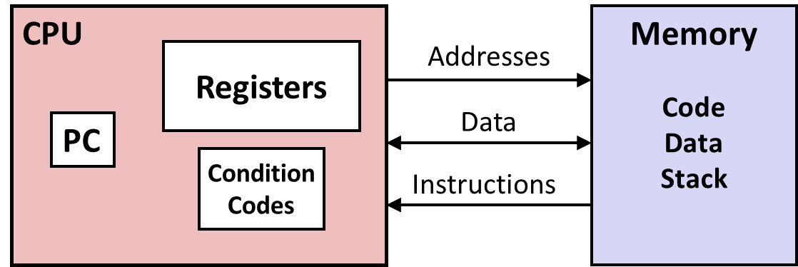
Levels of Abstraction
C code
C programmer
Nice clean layers,
but beware…
Assembly programmer
Computer Designer
Caches, clock freq, layout, …
Of course, you know that: It’s why you are taking this course.

Slide 19
Definitions
Architecture: (also ISA: instruction set architecture) The parts of a processor design that one needs to understand for writing correct machine/assembly code
  Examples: instruction set specification, registers
  Machine Code: The byte-level programs that a processor executes
  Assembly Code: A text representation of machine code
Microarchitecture: Implementation of the architecture
  Examples: cache sizes and core frequency
Example ISAs:
  Intel: x86, IA32, Itanium, x86-64
  ARM: Used in almost all mobile phones
  RISC V: New open-source ISA

Slide 20
Assembly/Machine Code View
CPU
Memory
Registers
Addresses
Data
Code
Data
Stack
PC
Condition
Codes
Instructions
Programmer-Visible State
  PC: Program counter
    Address of next instruction
    Called “RIP” (x86-64)
  Register file
    Heavily used program data
  Condition codes
    Store status information about most recent arithmetic or logical operation
    Used for conditional branching
  Memory
    Byte addressable array
    Code and user data
    Stack to support procedures

Slide 21
Assembly/Machine Code View
CPU
Memory
Registers
Addresses
Data
Code
Data
Stack
PC
Condition
Codes
Instructions
Programmer-Visible State
  PC: Program counter
    Address of next instruction
    Called “RIP” (x86-64)
  Register file
    Heavily used program data
  Condition codes
    Store status information about most recent arithmetic or logical operation
    Used for conditional branching
  Memory
    Byte addressable array
    Code and user data
    Stack to support procedures

Slide 22
Turning C into Object Code
  Code in files p1.c p2.c
  Compile with command: gcc –Og p1.c p2.c -o p
    Use basic optimizations (-Og) [New to recent versions of GCC]
    Put resulting binary in file p
text
C program (p1.c p2.c)
Compiler (gcc –Og -S)
text
Asm program (p1.s p2.s)
Assembler (gcc or as)
binary
Object program (p1.o p2.o)
Static libraries (.a)
Linker (gcc or ld)
binary
Executable program (p)

Slide 23
Note
The command-line option –Og instructs the compiler to apply a level of optimization that yields machine code that follows the overall structure of the original C code.
Invoking higher levels of optimization can generate code that is so heavily transformed that the relationship between the generated machine code and the original source code is difficult to understand.
We will therefore use -Og optimization as a learning tool and then see what happens as we increase the level of optimization. In practice, higher levels of optimization (e.g., specified with the option -O1 or -O2) are considered a better choice in terms of the resulting program performance.

Slide 24
Compiling Into Assembly
C Code (sum.c)
Generated x86-64 Assembly
long plus(long x, long y);
void sumstore(long x, long y,
long *dest)
{
long t = plus(x, y);
*dest = t;
}
sumstore:
pushq %rbx
movq %rdx, %rbx
call plus
movq %rax, (%rbx)
popq %rbx
ret
Obtain with command
  gcc –Og –S sum.c
Produces file sum.s
Warning: Will get very different results on different machines ( Linux, Mac OS-X, …) due to different versions of gcc and different compiler settings.

Slide 25
What it really looks like
.globl sumstore
.type sumstore, @function
sumstore:
.LFB35:
.cfi_startproc
pushq %rbx
.cfi_def_cfa_offset 16
.cfi_offset 3, -16
movq %rdx, %rbx
call plus
movq %rax, (%rbx)
popq %rbx
.cfi_def_cfa_offset 8
ret
.cfi_endproc
.LFE35:
.size sumstore, .-sumstore

Slide 26
What it really looks like
Things that look weird and are preceded by a ‘.’ are generally directives.
.globl sumstore
.type sumstore, @function
sumstore:
.LFB35:
.cfi_startproc
pushq %rbx
.cfi_def_cfa_offset 16
.cfi_offset 3, -16
movq %rdx, %rbx
call plus
movq %rax, (%rbx)
popq %rbx
.cfi_def_cfa_offset 8
ret
.cfi_endproc
.LFE35:
.size sumstore, .-sumstore
sumstore:
pushq %rbx
movq %rdx, %rbx
call plus
movq %rax, (%rbx)
popq %rbx
ret

Slide 27
Assembly Characteristics: Data Types
“Integer” data of 1, 2, 4, or 8 bytes
  Data values
  Addresses (untyped pointers)
Floating point data of 4, 8, or 10 bytes
(SIMD vector data types of 8, 16, 32 or 64 bytes)
Code: Byte sequences encoding series of instructions
No aggregate types such as arrays or structures
  Just contiguously allocated bytes in memory

Slide 28
Assembly Characteristics: Operations
Transfer data between memory and register
  Load data from memory into register
  Store register data into memory
Perform arithmetic function on register or memory data
Transfer control
  Unconditional jumps to/from procedures
  Conditional branches

Slide 29
Object Code
Code for sumstore
Assembler
  Translates .s into .o
  Binary encoding of each instruction
  Nearly-complete image of executable code
  Missing linkages between code in different files
Linker
  Resolves references between files
  Combines with static run-time libraries
    E.g., code for malloc, printf
  Some libraries are dynamically linked
    Linking occurs when program begins execution
0x0400595:
0x53
0x48
0x89
0xd3
0xe8
0xf2
0xff
0xff
0xff
0x48
0x89
0x03
0x5b
0xc3
  Total of 14 bytes
  Each instruction 1, 3, or 5 bytes
  Starts at address 0x0400595

Slide 30
Turning C into Object Code
  Code in files p1.c p2.c
  Compile with command: gcc –Og p1.c p2.c -o p
    Use basic optimizations (-Og) [New to recent versions of GCC]
    Put resulting binary in file p
text
C program (p1.c p2.c)
Compiler (gcc –Og -S)
text
Asm program (p1.s p2.s)
Assembler (gcc or as)
binary
Object program (p1.o p2.o)
Static libraries (.a)
Linker (gcc or ld)
binary
Executable program (p)

Slide 31
Machine Instruction Example
C Code
  Store value t where designated by dest
Assembly
  Move 8-byte value to memory
    Quad words in x86-64 parlance
  Operands:
    t: Register %rax
    dest: Register %rbx
    *dest: Memory M[%rbx]
Object Code
  3-byte instruction
  Stored at address 0x40059e
*dest = t;
movq %rax, (%rbx)
0x40059e: 48 89 03

Slide 32
Disassembling Object Code
Disassembled
0000000000400595 <sumstore>:
400595: 53 push %rbx
400596: 48 89 d3 mov %rdx,%rbx
400599: e8 f2 ff ff ff callq 400590 <plus>
40059e: 48 89 03 mov %rax,(%rbx)
4005a1: 5b pop %rbx
4005a2: c3 retq
Disassembler
  objdump –d sum
  Useful tool for examining object code
  Analyzes bit pattern of series of instructions
  Produces approximate rendition of assembly code
  Can be run on either a.out (complete executable) or .o file

Slide 33
Alternate Disassembly
Disassembled
Dump of assembler code for function sumstore:
0x0000000000400595 <+0>: push %rbx
0x0000000000400596 <+1>: mov %rdx,%rbx
0x0000000000400599 <+4>: callq 0x400590 <plus>
0x000000000040059e <+9>: mov %rax,(%rbx)
0x00000000004005a1 <+12>:pop %rbx
0x00000000004005a2 <+13>:retq
Within gdb Debugger
  Disassemble procedure
  gdb sum
  disassemble sumstore

Slide 34
Alternate Disassembly
Disassembled
Object
Code
Dump of assembler code for function sumstore:
0x0000000000400595 <+0>: push %rbx
0x0000000000400596 <+1>: mov %rdx,%rbx
0x0000000000400599 <+4>: callq 0x400590 <plus>
0x000000000040059e <+9>: mov %rax,(%rbx)
0x00000000004005a1 <+12>:pop %rbx
0x00000000004005a2 <+13>:retq
0x0400595:
0x53
0x48
0x89
0xd3
0xe8
0xf2
0xff
0xff
0xff
0x48
0x89
0x03
0x5b
0xc3
Within gdb Debugger
  Disassemble procedure
  gdb sum
  disassemble sumstore
  Examine the 14 bytes starting at sumstore
  x/14xb sumstore

Slide 35
What Can be Disassembled?
% objdump -d WINWORD.EXE
WINWORD.EXE: file format pei-i386
No symbols in "WINWORD.EXE".
Disassembly of section .text:
30001000 <.text>:
30001000: 55 push %ebp
30001001: 8b ec mov %esp,%ebp
30001003: 6a ff push $0xffffffff
30001005: 68 90 10 00 30 push $0x30001090
3000100a: 68 91 dc 4c 30 push $0x304cdc91
Reverse engineering forbidden by
Microsoft End User License Agreement
Anything that can be interpreted as executable code
Disassembler examines bytes and reconstructs assembly source

Slide 36
Machine Programming I: Summary
History of Intel processors and architectures
  Evolutionary design leads to many quirks and artifacts
C, assembly, machine code
  New forms of visible state: program counter, registers, ...
  Compiler must transform statements, expressions, procedures into low-level instruction sequences
Assembly Basics: Registers, operands, move
  The x86-64 move instructions cover wide range of data movement forms
Arithmetic
  C compiler will figure out different instruction combinations to carry out computation

Slide 37
What’s the role of ISA here?
The format and behavior of a machine-level program is defined by the instruction set architecture , or ISA, defining the processor state, the format of the instructions, and the effect each of these instructions will have on the state.

Slide 38
Two abstractions/illusions
The memory addresses used
by a machine-level program are virtual addresses , providing a memory model that appears to be a very large byte array.
Describe the behavior of a program as if each instruction is executed in sequence, with one instruction completing before the next one begins.
The actual implementation of the memory
system involves a combination of multiple hardware memories and operating
system software
The processor hardware is far more elaborate, executing many instructions concurrently,
but it employs safeguards to ensure that the overall behavior matches
the sequential operation dictated by the ISA
reality
reality
OS manages this virtual address space, translating virtual addresses into the physical addresses
of values in the actual processor memory

Slide 39
Note
The assembly-code representation is very close to machine code. Its main feature is that it is in a more readable textual format, as compared to the binary format of machine code.
Being able to understand assembly code and how it relates to the original C code is a key step in understanding how computers execute programs.
The machine code for x86-64 differs greatly from the original C code. Parts of the processor state are visible that normally are hidden from the C programmer.

Slide 40
The Processor State (hidden from the C programmer)
The program counter : (commonly referred to as the PC, and called %rip in x86-64) indicates the address in memory of the next instruction to be executed.
The integer register file : contains 16 named locations storing 64-bit values. These registers can hold addresses (corresponding to C pointers) or integer data. Some registers are used to keep track of critical parts of the program state, while others are used to hold temporary data, such as the arguments and local variables of a procedure, as well as the value to be returned by a function.

Slide 41
The Processor State (hidden from the C programmer)
The condition code registers: hold status information about the most recently executed arithmetic or logical instruction. These are used to implement conditional changes in the control or data flow, such as is required to implement if and while statements.
A set of vector registers: can each hold one or more integer or floating-point values.

Slide 42
Difference between C and Assembly
Whereas C provides a model in which objects of different data types can be declared and allocated in memory, machine code views the memory as simply a large byte-addressable array.
Aggregate data types in C such as arrays and structures are represented in machine code as contiguous collections of bytes.
Even for scalar data types, assembly code makes no distinctions between signed or unsigned integers, between different types of pointers, or even between pointers and integers.

Slide 43
pushq instruction indicates that the contents of register %rbx should be pushed onto the program stack.
All information about local variable names or data types has been stripped away.
linux> gcc -Og -c mstore.c

Slide 44
linux> gcc -Og -c mstore.c
This will generate an object-code file mstore.o that is in binary format and hence
cannot be viewed directly. Embedded within the 1,368 bytes of the file mstore.o
is a 14-byte sequence with the hexadecimal representation
53 48 89 d3 e8 00 00 00 00 48 89 03 5b c3
the program executed by the machine is simply a sequence of bytes encoding a series of instructions. The machine has very little information about the source code from which these instructions were
generated.

Slide 45
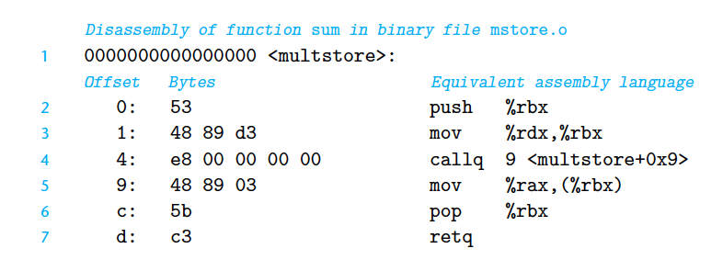
Disassemblers
-A set of programs
Generate Assembly code from machine code
linux> objdump -d mstore.o

Slide 46
Diassembler
x86-64 instructions can range in length from 1 to 15 bytes. The instruction encoding is designed so that commonly used instructions and those with fewer operands require a smaller number of bytes than do less common ones or ones with more operands.
The instruction format is designed in such a way that from a given starting position, there is a unique decoding of the bytes into machine instructions. For example, only the instruction pushq %rbx can start with byte value 53 .
The disassembler determines the assembly code based purely on the byte sequences in the machine-code file. It does not require access to the source or assembly-code versions of the program.
The disassembler uses a slightly different naming convention for the instructions than does the assembly code generated by gcc . In our example, it has omitted the suffix ‘q ’ from many of the instructions. These suffixes are size designators and can be omitted in most cases. Conversely, the disassembler adds the suffix ‘q ’ to the call and ret instructions. Again, these suffixes can safely be omitted.

Slide 47
#include <stdio.h>
void multstore(long, long, long *);
int main() {
long d;
multstore(2, 3, &d);
printf("2 * 3 --> %ld\n", d);
return 0;
}
long mult2(long a, long b) {
long s = a * b;
return s;
}
linux> gcc -Og -o prog main.c mstore.c
The file prog has grown to 8,655 bytes, since it contains not just the machine
code for the procedures we provided but also code used to start and terminate
the program as well as to interact with the operating system.

Slide 48
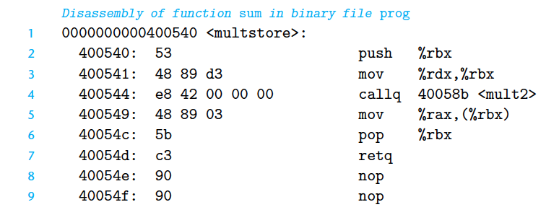
the linker has filled in the address that the callq instruction should use in calling the function mult2 (line 4 of the disassembly). One task for the linker is to match function calls with the locations of the executable code for those functions
linux> objdump -d prog
two additional lines of code (lines
8–9). These instructions will have no effect on the program, since they occur after
the return instruction (line 7). They have been inserted to grow the code for the
function to 16 bytes, enabling a better placement of the next block of code in terms
of memory system performance.
the addresses listed along the left are different—
the linker has shifted the location of this code to a different range of addresses

Slide 49
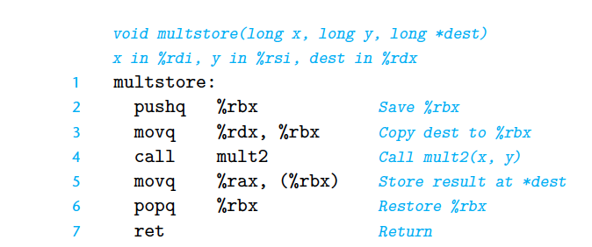
.file "010-mstore.c"
.text
.globl multstore
.type multstore, @function
multstore:
pushq %rbx
movq %rdx, %rbx
call mult2
movq %rax, (%rbx)
popq %rbx
ret
.size multstore, .-multstore
.ident "GCC: (Ubuntu 4.8.1-2ubuntu1~12.04) 4.8.1"
.section .note.GNU-stack,"",@progbits

Slide 50
Reading/What to do
Read: Book Chapter 02 (pg 166 to 197)
Take Notes
Explore the related practice problems
Explore the related HW
Explore the related online quiz

