Slide 1
Stack Operations: pushq and popq
Lecture 03

Slide 2
pushq and popq
A stack is a data structure where values can be added or deleted, but only according to a “last-in, first-out” discipline.
We add data to a stack via a push operation and remove it via a pop operation, with the property that the value popped will always be the value that was most recently pushed and is still on the stack.
A stack can be implemented as an array, where we always insert and remove elements from one end of the array. This end is called the top of the stack. With x86-64, the program stack is stored in some region of memory.

Slide 3
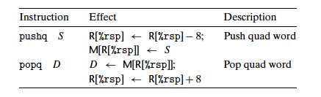
pushq and popq

Slide 4
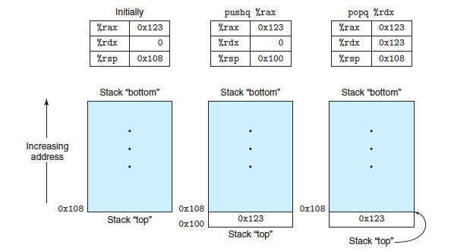
pushq and popq
By convention, we draw stacks upside down, so that the “top” of the stack is shown at the bottom. With x86-64, stacks grow toward lower addresses, so pushing involves decrementing the stack pointer (register %rsp) and storing to memory, while popping involves reading from memory and incrementing the stack pointer.

Slide 5
x86-64 Stack
CS 3843
Region of memory managed with stack discipline
Memory viewed as array of bytes.
Different regions have different purposes.
(Like ABI, a policy decision)
stack
memory
code

Slide 6
x86-64 Stack
CS 3843
Stack “Bottom”
Region of memory
managed with
stack discipline
stack
code
Stack Pointer: %rsp
Stack “Top”

Slide 7
x86-64 Stack
Region of memory managed with stack discipline
Grows toward lower addresses
Register %rsp contains
lowest stack address
  address of “top” element
Stack “Bottom”
Increasing
Addresses
Stack Grows
Down
Stack Pointer: %rsp
Stack “Top”

Slide 8
x86-64 Stack: Push
pushq Src
  Fetch operand at Src
  Decrement %rsp by 8
  Write operand at address given by %rsp
Stack “Bottom”
val
Increasing
Addresses
Stack Grows
Down
Stack Pointer: %rsp
Stack “Top”

Slide 9
x86-64 Stack: Push
pushq Src
  Fetch operand at Src
  Decrement %rsp by 8
  Write operand at address given by %rsp
Stack “Bottom”
val
Increasing
Addresses
Stack Grows
Down
Stack Pointer: %rsp
-8
Stack “Top”

Slide 10
x86-64 Stack: Pop
CS 3843
popq Dest
  Read value at address given by %rsp
  Increment %rsp by 8
  Store value at Dest (usually a register)
Stack “Bottom”
Increasing
Addresses
Stack Grows
Down
Stack Pointer: %rsp
val
Stack “Top”

Slide 11
x86-64 Stack: Pop
popq Dest
  Read value at address given by %rsp
  Increment %rsp by 8
  Store value at Dest (usually a register)
Stack “Bottom”
Increasing
Addresses
val
Stack Grows
Down
Stack Pointer: %rsp
+8
Stack “Top”

Slide 12
x86-64 Stack: Pop
popq Dest
  Read value at address given by %rsp
  Increment %rsp by 8
  Store value at Dest (usually a register)
Stack “Bottom”
Increasing
Addresses
Stack Grows
Down
Stack Pointer: %rsp
val
(The memory doesn’t change,
only the value of %rsp)
Stack “Top”

Slide 13
pushq and popq
The stack grows downward such that the top element of the stack has the lowest address of all stack elements. (By convention, we draw stacks upside down, with the stack “top” shown at the bottom of the figure.)
The stack pointer %rsp holds the address of the top stack element.
The pushq instruction provides the ability to push data onto the stack, while the popq instruction pops it.
Each of these instructions takes a single operand—the data source for pushing and the data destination for popping.

Slide 14
pushq and popq
Pushing a quad word value onto the stack involves first decrementing the stack pointer by 8 and then writing the value at the new top-of-stack address.
Therefore, the behavior of the instruction pushq %rbp is equivalent to that of the pair of instructions
subq $8,%rsp Decrement stack pointer
movq %rbp,(%rsp) Store %rbp on stack
Figure illustrate the effect of executing the instruction pushq %rax when %rsp is 0x108 and %rax is 0x123 . First %rsp is decremented by 8, giving 0x100 , and then 0x123 is stored at memory address 0x100 .

Slide 15
pushq and popq
Popping a quad word involves reading from the top-of-stack location and then incrementing the stack pointer by 8. Therefore, the instruction popq %rax is equivalent to the following pair of instructions:
movq (%rsp),%rax Read %rax from stack
addq $8,%rsp Increment stack pointer
Value 0x123 is read from memory and written to register %rdx . Register %rsp is incremented back to 0x108 .
As shown in the figure, the value 0x123 remains at memory location 0x104 until it is overwritten (e.g., by another push operation).
However, the stack top is always considered to be the address indicated by %rsp .

Slide 16
pushq and popq
Since the stack is contained in the same memory as the program code and other forms of program data, programs can access arbitrary positions within the stack using the standard memory addressing methods.
For example, assuming the topmost element of the stack is a quad word, the instruction movq 8(%rsp),%rdx will copy the second quad word from the stack to register %rdx .

