Slide 1
Lecture 04: Arithmetic and Logical Operations

Slide 2
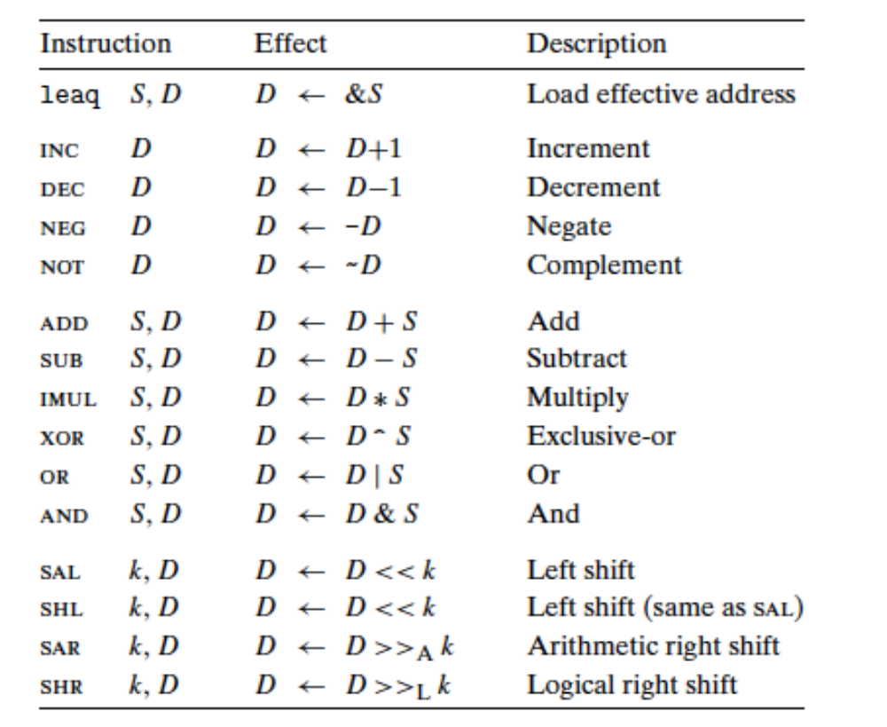

Slide 3
Arithmetic and Logical Operations
Most of the operations are given as instruction classes, as they can have different variants with different operand sizes. (Only leaq has no other size variants.) For example, the instruction class add consists of four addition instructions: addb, addw, addl, and addq, adding bytes, words, double words, and quad words, respectively.
The operations are divided into four groups: load effective address, unary, binary, and shifts. Binary operations have two operands, while unary operations have one operand

Slide 4
Some Arithmetic Operations
Two Operand Instructions:
  Format Computation
    addq Src,Dest Dest = Dest + Src
    subq Src,Dest Dest = Dest − Src
    imulq Src,Dest Dest = Dest * Src
    salq Src,Dest Dest = Dest << Src Also called shlq
    sarq Src,Dest Dest = Dest >> Src Arithmetic
    shrq Src,Dest Dest = Dest >> Src Logical
    xorq Src,Dest Dest = Dest ^ Src
    andq Src,Dest Dest = Dest & Src
    orq Src,Dest Dest = Dest | Src
Watch out for argument order! Src,Dest
(Warning: Intel docs use “op Dest,Src”)
No distinction between signed and unsigned int (why?)

Slide 5
Some Arithmetic Operations
One Operand Instructions
    incq Dest Dest = Dest + 1
    decq Dest Dest = Dest − 1
    negq Dest Dest = − Dest
    notq Dest Dest = ~Dest
See book for more instructions

Slide 6
Unary Operations
Operations in the second group are unary operations, with the single operand serving as both source and destination. This operand can be either a register or a memory location.
For example, the instruction incq (%rsp) causes the 8-byte element on the top of the stack to be incremented.
This syntax is reminiscent of the C increment (++) and decrement (--) operators.

Slide 7
Binary Operations
The third group consists of binary operations, where the second operand is used as both a source and a destination. This syntax is reminiscent of the C assignment operators, such as x -= y.
Observe, however, that the source operand is given first and the destination second. This looks peculiar for noncommutative operations. For example, the instruction subq %rax,%rdx decrements register %rdx by the value in %rax. (It helps to read the instruction as “Subtract %rax from %rdx.”)
The first operand can be either an immediate value, a register, or a memory location. The second can be either a register or a memory location. As with the mov instructions, the two operands cannot both be memory locations. Note that when the second operand is a memory location, the processor must read the value from memory, perform the operation, and then write the result back to memory.

Slide 8
shift operations
The final group consists of shift operations, where the shift amount is given first and the value to shift is given second. Both arithmetic and logical right shifts are possible. The different shift instructions can specify the shift amount either as an immediate value or with the single-byte register %cl. (These instructions are unusual in only allowing this specific register as the operand.)
In principle, having a 1-byte shift amount would make it possible to encode shift amounts ranging up to 2^8 − 1= 255. With x86-64, a shift instruction operating on data values that are w bits long determines the shift amount from the low-order m bits of register %cl, where 2^m = w. The higher-order bits are ignored. So, for example, when register %cl has hexadecimal value 0xFF, then instruction salb would shift by 7, while salw would shift by 15, sall would shift by 31, and salq would shift by 63.

Slide 9
shift operations
There are two names for the left shift instruction: sal and shl. Both have the same effect, filling from the right with zeros. The right shift instructions differ in that sar performs an arithmetic shift (fill with copies of the sign bit), whereas shr performs a logical shift (fill with zeros). The destination operand of a shift operation can be either a register or a memory location. We denote the two different right shift operations as >>A (arithmetic) and >>L (logical).

Slide 10
Address Computation Instruction
leaq Src, Dst
  Src is address mode expression
  Set Dst to address denoted by expression
Uses
  Computing addresses without a memory reference
    E.g., translation of p = &x[i];
  Computing arithmetic expressions of the form x + k*y
    k = 1, 2, 4, or 8
Example
long m12(long x)
{
return x*12;
}
Converted to ASM by compiler:
leaq (%rdi,%rdi,2), %rax # t = x+2*x
salq $2, %rax # return t<<2

Slide 11
leaq instruction
In some cases, you may want to load the address of a variable instead of its value. This is handy when working with strings or arrays. For this purpose, use the lea(load effective address) instruction, which can perform the same address computations as mov:
The load effective address instruction leaq is actually a variant of the movq instruction. It has the form of an instruction that reads from memory to a register, but it does not reference memory at all. Its first operand appears to be a memory reference, but instead of reading from the designated location, the instruction copies the effective address to the destination

Slide 12
leaq instruction
This instruction can be used to generate pointers for later memory references. In addition, it can be used to compactly describe common arithmetic operations. For example, if register %rdx contains value x , then the instruction leaq 7(%rdx,%rdx,4), %rax will set register %rax to 5x +7.
Compilers often find clever uses of leaqthat have nothing to do with effective address computations.
The destination operand must be a register.

Slide 13
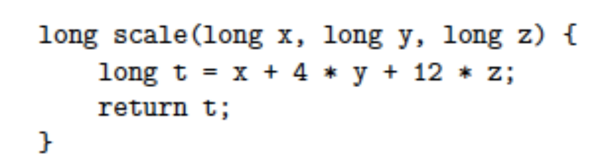
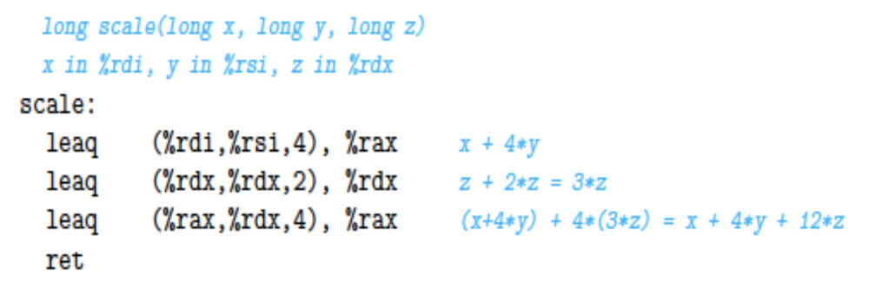
example

Slide 14
Arithmetic Expression Example
arith:
leaq (%rdi,%rsi), %rax
addq %rdx, %rax
leaq (%rsi,%rsi,2), %rdx
salq $4, %rdx
leaq 4(%rdi,%rdx), %rcx
imulq %rcx, %rax
ret
long arith
(long x, long y, long z)
{
long t1 = x+y;
long t2 = z+t1;
long t3 = x+4;
long t4 = y * 48;
long t5 = t3 + t4;
long rval = t2 * t5;
return rval;
}
Interesting Instructions
  leaq: address computation
  salq: shift
  imulq: multiplication
    But, only used once

Slide 15
Understanding Arithmetic Expression Example
arith:
leaq (%rdi,%rsi), %rax # t1
addq %rdx, %rax # t2
leaq (%rsi,%rsi,2), %rdx
salq $4, %rdx # t4
leaq 4(%rdi,%rdx), %rcx # t5
imulq %rcx, %rax # rval
ret
long arith
(long x, long y, long z)
{
long t1 = x+y;
long t2 = z+t1;
long t3 = x+4;
long t4 = y * 48;
long t5 = t3 + t4;
long rval = t2 * t5;
return rval;
}
Register | Use(s)
%rdi | Argument x
%rsi | Argument y
%rdx | Argument z, t4
%rax | t1, t2, rval
%rcx | t5

Slide 16
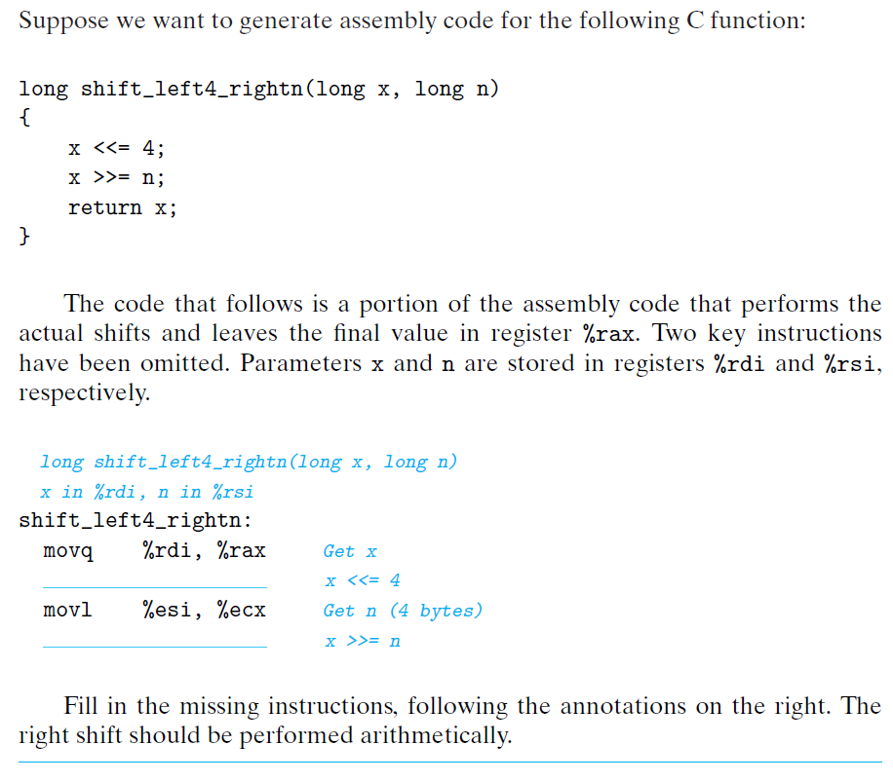
practice

Slide 17
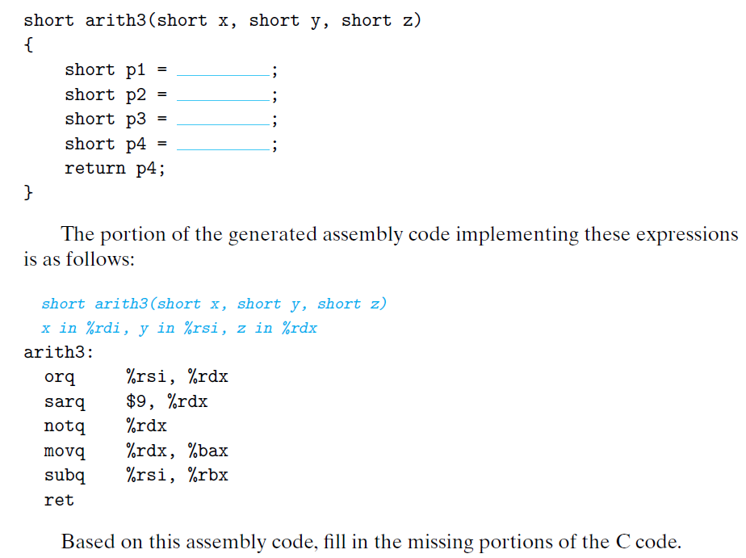
practice

