Slide 1

05: Bits, Bytes, and Integers
Book Chapter: 02
Unsigned and 2’s Complement Representation

Slide 2
Integer Representation
one that can only represent nonnegative numbers: Unsigned Representation
one that can represent negative, zero, and positive numbers: Two’s Complement Representation
Two different ways bits can be used to encode integers

Slide 3
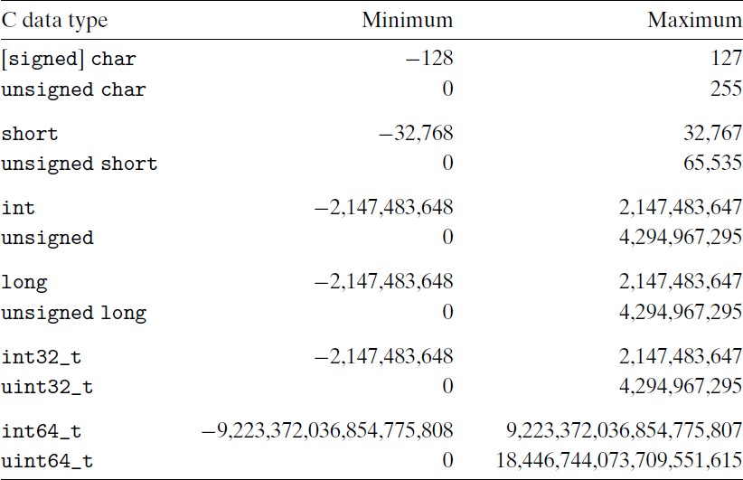
Typical ranges for C integral data types for 32-bit programs.

Slide 4
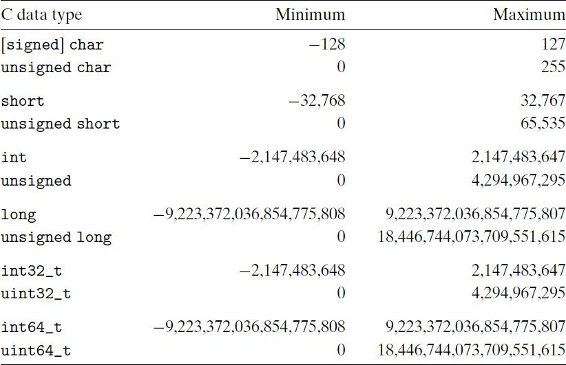
Typical ranges for C integral data types for 64-bit programs.

Slide 5
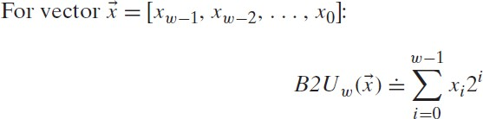
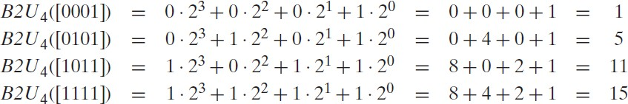
Unsigned (only zero and positive integers) Encoding

Slide 6
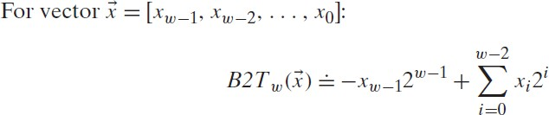
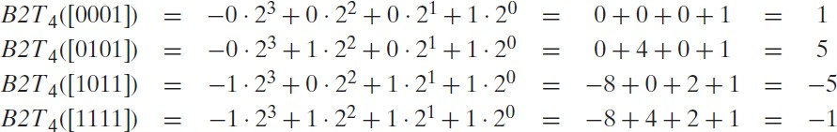
Two’s-Complement (positive, zero, negative integers) Encodings

Slide 7
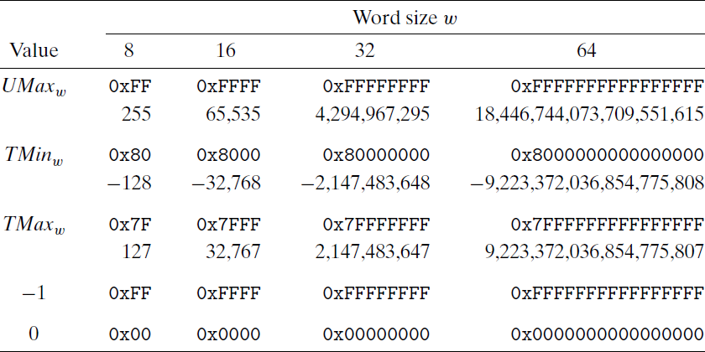
Important numbers. Both numeric values and hexadecimal representations are shown.

Slide 8
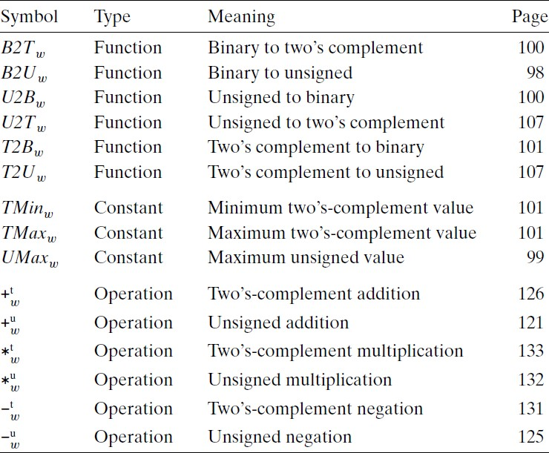
Terminology for integer data and arithmetic operations. The subscript
w denotes the number of bits in the data representation.

Slide 9
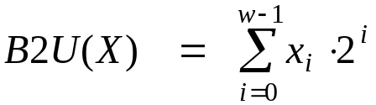
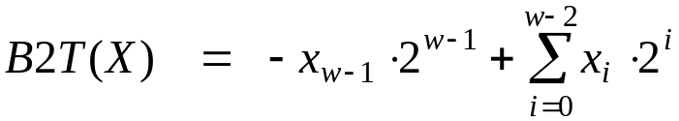
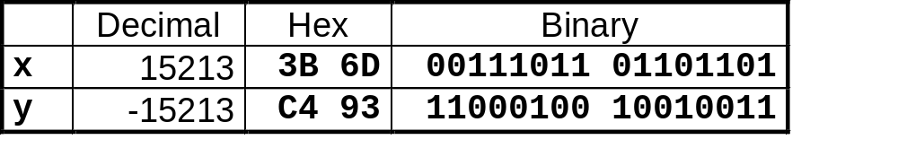
Encoding Integers
Unsigned
Two’s Complement
short int x = 15213;
short int y = -15213;
Sign
Bit
C short 2 bytes long
Sign Bit
  For 2’s complement, most significant bit indicates sign
    0 for nonnegative
    1 for negative

Slide 10
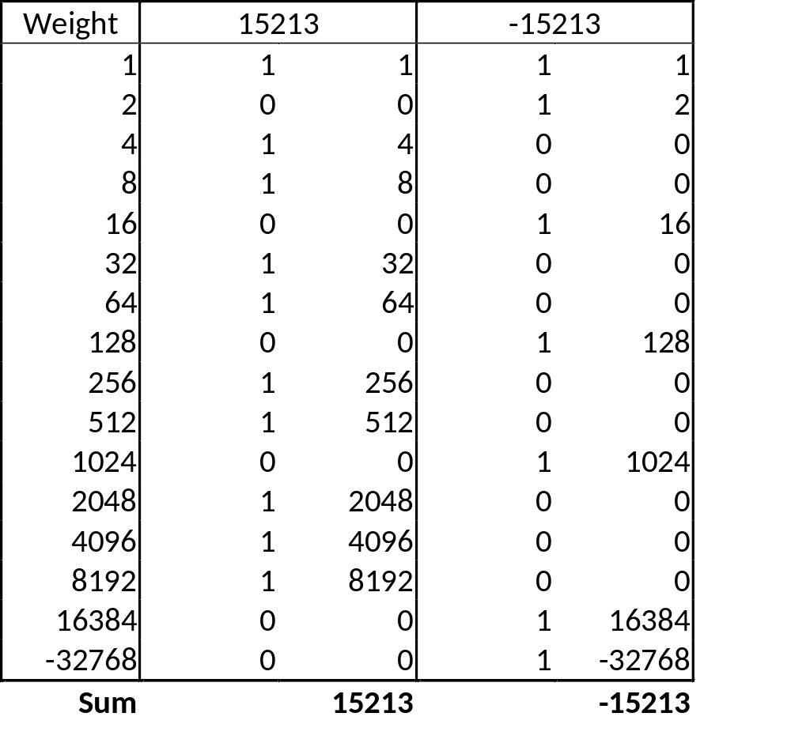
Two-complement Encoding Example (Cont.)
x = 15213: 00111011 01101101
y = -15213: 11000100 10010011

Slide 11
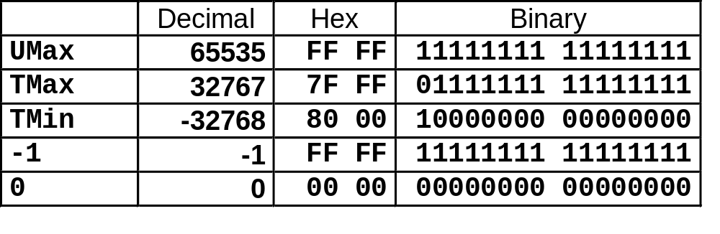
Numeric Ranges
Unsigned Values
  UMin = 0
    000…0
  UMax = 2^{w} – 1
    111…1
Two’s Complement Values
  TMin = –2^{w–1}
    100…0
  TMax = 2^{w–1} – 1
    011…1
Other Values
  Minus 1
    111…1
Values for W = 16

Slide 12
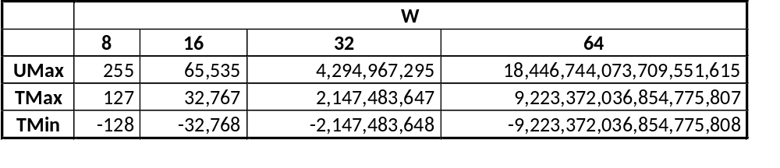
Values for Different Word Sizes
Observations
  |TMin | = TMax + 1
    Asymmetric range
  UMax = 2 * TMax + 1
C Programming
  #include <limits.h>
  Declares constants, e.g.,
    ULONG_MAX
    LONG_MAX
    LONG_MIN
  Values platform specific

Slide 13
Unsigned & Signed Numeric Values
Equivalence
  Same encodings for nonnegative values
Uniqueness
  Every bit pattern represents unique integer value
  Each representable integer has unique bit encoding
⇒ Can Invert Mappings
  U2B(x) = B2U⁻¹(x)
    Bit pattern for unsigned integer
  T2B(x) = B2T⁻¹(x)
    Bit pattern for two’s comp integer
X
B2U(X)
B2T(X)
0000
0
0
0001
1
1
0010
2
2
0011
3
3
0100
4
4
0101
5
5
0110
6
6
0111
7
7
1000
8
–8
1001
9
–7
1010
10
–6
1011
11
–5
1100
12
–4
1101
13
–3
1110
14
–2
1111
15
–1

Slide 14
Mapping Between Signed & Unsigned
Two’s Complement
Unsigned
T2U
x
T2B
B2U
ux
X
Maintain Same Bit Pattern
Unsigned
U2T
Two’s Complement
ux
U2B
B2T
x
X
Maintain Same Bit Pattern
Mappings between unsigned and two’s complement numbers:
Keep bit representations and reinterpret

Slide 15
Mapping Signed ↔ Unsigned
Bits
0000
0001
0010
0011
0100
0101
0110
0111
1000
1001
1010
1011
1100
1101
1110
1111
Signed
0
1
2
3
4
5
6
7
-8
-7
-6
-5
-4
-3
-2
-1
Unsigned
0
1
2
3
4
5
6
7
8
9
10
11
12
13
14
15
T2U
U2T

Slide 16
Mapping Signed ↔ Unsigned
Bits
0000
0001
0010
0011
0100
0101
0110
0111
1000
1001
1010
1011
1100
1101
1110
1111
Signed
0
1
2
3
4
5
6
7
-8
-7
-6
-5
-4
-3
-2
-1
Unsigned
0
1
2
3
4
5
6
7
8
9
10
11
12
13
14
15
=
+/- 16

Slide 17
Relation between Signed & Unsigned
Two’s Complement
Unsigned
T2U
x
T2B
B2U
ux
X
Maintain Same Bit Pattern
w–1
0
ux
+
+
+
• • •
+
+
+
x
-
+
+
• • •
+
+
+
Large negative weight
becomes
Large positive weight

Slide 18
Conversion Visualized
2’s Comp. → Unsigned
  Ordering Inversion
  Negative → Big Positive
UMax – 1
TMax + 1
Unsigned
Range
TMax
TMax
2’s Complement Range
0
0
–1
–2
TMin

Slide 19
Signed vs. Unsigned in C
Constants
  By default are considered to be signed integers
  Unsigned if have “U” as suffix
    0U, 4294967259U
Casting
  Explicit casting between signed & unsigned same as U2T and T2U
    int tx, ty;
    unsigned ux, uy;
    tx = (int) ux;
    uy = (unsigned) ty;
  Implicit casting also occurs via assignments and procedure calls
    tx = ux;
    uy = ty;

Slide 20
Casting Surprises
Expression Evaluation
  If there is a mix of unsigned and signed in single expression,
  signed values implicitly cast to unsigned
  Including comparison operations <, >, ==, <=, >=
  Examples for W = 32: TMIN = -2,147,483,648 , TMAX = 2,147,483,647
Constant₁ Constant₂ Relation Evaluation
  0 0U
  -1 0
  -1 0U
  2147483647 -2147483647-1
  2147483647U -2147483647-1
  -1 -2
  (unsigned)-1 -2
  2147483647 2147483648U
  2147483647 (int) 2147483648U
  0 0U == unsigned
  -1 0 < signed
  -1 0U > unsigned
  2147483647 -2147483648 > signed
  2147483647U -2147483648 < unsigned
  -1 -2 > signed
  (unsigned) -1 -2 > unsigned
  2147483647 2147483648U < unsigned
  2147483647 (int) 2147483648U > signed

Slide 21
Summary
Casting Signed ↔ Unsigned: Basic Rules
Bit pattern is maintained
But reinterpreted
Can have unexpected effects: adding or subtracting 2^{w}
Expression containing signed and unsigned int
  int is cast to unsigned!!

Slide 22

Binary to Decimal
Unsigned = simple binary = B2U
  0101 = 5, 1111 = F, 1110 = E, 1001
= 9
Signed = two’s complement = B2T
  0 101 = positive number; same as B2U = 5
  1 111 = -1*2³ + 7 = -8 + 7 = -1
  1 110 = -1*2³ + 6 = -8 + 6 = -2
  1 001 = -1*2³ + 1 = -8 + 1 = -7
  Reminder: left-most bit is sign bit
CODE | B2U | B2T | HEX
0000 | 0 | 0 | 0
0001 | 1 | 1 | 1
0010 | 2 | 2 | 2
0011 | 3 | 3 | 3
0100 | 4 | 4 | 4
0101 | 5 | 5 | 5
0110 | 6 | 6 | 6
0111 | 7 | 7 | 7
1000 | 8 | -8 | 8
1001 | 9 | -7 | 9
1010 | 10 | -6 | A
1011 | 11 | -5 | B
1100 | 12 | -4 | C
1101 | 13 | -3 | D
1110 | 14 | -2 | E
1111 | 15 | -1 | F
30

Slide 23
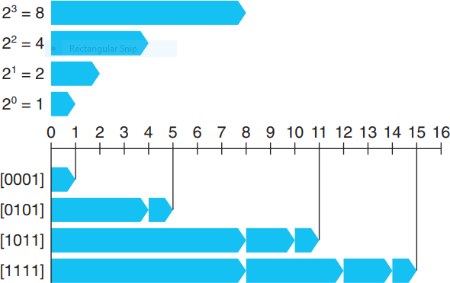
Unsigned

Slide 24
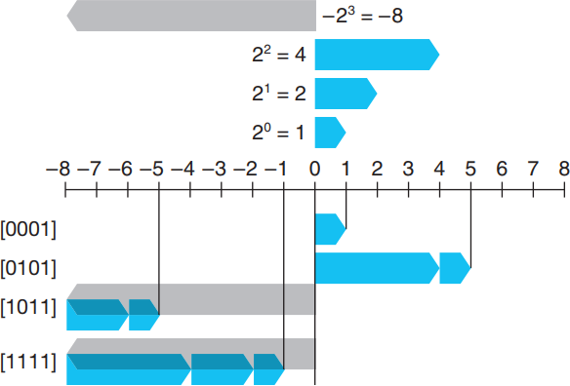
2’s Complement

Slide 25
Note
A few points are worth highlighting about these numbers. First, as observed, the two’s-complement range is asymmetric: |TMin| =|TMax| + 1; that is, there is no positive counterpart to TMin. As we shall see, this leads to some peculiar properties of two’s-complement arithmetic and can be the source of subtle program bugs.
This asymmetry arises because half the bit patterns (those with the sign bit set to 1) represent negative numbers, while half (those with the sign bit set to 0) represent nonnegative numbers. Since 0 is nonnegative, this means that it can represent one less positive number than negative.
Second, the maximum unsigned value is just over twice the maximum two’s-complement value: UMax = 2TMax + 1. All of the bit patterns that denote negative numbers in two’s- complement notation become positive values in an unsigned representation.

Slide 26
Unsigned Representation
Unsigned values are very useful when we want to think of words as just collections of bits with no numeric interpretation.
Addresses are naturally unsigned, so systems programmers find unsigned types to be helpful.
Unsigned values are also useful when implementing mathematical packages for modular arithmetic and for multiprecision arithmetic, in which numbers are represented by arrays of words.

Slide 27
Reading/What to do
Read: Book Chapter 02 (pg 59 to 83)
Take Notes
Explore the related practice problems
Explore the related HW
Explore the related online quiz

