Slide 1
Lecture 02
CS 3843 – Computer Organization

Slide 2

02: Bits, Bytes, and Integers
Book Chapter: 2
Decimal, Binary and Hexadecimal

Slide 3
Representing and Manipulating Information

Slide 4
Everything is bits
Each bit is 0 or 1
By encoding/interpreting sets of bits in various ways
  Computers determine what to do (instructions)
  … and represent and manipulate numbers, sets, strings, etc…
Why bits? Electronic Implementation
  Easy to store with bistable elements
  Reliably transmitted on noisy and inaccurate wires
0
1
0
1.1V
0.9V
0.2V
0.0V

Slide 5
Why Binary?
Decimal or Base-10 or 10-valued
Binary or Base-2 or 2-valued
Binary: easier to store, process and transmit information
Presence or Absence of a signal
Presence or Absence of a hole in a punched card
High or low voltage on a wire
Magnetic domain oriented clockwise or counterclockwise

Slide 6
A single 0 or 1 is called a bit. 1011 is four bits. Eight bits, like 11000101, are called a byte
1 byte = 8 bits
4 bytes = 32 bits
8 bytes = 64 bits

Slide 7
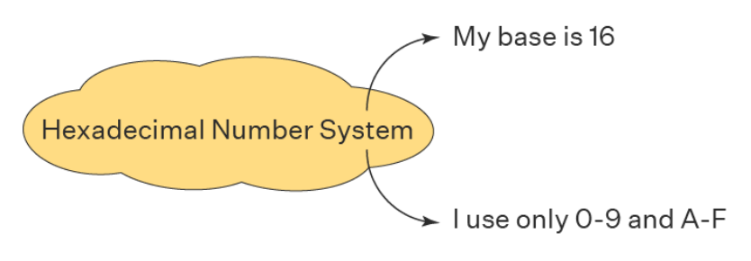
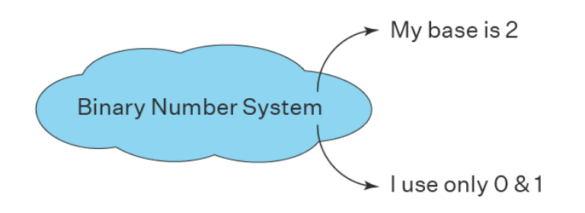
My base is 10
Decimal Number System
I use only 0-9

Slide 8
For example, can count in binary
Base 2 Number Representation
  Represent 15213₁₀ as 11101101101101₂
  Represent 1.20₁₀ as 1.0011001100110011[0011]…₂
  Represent 1.5213 X 10⁴ as 1.1101101101101₂ X 2¹³

Slide 9
Binary, Decimal, Hexadecimal
  Binary (Base-2) 000000002 to 111111112
  Decimal (Base 10): 010 to 25510
  Hexadecimal (Base 16) 0016 to FF16
A single byte consists of 8 bits. In binary notation, its value ranges from 00000000₂ to 11111111₂.When viewed as a decimal integer, its value ranges from 0₁₀ to 255₁₀.
Neither notation is very convenient for describing bit patterns. Binary notation is too verbose, while with decimal notation it is tedious to convert to and from bit patterns. Instead, we write bit patterns as base-16, or hexadecimal numbers. Hexadecimal (or simply “hex”) uses digits ‘0’ through ‘9’ along with characters ‘A’ through ‘F’ to represent 16 possible values

Slide 10
Encoding Byte Values
Decimal
Hex
Binary
Byte = 8 bits
  Binary 000000002 to 111111112
  Decimal: 010 to 25510
  Hexadecimal 0016 to FF16
    Base 16 number representation
    Use characters ‘0’ to ‘9’ and ‘A’ to ‘F’
    Write FA1D37B16 in C language as
      0xFA1D37B
      0xfa1d37b
0
0
0000
1
1
0001
2
2
0010
3
3
0011
4
4
0100
5
5
0101
6
6
0110
7
7
0111
8
8
1000
9
9
1001
A
10
1010
B
11
1011
C
12
1100
D
13
1101
E
14
1110
F
15
1111

Slide 11
Conversion

Slide 12
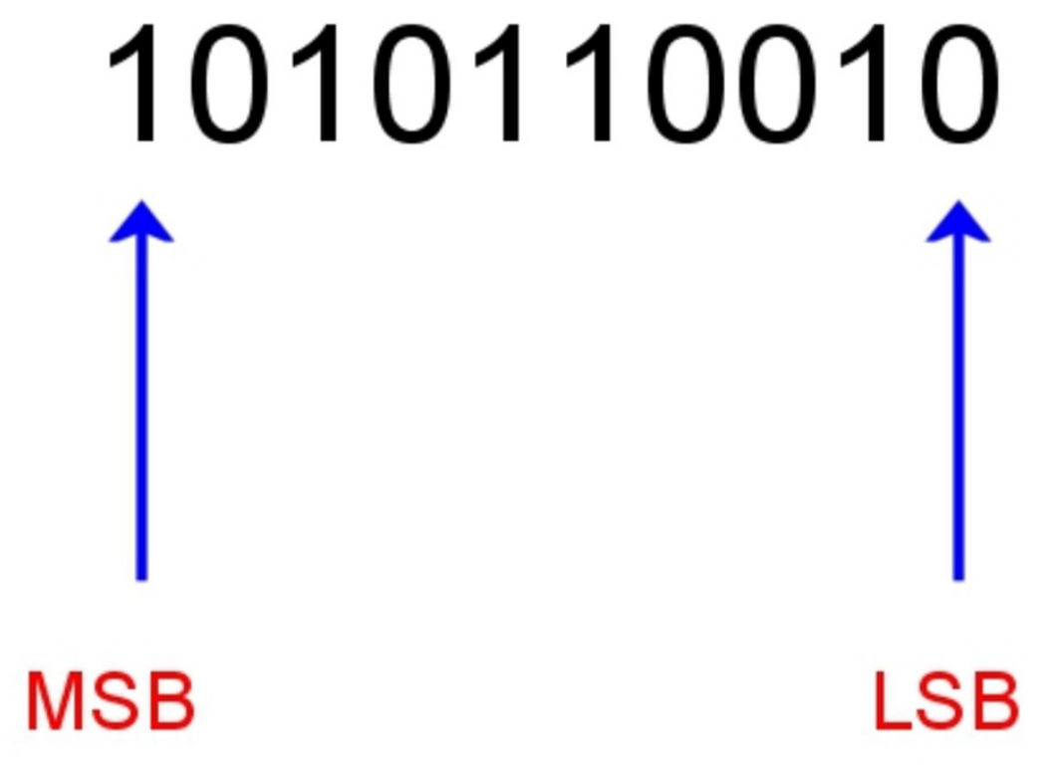
MSB: most significant bit/the leftmost digit
LSB: least significant bit/the rightmost digit

Slide 13

Hex to Binary
For example, suppose you are given the number 0x173A4C. You can convert this to binary format by expanding each hexadecimal digit, as follows:
This gives the binary representation 000101110011101001001100

Slide 14

Binary to Hex

Slide 15
Converting from decimal to another base
To convert from decimal to base b, divide the decimal number by b, and write the remainders (which will be between 0 and b – 1), until the quotient is zero.
Then, write the remainders in order from the last remainder obtained to the first remainder obtained.
Example: convert (221)₁₀ to base 2 (binary) (see the next slide)

Slide 16
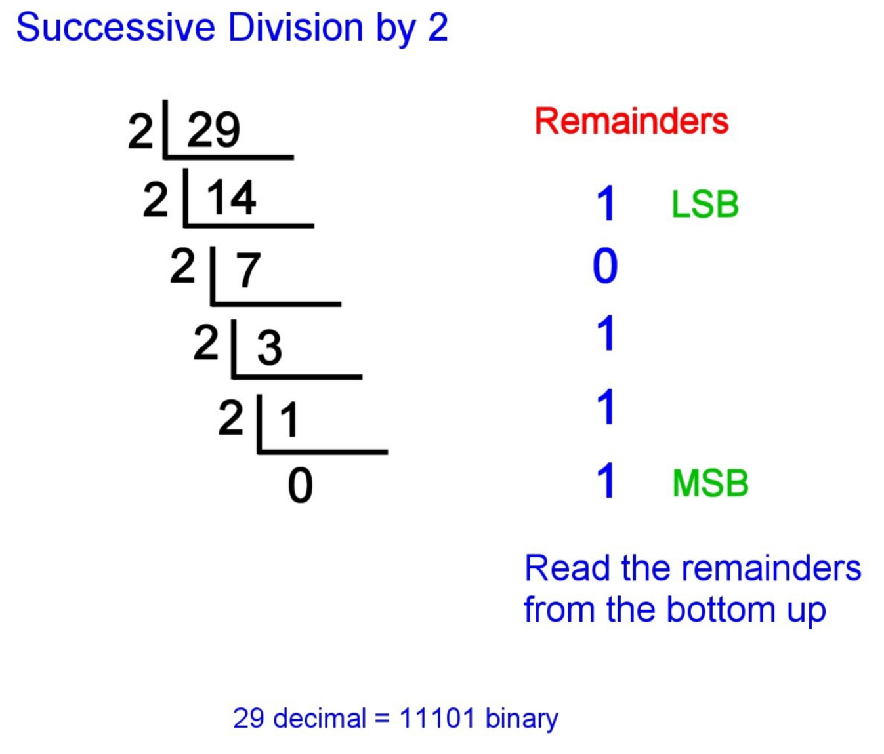
Decimal to Binary

Slide 17
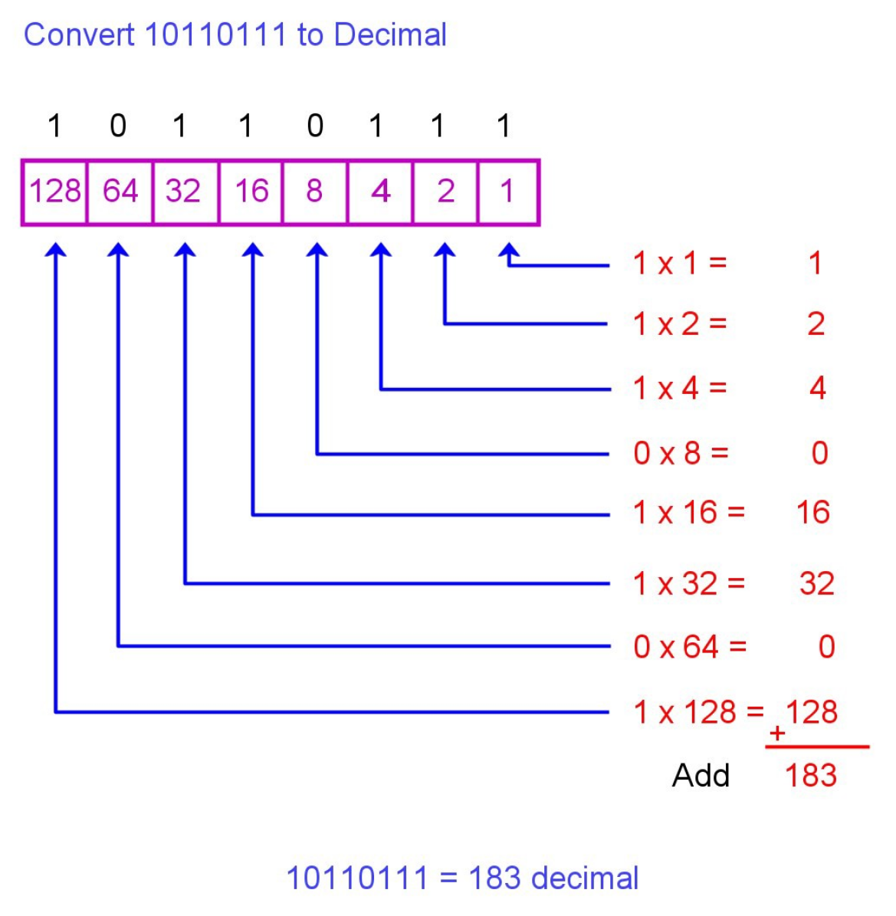
Binary to Decimal

Slide 18
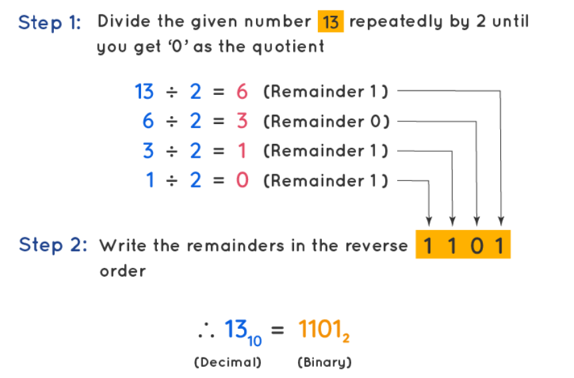
Decimal to Binary

Slide 19
Example: Convert (221)₁₀ to binary
 | Quotient | Remainder
2 | 221 | 1
2 | 110 | 0
2 | 55 | 1
2 | 27 | 1
2 | 13 | 1
2 | 6 | 0
2 | 3 | 1
2 | 1 | 1
 | 0
Now, if we write the remainders in order from the last one obtained, to the first one obtained, we have: (221)₁₀ = (11011101)₂
Thus, this expresses the binary representation of the original decimal number.

Slide 20
Binary to Hex correspondence
Binary | Hex | Binary | Hex
0000 | 0 | 1000 | 8
0001 | 1 | 1001 | 9
0010 | 2 | 1010 | A
0011 | 3 | 1011 | B
0100 | 4 | 1100 | C
0101 | 5 | 1101 | D
0110 | 6 | 1110 | E
0111 | 7 | 1111 | F
4 binary digits can be converted to a single hex digit, as shown below.

Slide 21
Example: Convert (743)₁₀ to hexadecimal
Note: Since remainders can have values from 0 to b - 1, that is, 0 to 15, we use F for 15, E for 14, D for 13, C for 12, B for 11, and A for 10
 | Quotient | Remainder
16 | 743 | 7
16 | 46 | E
16 | 2 | 2
 | 0
Therefore, if we write the remainders in order from the last one obtained to the first one obtained, we have:
(743)₁₀ = (2E7)₁₆

Slide 22
To convert from base b to decimal
We can do the conversion by multiplying the value of each digit, d_{m,} by d^{m}, for m from 0 (least significant digit) to n-1 (most significant digit) for an n digit number, and by summing all the products obtained in this way.

Slide 23
Example of conversion from base b to decimal
Problem: Convert (5377)₈ to decimal.
Solution:
(5377)₈ = 5 * 8³ + 3 * 8² + 7 * 8¹ + 7 * 8⁰
= 5 * 512 + 3 * 64 + 7 * 8 + 7 * 1
= 2560 + 192 + 56 + 7
= 2815

Slide 24
Reading/What to Do
Read: Book Chapter 02 (pg 31 to 57)
Take Notes
Explore the related practice problems
Explore the related HW
Explore the related online quiz

